Slide 1

1995 Settlement Agreement
Susan Burke
INL Coordinator
Idaho Department Of Environmental Quality
January 17, 2017

Slide 2
1995 Settlement Agreement
Between State of Idaho, DOE and Navy
Settled lawsuit
Only state with a court order requiring nuclear waste to be removed by specified dates
Covers spent nuclear fuel, high-level waste and transuranic waste

Slide 3
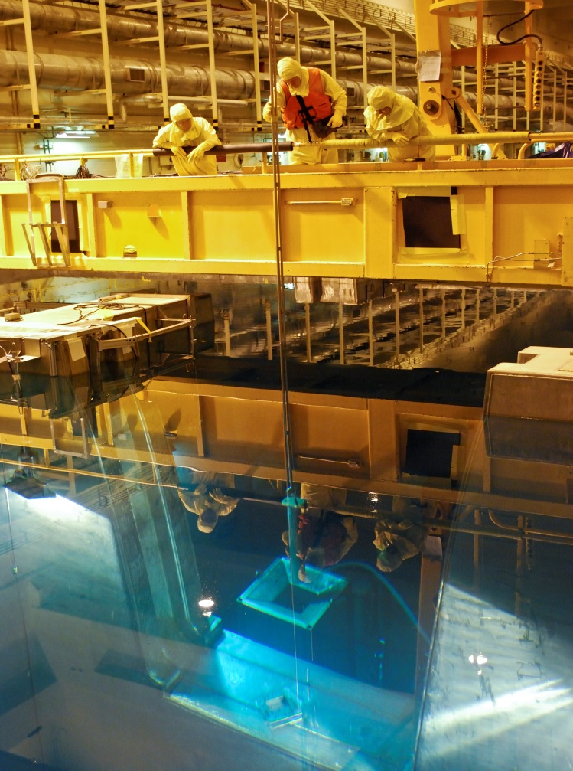
Spent Nuclear Fuel

Slide 4
Spent Nuclear Fuel
Removed 116 MTHM of fuel from 5 of 6 basins and canals and closed them.
Provided annual accounting of actual and estimated fuel shipments to INL

Slide 5
Spent Nuclear Fuel
Transfer spent nuclear fuel from wet to dry storage by December 31, 2023
Remove all spent fuel, including naval spent fuel and Three Mile Island spent fuel from Idaho by January 1, 2035

Slide 6
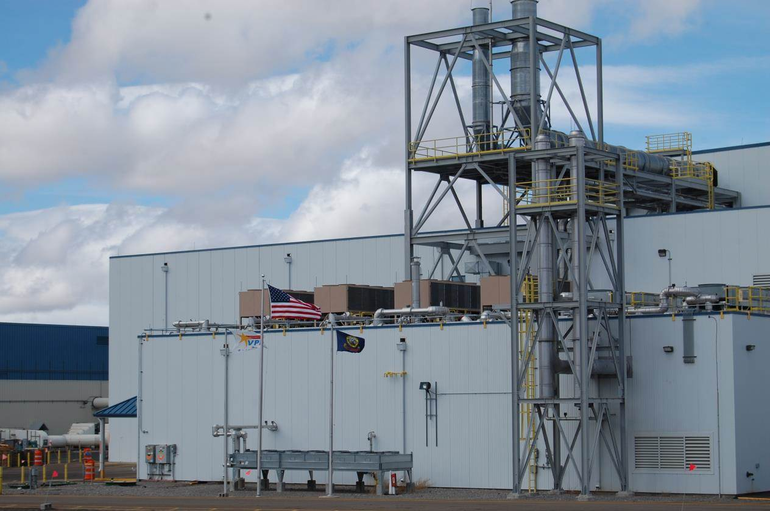
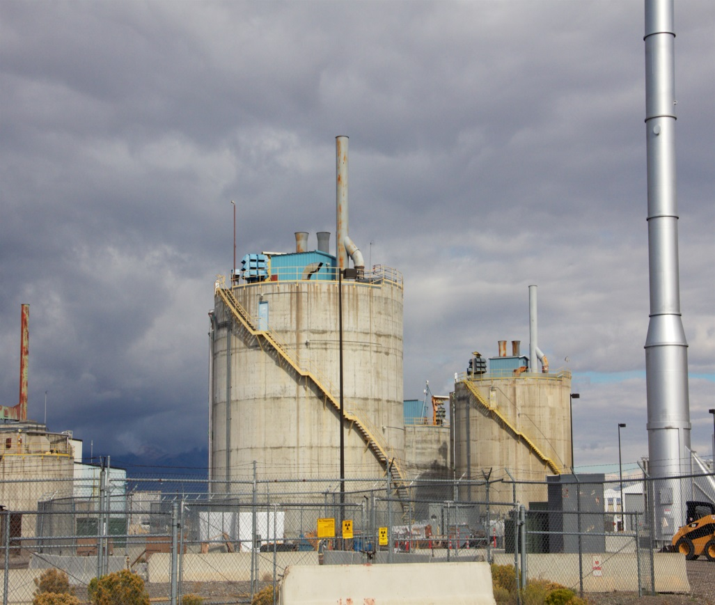
High Level Waste

Slide 7
High Level Waste
Treated 330,000 gallons of high level waste (1997)
Treated non-sodium bearing liquid waste (1998)
Provided documents regarding calcine treatment:
  Record of Decision (2009)
  RCRA permit application (2012)

Slide 8
High Level Waste
Complete treatment of sodium bearing liquid waste
By December 31, 2035 treat all high level waste so that it is ready for disposal outside of Idaho

Slide 9
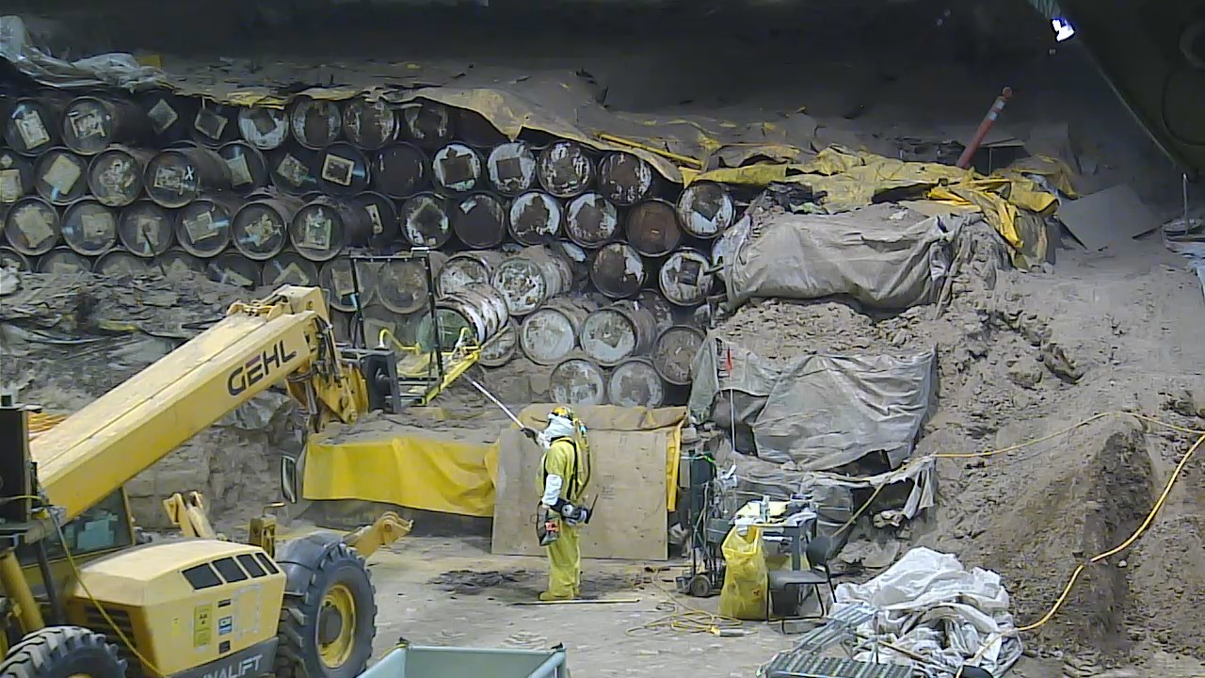
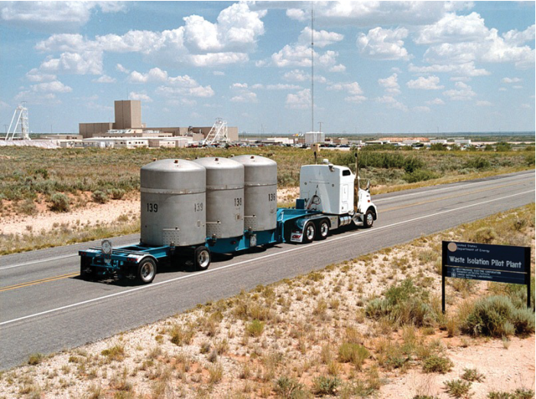
Transuranic Waste

Slide 10
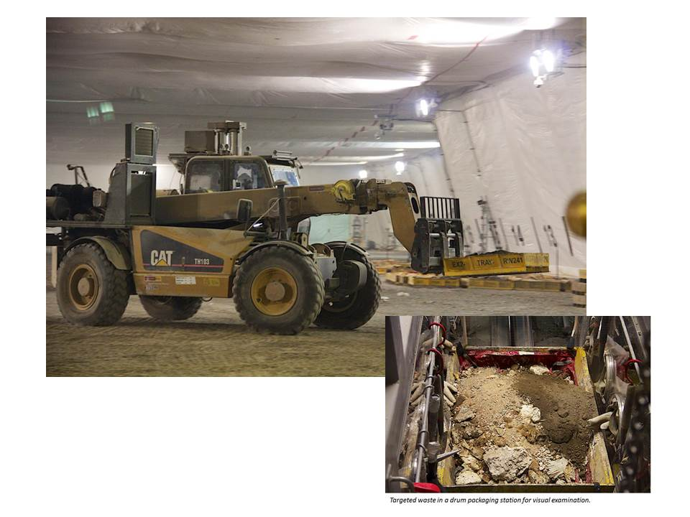
Transuranic Waste

Slide 11
Transuranic Waste
Began shipment to WIPP on April 27, 1999
Shipped 3,100 cubic meters by October 21, 2002
Constructed and operated a mixed waste treatment facility (AMWTP) (2003)
Sent the first 3-year running average of 2,000 cubic meters out of Idaho by February 21, 2006
Shipped 40,836 cubic meters out of Idaho

Slide 12
Transuranic Waste
Ship a 3-year running average of 2,000 cubic meters out of Idaho
Ship all transuranic waste located at the INL in 1995 to WIPP by December 31, 2018

