Slide 1
1995 Settlement Agreement
“The rest of the story”
Darrell G. Early
Deputy Attorney General
Office of the Idaho Attorney General

Slide 2
Subsequent Events
Buried Waste Litigation
Agreement to Implement
Navy Addendum
Commercial Fuel MOA

Slide 3
“All means all!”
Section B.1:
“DOE shall ship all transuranic waste now located at the INEL, currently estimated at 65,000 cubic meters in volume, to the Waste Isolation Pilot Plant (WIPP) or such other facility designated by DOE, by a target date of December 31, 2013, and in no event later than December 31, 2018.”

Slide 4
“All means all!”
Post 1995 – Actions by DOE indicated intent to leave buried TRU waste in place.
2001-2002 – Pit 9 Dispute Resolution – brought issue to a head.
  “As the State knows, the 95 SA commitment to ship 65,000 cubic meters of transuranic waste out of state by 2018 referred to only the post-1970 retrievably stored waste and not to any of the pre-1970 buried waste.”
Motion to Re-open litigation for Declaratory Relief – 4/18/2002.

Slide 5
“All means all!” cont.
Summary Judgment for Idaho 3/31/2003
Appeal to the Ninth Circuit – Reversed – 12/3/2004
  “We remand the case for the district court to consider the parties’ extrinsic evidence, including the source of the 65,000 cubic meter estimate in interpreting the contract so as to give effect to the second clause as well as the first.”
Five Day Court Trial 2/6-10/2006
Decision by Judge Lodge – 5/25/2006.
Appeal to the Ninth Circuit – Affirmed 3/18/2008

Slide 6
U.S. District Court Judge Edward Lodge Ruling in May 2006:
Transuranic Waste Definition does not include alpha low level waste and DOE not obligated to remove.
DOE must remove all "transuranic waste" buried in the Subsurface Disposal Area.
But: How and when that was to be done is governed by CERCLA and the FFA/CO.

Slide 7
“The court’s interpretation of the parties obligations under the 1995 Agreement assures that the concerns of both parties will be met. The United States as been and will be able to store spent nuclear fuel at the INEL and the ultimate removal of buried waste from INEL will continue to progress on the timetable established in the FFA/CO and in accordance with the requirements of CERCLA. The State of Idaho is assured that the waste will be removed and such waste will no longer endanger the Snake River aquifer. The waste located in the TSA will be removed upon the time schedule outlined in the 1995 Agreement and buried waste shall be removed, once it is determined if and how it can be safely be moved, as directed by the FFA/CO and CERCLA.”

Slide 8
Agreement to Implement
What does “all” really mean?

Slide 9
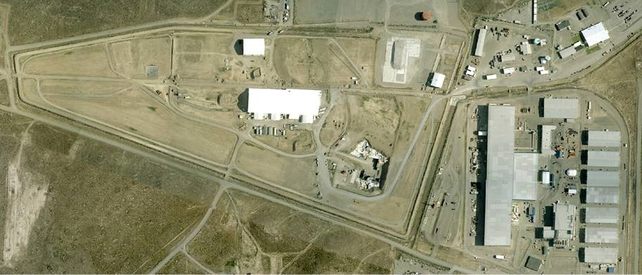
Subsurface Disposal Area
35 acres of waste disposal in 97-acre area
15 acres of pits and trenches containing shipments from Rocky Flats (Rocky Flats barrels were retrieved in 1970s from 2 of the pits)

Slide 10
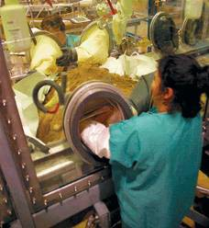
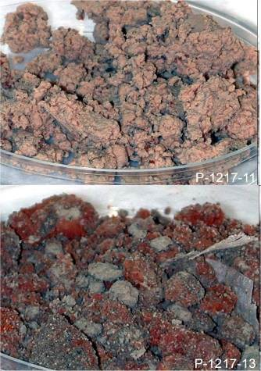
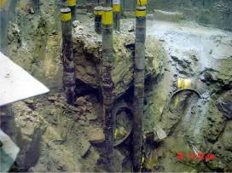
Retrieval Challenges
Pit 9 retrieval in 2004 showed problems with wholesale retrieval; only 13% of waste contained enough Transuranics to qualify for WIPP disposal
Most transuranic curies are concentrated in a few waste types.

Slide 11
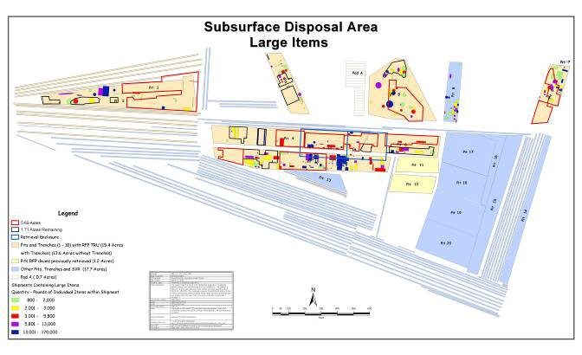
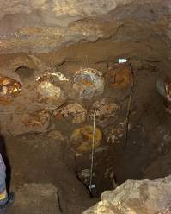
Retrieval Challenges
Degraded containers
Objects that are difficult to move
High gamma radiation or biological hazards
Classified materials
Waste that can spontaneously ignite when exposed to air
Containers already seriously degraded in Pit 1 during 1969 retrieval

Slide 12
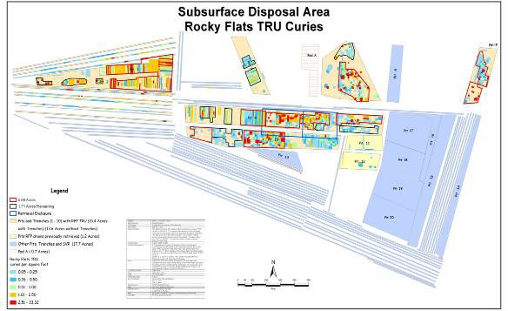
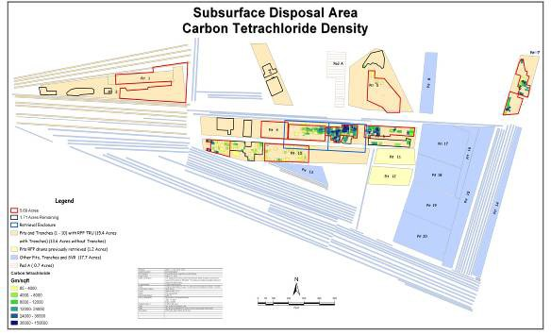
Targeted wastes concentrated in certain areas
Mobile hazardous solvents co-located in one of the Targeted Waste forms

Slide 13
--Technical Considerations
--Legal Considerations
--Policy Considerations

Slide 14
Structure of 2008 Agreement
Requires retrieval of 5 Waste Types most likely to contain transuranics + uranium waste form.
Requires retrieval of at least 5.7 acres and up to
7.4 acres likely to contain most transuranics, hazardous solvents & uranium.
Requires shipment of at least 7,485 cubic meters of Targeted Waste out of Idaho.
Coordinates w/ Superfund cleanup to ensure protection of Aquifer where contamination is left in place.

Slide 15
Structure of 2008 Agreement (continued)
Establishes checks & balances to review assumptions and ensure performance.
Requires review of assumptions & revisiting them if they do not prove out.
Allows vigorous oversight by State & U.S. EPA.
Continues Judge Lodge’s jurisdiction over disputes the parties cannot resolve.

Slide 16
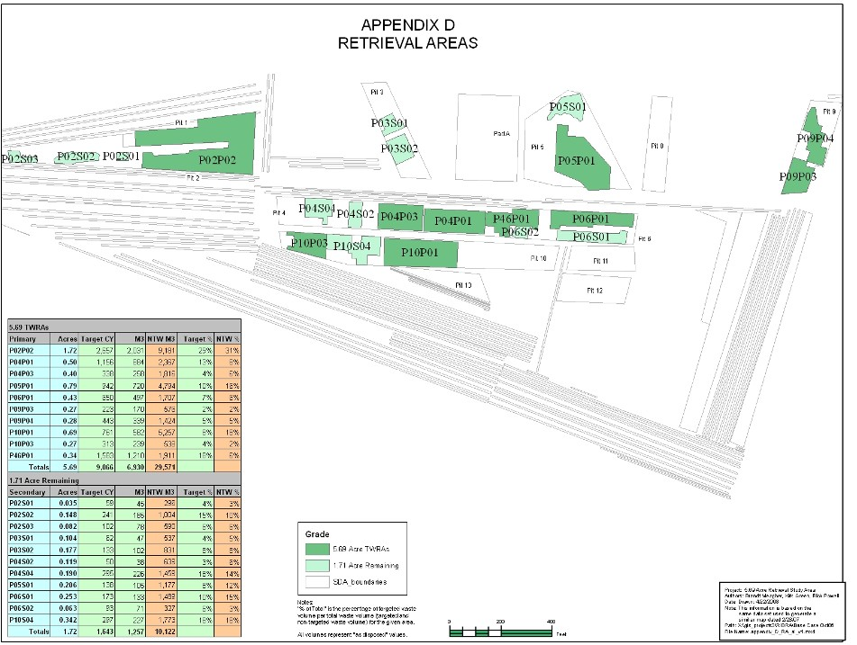
INSERT APPENDIX MAP IDENTIFYING RETRIEVAL AREAS

Slide 17
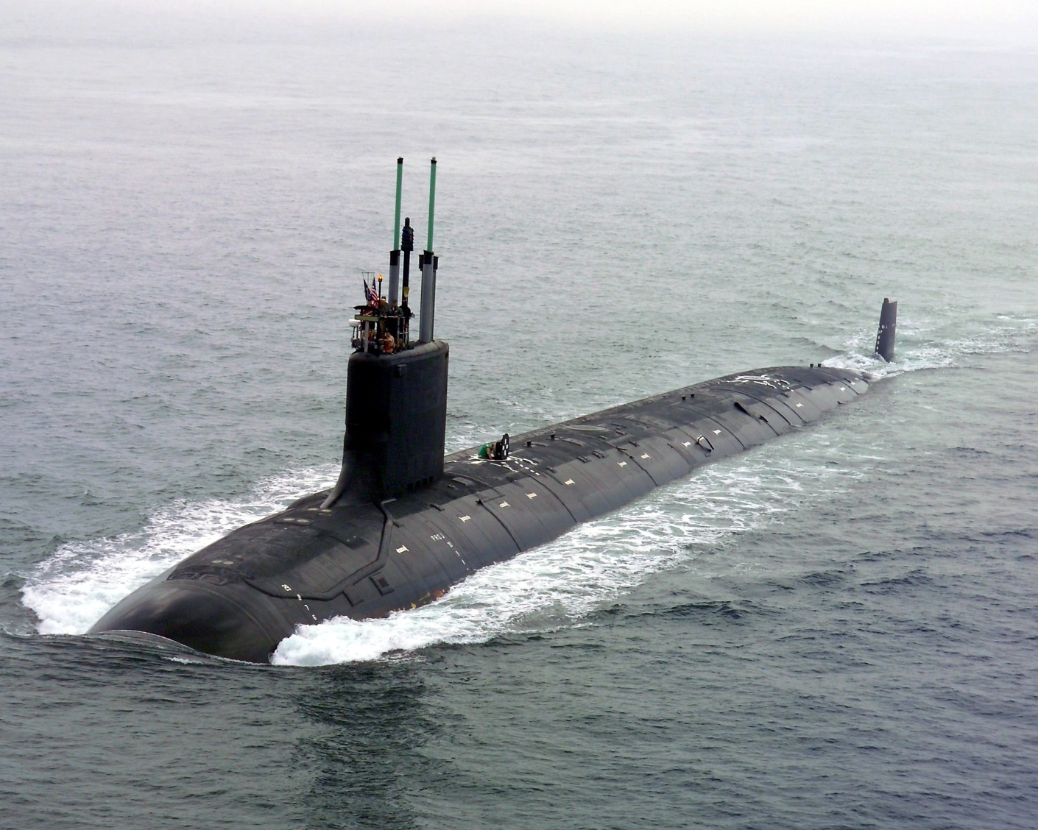
NAVY ADDENDUM

Slide 18
WHY?
Late 2004 - Navy Approached the State with concern about uncertainty regarding the future of the NRF in the post 2035 Era.
2023 deadline for wet/dry inconsistent with need for cooling of Navy SNF. Meant possibly closing active receipt at the NRF even earlier.
Wanted to invest in new infrastructure but uncertain if welcome in Idaho.
Resolve uncertainty by agreeing to terms concerning future receipt and management of Navy SNF at the INL.

Slide 19
WHAT IT DOES
Allows the Navy to continue operation of the NRF in Idaho including keeping some SNF in Idaho after 2035.
Requires all the Navy SNF arriving before 2026 to leave Idaho by 2035. After 2026 it can stay only for as long as “reasonably necessary.”
Caps the amount of Navy SNF that can be in Idaho at any one time post 2035 at nine (9) MTHM
Caps the number of shipments allowed to the INL at twenty (20) per year on a running average.
Allows Navy to cool SNF in water pools for six (6) years.
Allows Navy to store a small amount of SNF (750 kg.) for archival study.

Slide 20
What it does…
Makes the remedies of the original 1995 Agreement applicable to new provisions if Navy does not meet the Navy Addendum.
  Stop Shipments of SNF
  Penalties of $60,000 per day.

Slide 21
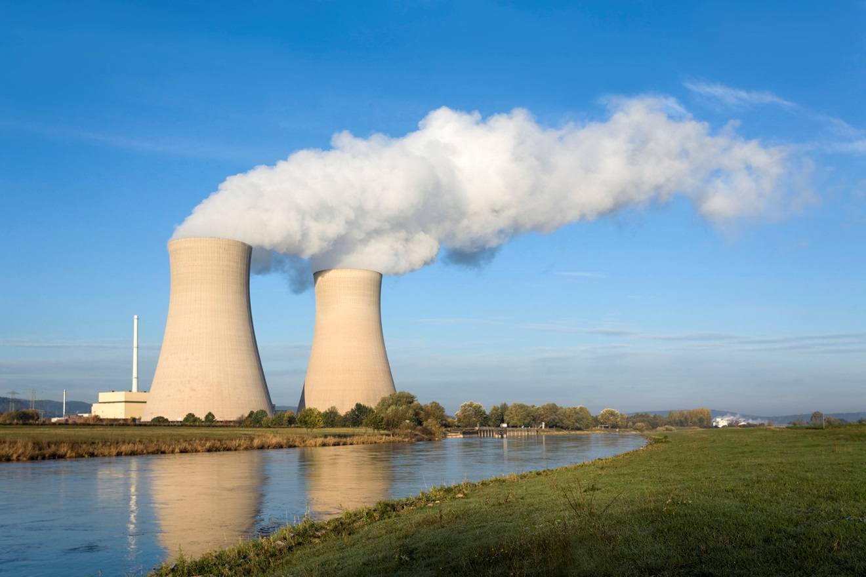
COMMERCIAL FUEL MOA

Slide 22
WHY
Section D.2.e: “Except as set forth in Section D.2.d above, DOE will make no shipments of spent fuel from commercial nuclear power plants to INEL.”
Section J.1: *** “Idaho shall have the ability, in its sole discretion, to waive performance by the federal parties of any terms, conditions and obligations contained in this Agreement.”

Slide 23
North Anna Fuel Shipment
2004 – DOE approached the State to ask for a waiver to allow shipment of fuel from the North Anna Powerplant to INL for research.
Idaho agreed with specific conditions:
  Limited quantity (4 fuel rods & 2 control rods)
  Counted against the annual shipment limit and material remaining counted against total limit.
  All materials except for destructive examination wastes would leave by the end of 2006.

Slide 24
More Commercial Fuel Research
Subsequent to 2004, DOE/INL approached Idaho several more times with requests to allow for commercial fuel to come to Idaho.
At the time of these requests DOE/INL did not appear to have contracts or firm commitments to conduct the research but wanted a commitment that they would be allowed if the contracts could be firmed.
Idaho was reluctant to grant open waiver until more details available.
DOE/INL didn’t follow up with firm requests

Slide 25
2011 MOA
DOE/INL engaged Idaho and explained that lack of certainty concerning Commercial SNF research was impairing the lab’s ability to compete for research.
Idaho agreed to an MOA to allow “research quantities” of Commercial SNF to INL upon certain conditions.

Slide 26
TERMS
Is a “conditional waiver” not a contract amendment.
Terminable “at will” by Idaho.
Allows only “research quantities” = only what is necessary for the specific research project.
Not more that 400 kg. in any calendar year
Shipments count against the annual cap of shipments – regardless of size.
Volume MTHM remaining onsite counts against the total cap.
Allows for a “library” of not more than 10 kg.
Notification/documentation and reports.

