Slide 1
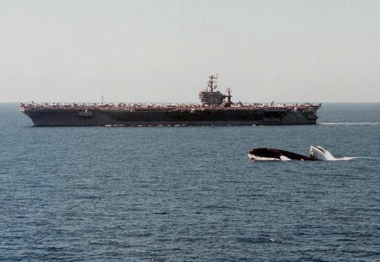
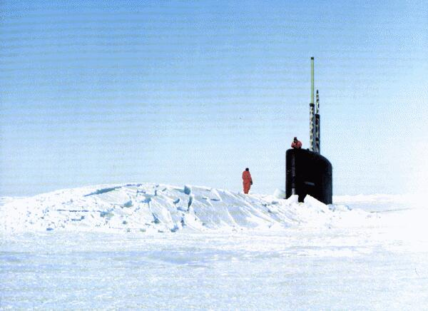
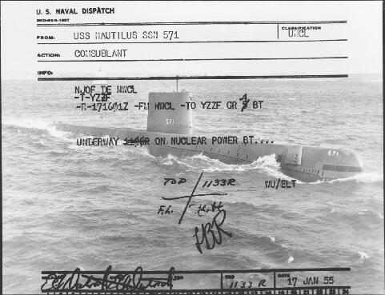
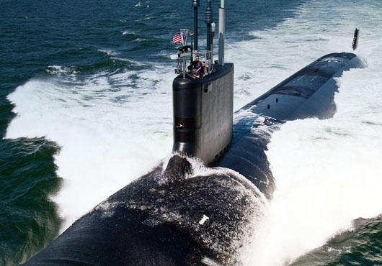
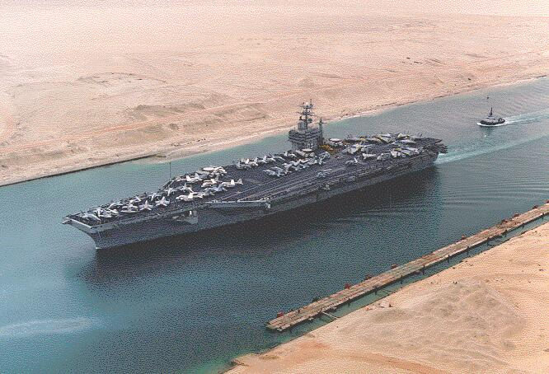
United States Naval Nuclear Propulsion Program
Presentation to Idaho LINE Commission
January 2017
Rail track facing southwest

Slide 2
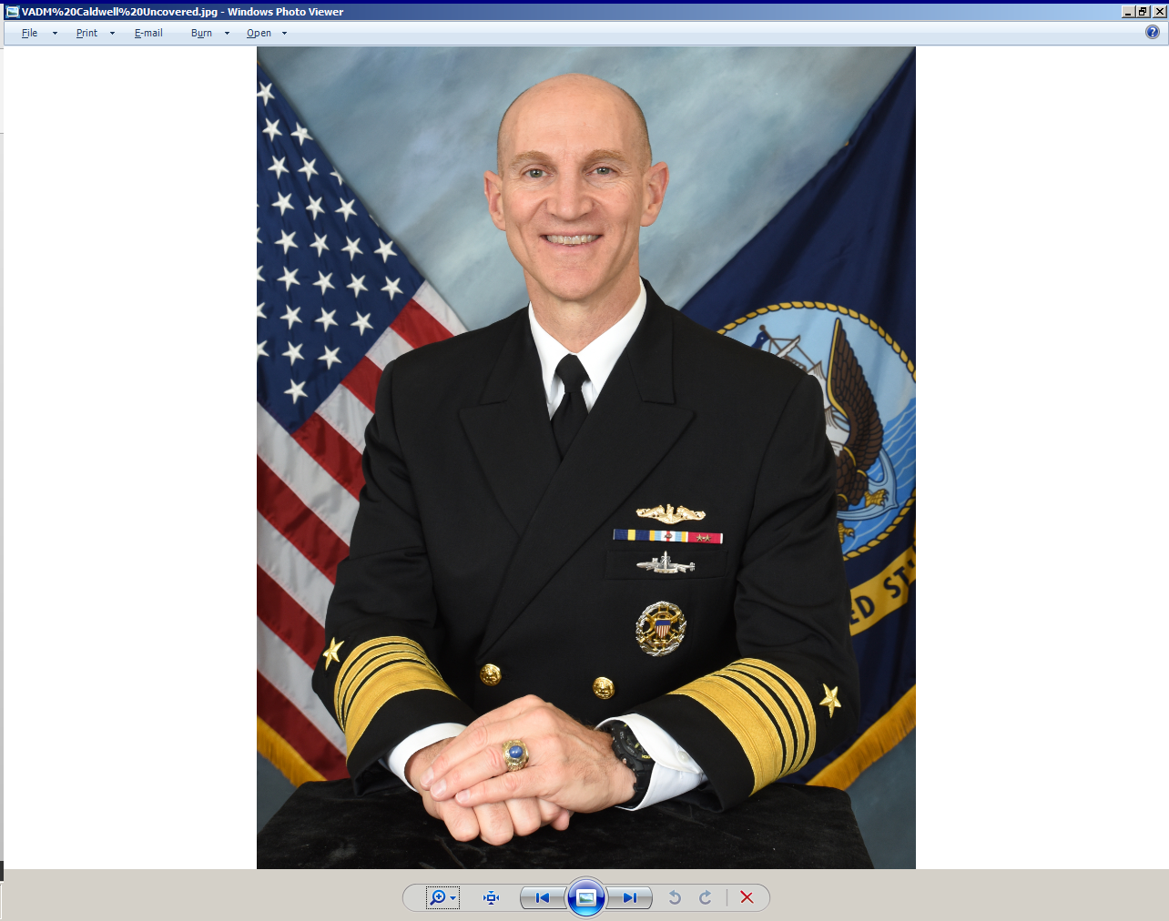
Integrated Navy and DOE Program
FOCUSED MISSION
  Provide militarily effective nuclear propulsion plants and ensure
  their safe, reliable, and long-lived operation
CRADLE TO GRAVE RESPONSIBILITY AND
ACCOUNTABILITY FOR ALL ASPECTS
  Research, development, design, construction
  Maintenance, repair, overhaul, disposal
  Radiological controls, environment, safety, health matters
  Officer operator selection, operator training
  Administration (security, nuclear safeguards, transportation,
  public information, procurement and fiscal management)
PROGRAM RECORD
  Program founded in 1948
  Over 6,800 reactor-years of safe operations
  Over 160,000,000 miles safely steamed
  101 operating reactors (compared to 99 commercial power reactors)
  Welcomed in more than 150 ports in over 50 countries worldwide
Admiral James F. Caldwell, Jr.
EXECUTIVE ORDER 12344 SET FORTH IN PUBLIC LAW 98-525 AND 106-65

Slide 3
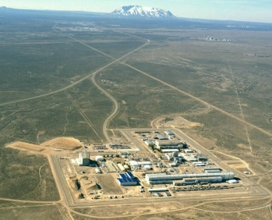
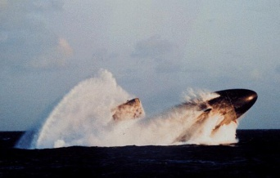
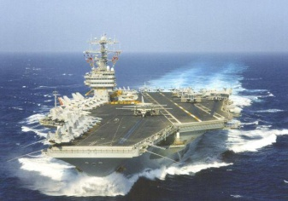
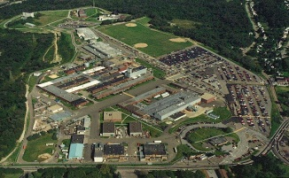
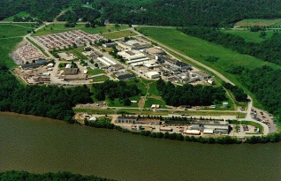
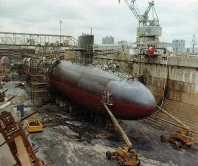

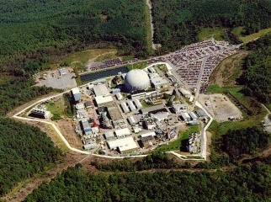
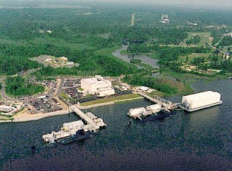
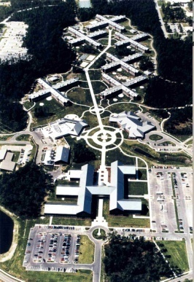
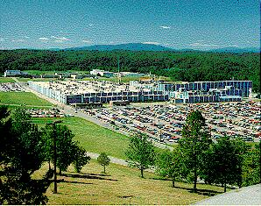
Naval Nuclear Propulsion Program
Field Offices
REPORT TO DIRECTOR
- Ensures focus on mission
- Immediate identification of concerns
NAVAL REACTORS FACILITY
Dry Storage Program - Expended Core Facility
NUCLEAR POWERED FLEET - 80 warships - About 45% of major combatants
Naval Reactors
DEDICATED LABORATORIES
Bettis Laboratory Site
Knolls Laboratory Site
Government Owned /
Contractor Operated
SHIPYARDS 4 Public / 2 Private
R&D/TRAINING REACTORS - Train 3500 students/year
SPECIALIZED INDUSTRIAL BASE
- Single dedicated prime contractor - Hundreds of suppliers
SCHOOLS - Nuclear Power School - Nuclear Field “A” School

Slide 4
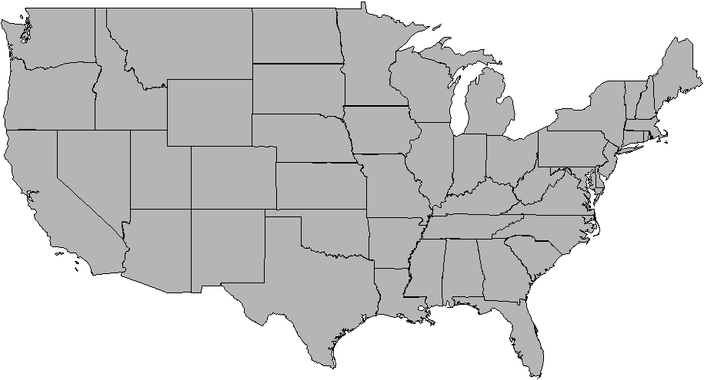
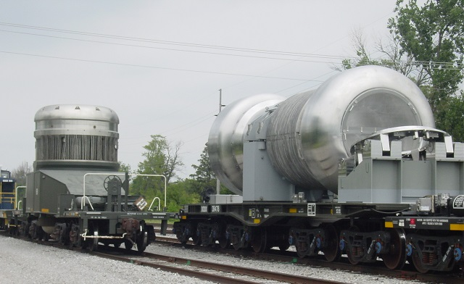
Naval Spent Fuel Shipping
850 CONTAINERS SAFELY SHIPPED
(March 1957 to Present)
WA
MT
ND
MN
VT
NH
ME
ID
SD
WI
OR
WY
NY
MI
MA
NE
IA
IL
PA
CT
IN
OH
RI
NV
UT
CO
WV
NJ
KS
MO
VA
DE
CA
KY
MD
OK
TN
NC
AZ
NM
AR
After defueling, all naval spent
fuel transported by rail to NRF for
examination:
  Ensures maximum performance of current fuel
  Enables design of new fuel with longer lifetimes
SC
MS
AL
GA
TX
LA
Originating Shipyard
FL
Destination (NRF)

Slide 5
State of Idaho Agreement and Consent Order
The 1995 Agreement and Consent Order governs management of all spent nuclear fuel and transuranic waste at the Idaho National Laboratory
BACKGROUND
The agreement resolved litigation related to concern of Idaho officials that the INL was becoming a de facto permanent repository for spent fuel and transuranic waste.
Litigation also led to preparation of a Programmatic EIS for management of spent nuclear fuel across the DOE.
ONGOING NAVY OBLIGATIONS
Limit the number of shipments of naval spent nuclear fuel to Idaho to a running average of 20 containers per year.
Provide to Idaho annual reports on actual shipments made in the prior calendar year and expected shipments during the next calendar year.
Include naval spent nuclear fuel among the early shipments to a permanent geologic repository or interim storage site.
2008 ADDENDUM TO AGREEMENT
Continued use of water pool at the Naval Reactors Facility beyond 2023.
Continued management of a limited in-process inventory of naval spent nuclear fuel at the Naval Reactors Facility in Idaho beyond 2035.
Continued archival storage of some naval spent nuclear fuel to support designs under development or in service.
NAVAL REACTORS IS COMPLIANT WITH THE AGREEMENT AND ADDENDUM

Slide 6
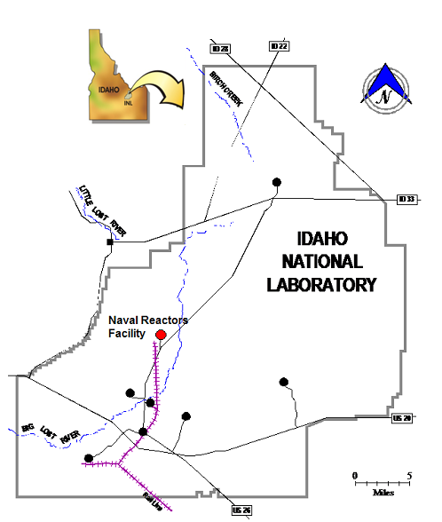
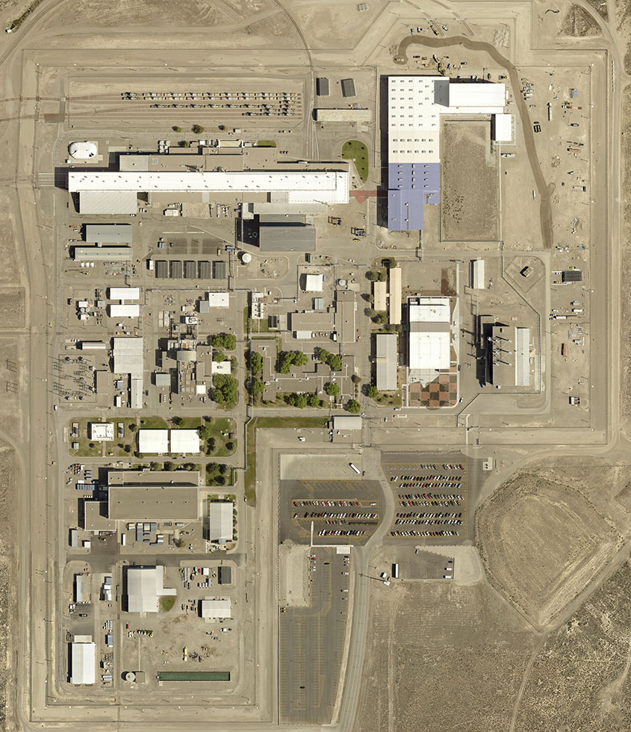
Naval Reactors Facility
Cask Shipping and Receiving Facility
Expended Core Facility
Overpack Storage
A1W Prototype
S1W Prototype
S5G Prototype
Spent Fuel Packaging Facility
SERVING A VITAL ROLE SUPPORTING THE NATION’S NUCLEAR POWERED FLEET FOR OVER 60 YEARS

Slide 7
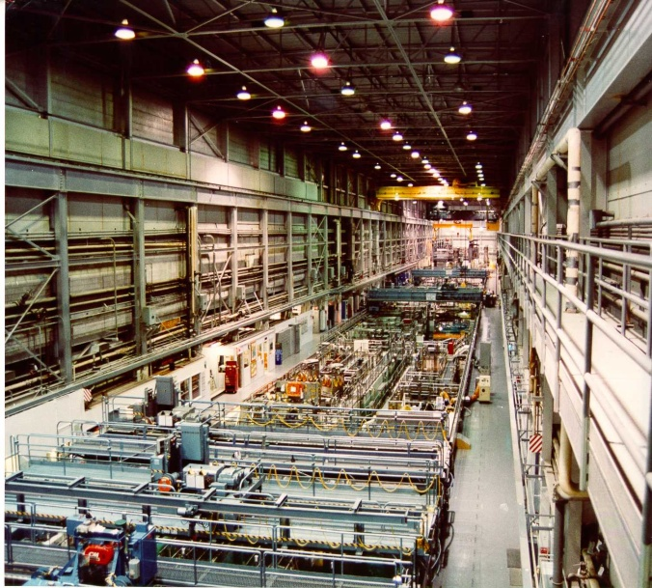
Expended Core Facility
Providing unique capabilities to the Naval Nuclear Propulsion Program
CAPABILITIES AND ACCOMPLISHMENTS:
Began operations in 1958
Large water pool
  Visual examination, processing, and storage of spent fuel
  Assembly/disassembly to support irradiation testing of new materials
Shielded hot cells for detailed examination of spent fuel and test specimens
Specialized facilities for placing spent fuel in sealed canisters for dry storage/disposal

Slide 8
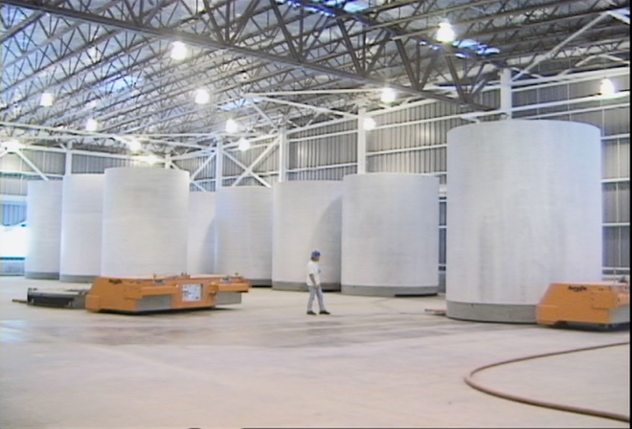
Dry Storage Packaging Operations
Placing Naval Nuclear Fuel into Dry Storage Canisters since 2003
Dry Storage Packaging is on track to meet the 2023 provision of the Idaho Settlement Agreement and Consent Order.
Over 130 spent fuel canisters have been loaded since 2003.
Spent fuel canisters are ready to be shipped to a permanent repository.
OVER 70% OF NAVAL SPENT FUEL INVENTORY SUBJECT TO 2023 PROVISION HAS ALREADY BEEN PLACED IN DRY STORAGE

Slide 9
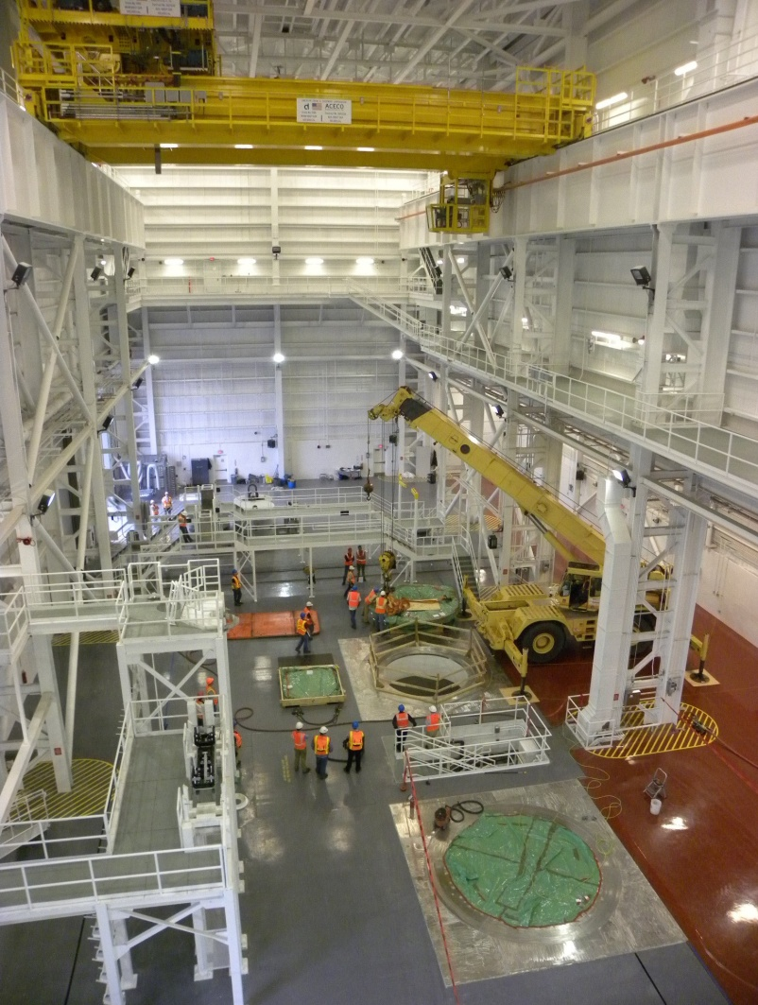
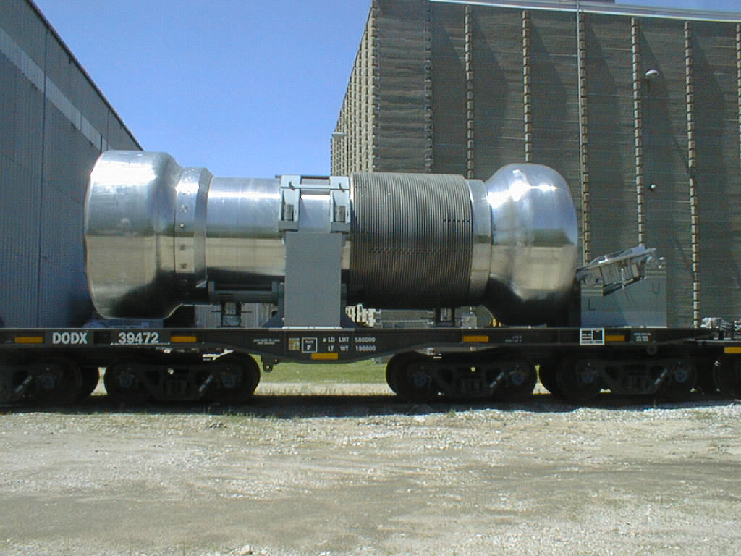
Cask Shipping and Receiving Facility
Cask Shipping and Receiving Facility was constructed for:
Unloading aircraft carrier fuel from M-290 shipping containers.
Loading spent fuel into shipping containers for rail transport to a permanent repository or interim storage facility.
NAVAL SPENT FUEL CANISTERS ARE ROAD-READY FOR SHIPMENT

Slide 10
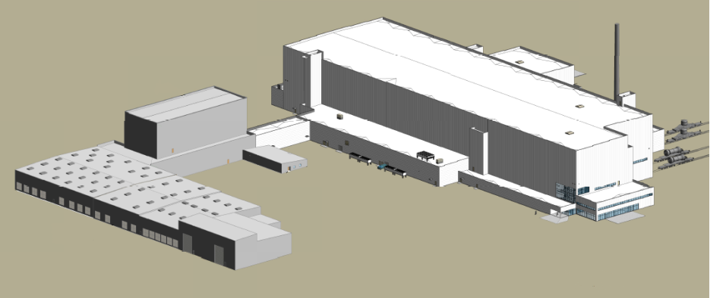
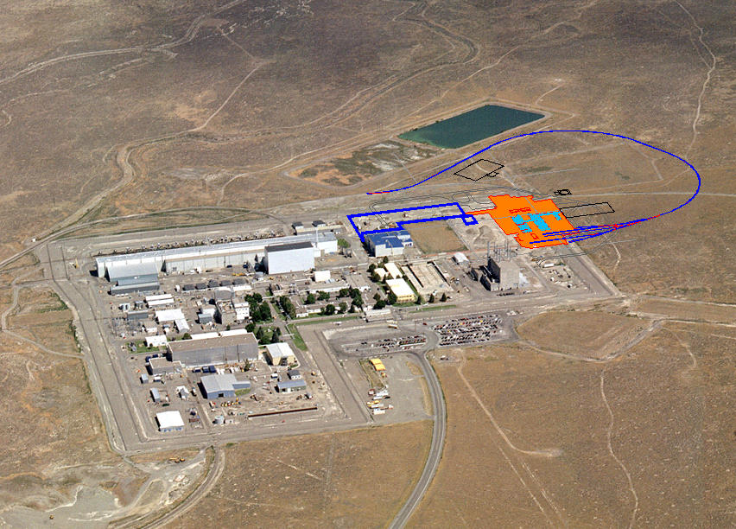
Spent Fuel Handling Recapitalization Project
New Spent Fuel Handling Facility
Expended Core Facility
Cask Shipping and Receiving Facility & Overpack Storage Facility
N
VITAL RECAPITALIZATION EFFORT TO SUSTAIN THE NAVAL REACTORS FACILITY MISSION INTO THE FUTURE

Slide 11
Socioeconomic Impact Summary
Naval Reactors invests more than $400M in Idaho each year
1,405 employees at NRF
Spent Fuel Handling Recapitalization Project will provide additional jobs during construction
Each job at NRF adds about one to two jobs in the community

