Slide 1

January 17th, 2017
The UAMPS Carbon Free Power Project with NuScale SMR Technology
Status Update – Idaho Governor’s LINE Commission
Mike McGough
Ted Rampton
NuScale Power
GM UAMPS CFPP

Slide 2
What’s Nu?

Slide 3
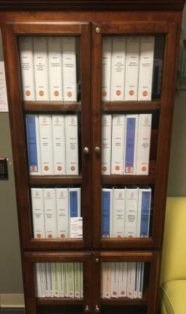
DCA Status-Completed 12/31/16
Pre-application accomplishments
  >130 meetings
  15 NRC audits and inspections
  >1,000 documents on our docket
  September Readiness Assessment
    84 NRC personnel
    8 working days
    Cost >$1 Million
    85 docketing items identified
12,000 pages, 13.5 feet of bookshelf space
14 Topical Reports

Slide 4
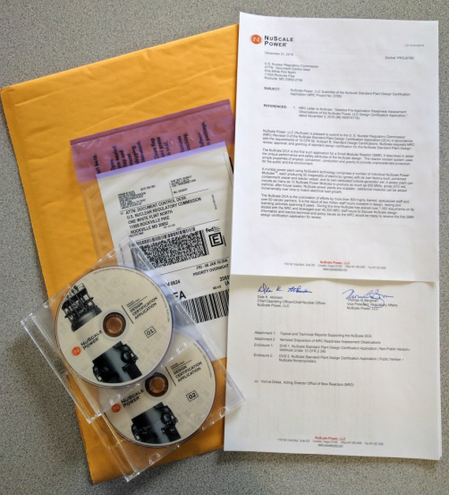
Final DCA Assembly and Submittal

Slide 5
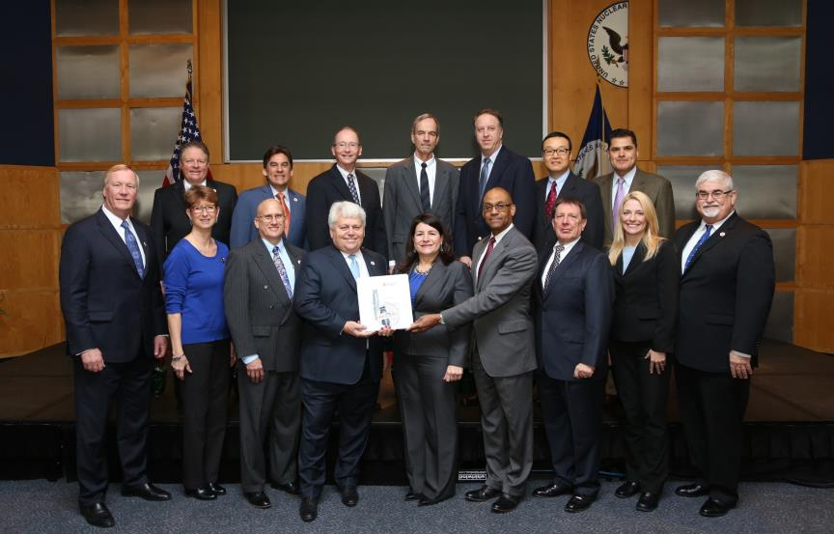
DCA Hand-off to NRC
Bottom row from left to right: John Hopkins (NuScale Chairman and CEO); Mary Jane Ross-Lee (USNRC NRR Deputy Director of Engineering), Tom Bergman (NuScale VP Regulatory Affairs), Dale Atkinson (NuScale COO/CNO), Vonna Ordaz (NRC Acting Director of NRO), Mike Johnson (USNRC DEDO), Frank Akstulewicz (USNRC, NRO Director of New Reactor Licensing), Anna Bradford (USNRC NRO Deputy Director of New Reactor Licensing), Steven Mirsky (NuScale Manager of Regulatory Affairs)
Top row from left to right - Mike McGough (NuScale Chief Commercial Officer), Dr. Jose Reyes (NuScale Chief Technology Officer), Greg Cranston (URSNRC NRO Lead NuScale Project Manager), Ray Furstenau (USDOE Acting Assistant Secretary Office of Nuclear Energy), Tim Beville (USDOE, NuScale Project Manager), Sam Lee (USNRC NRO Branch Chief of Licensing Branch 1), and Omid Tabaitabai (USNRC - NRO NuScale Senior Project Manager)

Slide 6
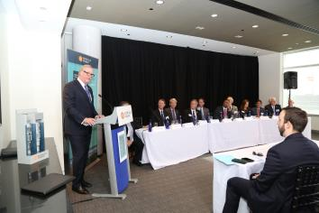
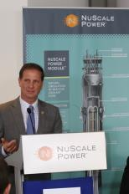
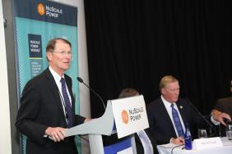
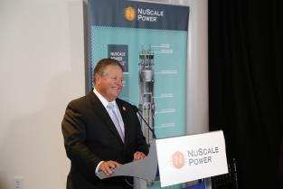
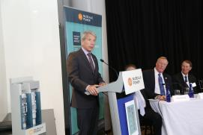
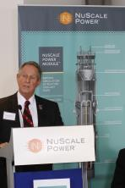
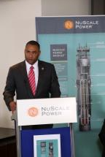
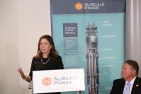
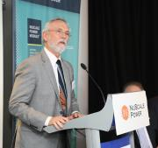
DCA Announcement PR Event – Jan. 12th
Dr. Lynn Orr, Undersecretary for Science and Energy
Rep. Stewart (R-UT 2nd)
John Hopkins, Chairman and CEO of NuScale Power
Mike McGough, Chief Commercial Officer of NuScale Power
Rep. Schrader (D-OR 5th)
Maria Korsnick, CEO
Nuclear Energy Institute
Speakers: John Hopkins, Chairman and CEO of NuScale Power; Mike McGough, Chief Commercial Officer of NuScale Power, Dr. Lynn Orr, Undersecretary for Science and Energy, U.S. Department of Energy; Maria Korsnick, CEO Nuclear Energy Institute; Members of Congress including Rep. Newhouse (R-WA 4th), Rep. Schrader (D-OR 5th), Rep. Stewart (R-UT 2nd), Rep. Veasey (D-TX 33rd), Rep. Wilson (R-SC 2nd )
Rep. Veasey (D-TX 33rd)
Rep. Wilson (R-SC 2nd )
Rep. Newhouse (R-WA 4th),

Slide 7
DCA Submittal Update
What happens after we submit DCA?
  Meet with NRC shortly after submittal
    Walk them through application
    Address any immediate questions they’ve developed
  Support NRC acceptance review (~60 days)
    Address questions/concerns as they identify them
    Head off potential docketing issues
    Supplement application if necessary and have time
  Develop responses to remaining potential RAIs from readiness assessment
  Work on application review risks
  Expected NRC fees ~$1MM/month in 2017
  Once accepted, 40-month review clock starts to issuance of design certification (expected Summer 2020)

Slide 8
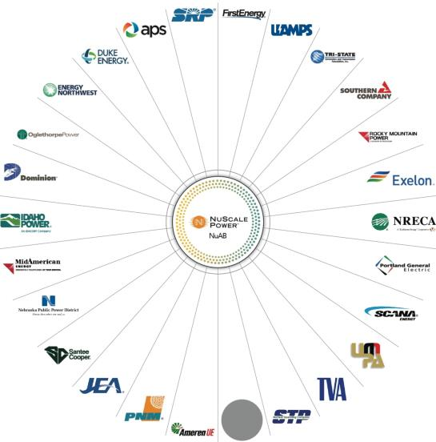
NuScale Advisory Board (NuAB)

Slide 9
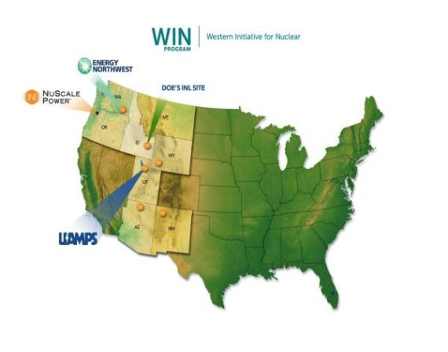
Program WIN (Western Initiative for Nuclear)
Western Initiative for Nuclear (WIN) is a multi-western state collaboration to deploy a series of NuScale Power Projects
Involved Program WIN participants: NuScale, UAMPS, Energy Northwest, ID, UT, OR, WA, WY, AZ, NM, MT?, CO?

Slide 10

NMIN – New Mexico Initiative for Nuclear

Slide 11
What Will Project WIN mean to Idaho?
Establishes INL as key player in SMR deployment
Creates slipstream for other NuScale projects, both within WIN family and elsewhere worldwide
Project will create ~1000 construction jobs at peak, for duration of 2-3 years
Indirect economic benefits and associated job multipliers
Full-time plant employment ~360 at average salaries $85K
Indirect economic benefits
Establishes Idaho as potential desired location for NuScale supply chain members—Premier already working under contract

Slide 12
What is Needed to Ensure Success in Idaho?
Need a committed owner/buyer – will ultimately drive site selection decision for first project—UAMPS CFPP
Project will need to demonstrate sufficient need for/use of generated power
State should consider doing economic impact study
Suitable plant economics/investment profile (e.g. long-term PPA’s)
Favorable/supportive local and state permitting and approval processes
Economic development incentives (ala Eagle Rock?)
Sufficient capable facility workforce and community interest
Possible implementation of new federal programs for Port of Lewiston and bridges/roads upgrades on haul route

Slide 13
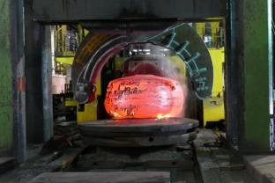
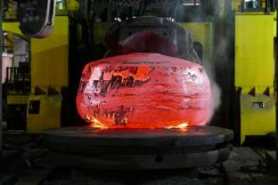
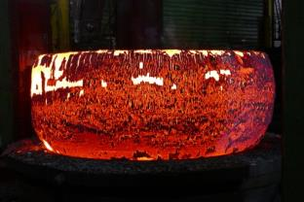
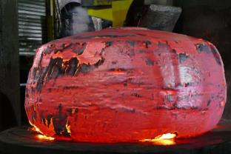
NuScale RPV Head Ingot Being Forged
150 inches diameter
30 inches high
142,000 pounds
Images Provided courtesy of Sheffield Forgemasters International Ltd

Slide 14
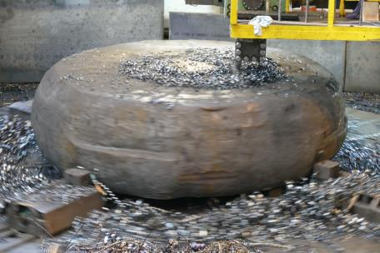
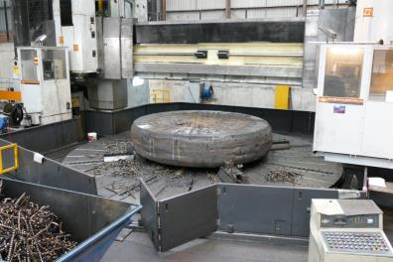
Machining of the NuScale RPV Head
Images provided courtesy of Sheffield Forgemasters International Ltd

Slide 15
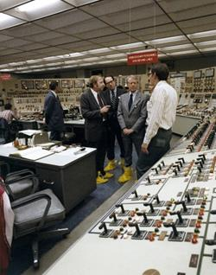
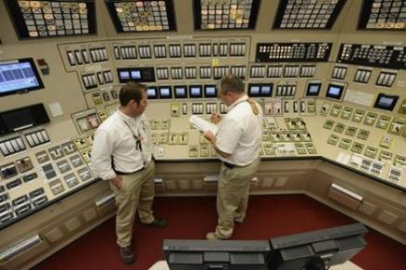
Control Rooms
In this April 29, 2015 photo, Chris Dujado, left, and Billy Horton, right, control room operators for Unit 2, review information from monitoring panels at the Watts Bar Nuclear Plant near Spring City, Tenn. The control room design is strikingly similar to those of the 1960s, despite innovations behind the panels. (AP Photo/Mark Zaleski)
President Jimmy Carter briefed by James R. Floyd, supervisor of TMI-2 operations, with Harold R. Denton, director of the Office of Nuclear Reactor Regulation in the Nuclear Regulatory Commission. This control room design was complete in the late 1960s, before construction began in 1970.

Slide 16
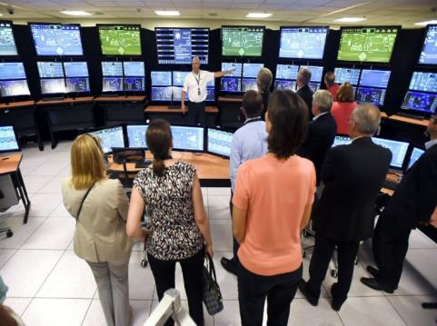
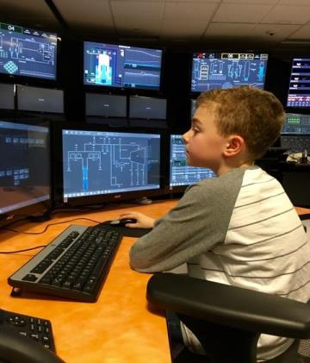
NuScale Power Control Room Simulator
The NuScale Power simulator control room design brings together decades of Digital I&C, Human Factors Engineering and Human Systems Interface research and field experience.
At a recent NuScale Family day, 10-year-old Sam Shore felt completely at home in the NuScale Control Room Simulator.

Slide 17
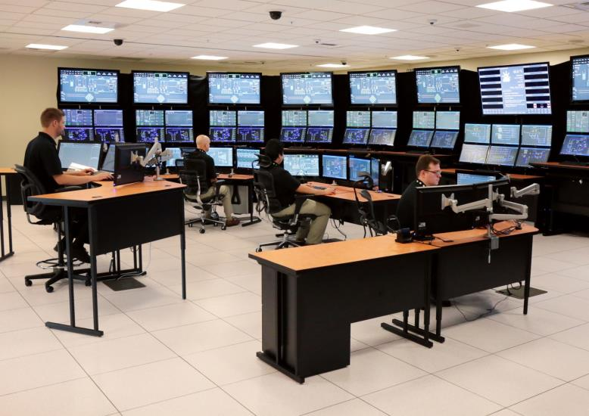
NuScale Control Room Simulator

Slide 18
NPM Selection Process
18

Slide 19
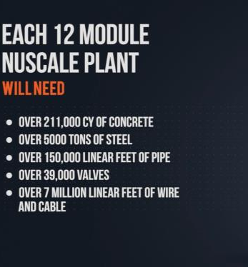
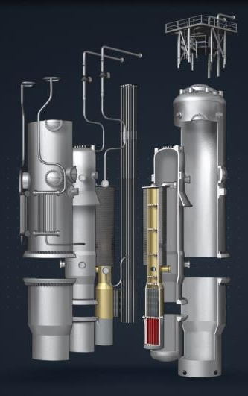

NuScale Plant Needs

Slide 20
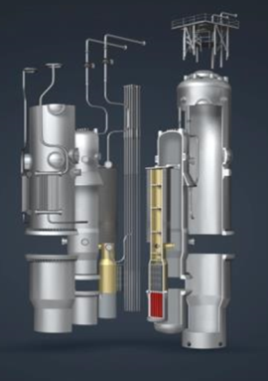
Supplier Scope - Minimum
Fabricate the NuScale Power Module
  Containment Vessel
  Reactor Vessel
  Reactor vessel internals and piping
  Steam Generator
  Assembly and testing, including ITAAC
Install equipment from other OEMs
For domestic plants with an opportunity for international export
A plan to increase production to meet demand
Value > $350M in fabricator scope per plant

Slide 21
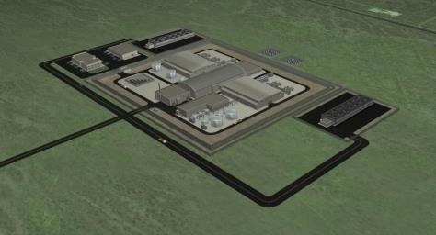
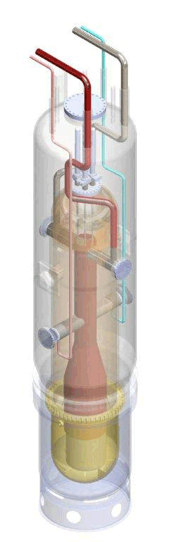
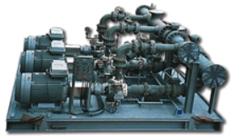



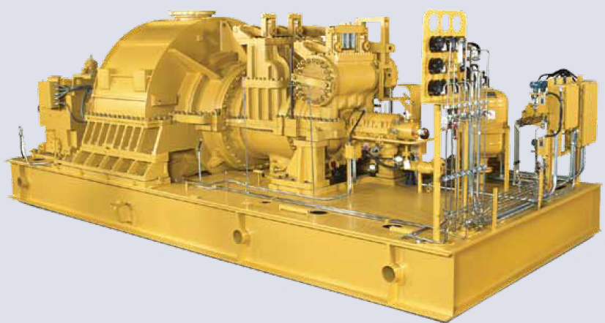



Supplier Scope Options
The NuScale Supply Chain is still largely unassigned to the supply base
Opportunities to supply equipment and plant content beyond just the NuScale Power Module
Consider balance of plant equipment, miscellaneous OEM equipment, construction equipment and materials, and services.
Meet the minimum scope, but consider:
Power Module
Other
Modules/Skids
“Expanding the Pie”
Construction Materials
OEM Equipment

Slide 22

Selection Process Timeline
Milestones
RFP Issued
Supplier(s)
Selected
11/03/2016
02/27/2017
12/29/2017
Contract Executed
RFP Responses Due
Expression of Interest Due
04/16/2018
01/30/2017
08/28/2017
4Q16
1Q17
2Q17
3Q17
4Q17
1Q18
2Q18
EOI Instructions issued
Teams are developed
EOI Prepared
RFP Response Preparation
Due Diligence on NuScale (for investors)
EOI Prepared
RFP Evaluation
QA Program Review
Site Visits
Questions
Answers
Down Select
RFP Prepared
EOI’s Reviewed
Down select (if needed)
Activities
Final Negotiations

Slide 23
Key Selection Criteria
Scope responsiveness
Domestic Manufacturing – US Jobs
Technical Capabilities and Experience
Willingness to take on commercial risks
  Development Risks
  Investment Risks
Soundness of the plan
  For the first plant
  Follow-on plants
  To meet long term production requirements
Physical location of fabrication – impact on logistics
Terms and Conditions

Slide 24
NuFAB Company Attendee List
AddiTec
Amec Foster Wheeler
AMMI Nuclear
ARES Corporation
AREVA
AREVA NP
AT&F
ATB Riva Calzoni
ATC Nuclear
ATI
ATI Forged Products
AZZ Nuclear|NLI
AZZ WSI
Black Diamond Services, Inc.
BWXT Nuclear Energy, Inc.
C4 Welding, Inc
Cammell Laird
Carr's Engineering
Centrus Energy Corp.
Chatham Steel Corporation
ClearPath Foundation
Columbiana Hi Tech LLC
Concurrent Technologies Corporation
Control Components, Inc.
CONUAR - FAE
Curtiss-Wright
Doosan
Dresser-Rand/Siemens
DuBose National Energy Services, Inc
ENERCON
Energy Steel
Ensa
EOCS
Fluor
GE Hitachi Nuclear Energy
Girard Machine Inc.
Greenberry Industrial LLC
Hartford Steam Boiler
Hayward Tyler, Inc.
Hirschfeld Industries
Hitachi Zosen - NAC International
Hitachi Zosen Corporation
ICA Fluor
IMI CCI
JGC Corporation
Joseph Oat Corporation
Laron, Inc.
Larsen & Toubro Ltd
Lehigh Heavy Forge Corporation
Major Tool & Machine
Metalex Manufacturing, Inc.
MetalTek International
Mid Columbia Engineering, Inc.
Mitsubishi Heavy Industries, LTD
Mitsubishi Nuclear Energy System, Inc.
NAC International
Newport News Industrial
Nippon Steel & Sumitomo Metal USA
North American Forgemasters
Northrop Grumman Commercial Energy
Northrop Grumman Corporation
NuSource LLC
Paxton & Vierling Steel
Petersen Inc.
Precision Custom Components, LLC
Premier Technology Inc.
Quintus Technologies
Rock Creek Innovations, LLC
Rolls-Royce
R-V Industries, Inc.
Sandmeyer Steel Company
Sandvik Materials Technology
Saulsbury Industries Inc.
Scot Forge
Sequoia Consulting Group, Inc
Shanghai Electric Nuclear Power Group
SIET
SPX FLOW
Sumitomo Corporation Of Americas
Tectubi Raccordi Spa
Teledyne Brown Engineering Inc.
Tioga Pipe Supply Co Inc
Ultra Electronics - NCS
US NIC
USDOE
Utah Associated Municipal Power Systems
ValvTechnologies
Vigor
Vigor Works LLC
Wachs Services
Wagstaff Applied Technologies
Williams Industrial Services, LLC

Slide 25
Key Takeaways
UAMPS CFPP On track for Commercial Operation in 2026
INL is selected location
NuScale Design Certification App submitted, 40-month NRC review
Project mobilization, site prep commences mid 2020
Safety-related construction starts early-2021
NuScale SMR is the safest nuclear plant ever designed
First 12 NuScale Projects identified—”Fast Followers” to the UAMPS CFPP, in operation before 2035.
Continued US DOE support and encouragement
INL key objectives include SMR deployment

Slide 26

The Element of Nu
26

Slide 27
Background Refresher Slides

Slide 28


UAMPS CFPP Project Schedule (Nov 2016)
2016 | 2017 | 2018 | 2019 | 2020 | 2021 | 2022 | 2023 | 2024 | 2025 | 2026 | 2027
Project
Development
Implement QA program
EPC Contract Execution
FNTP
Final Acceptance
EPC Development Agreement
LNTPs
Onboard Partners
Design & Engineering
Start Finalized Plant Design
Complete Final
Plant Design
Site Specific Engineering
Preliminary
For Discussion Purposes only
Licensing
Submit DCA
NRC Issue DC
Site Use Agreement
Start COLA
Submit COLA
NRC Issue COL
Site Selection
Site Characterization
Site Prep & Mobilization
1st Safety Concrete Pour
1st Fuel load
Construction and Fabrication
Procure Long Lead NPM Materials
Start NPM
Fabrication
Install
NPM 1
Install
NPM 12
NPM Fabricator
Start Operational
Readiness Program
Operator Training Program Accreditation
Operations
NPM 1
COD
NPM 12
COD
33

Slide 29
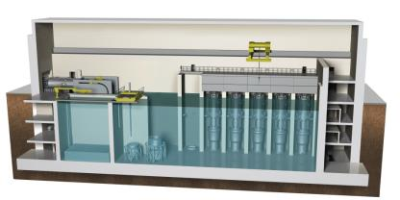
What is a NuScale Power Module?
A NuScale Power Module (NPM) includes the reactor vessel, steam generators, pressurizer and containment in an integral package that eliminates reactor coolant pumps and large bore piping (no LB-LOCA)
Each NPM is 50 MWe and factory built for easy transport and installation
Each NPM has its own skid-mounted steam turbine-generator and condenser
Each NPM is installed below-grade in a seismically robust, steel-lined, concrete pool
NPMs can be incrementally added to match load growth - up to 12 NPMs for 600 MWe gross (~570 net) total output
29

Slide 30
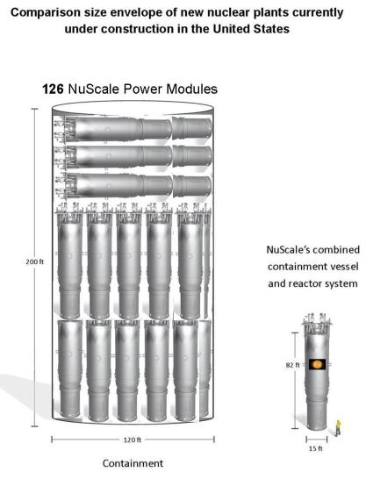
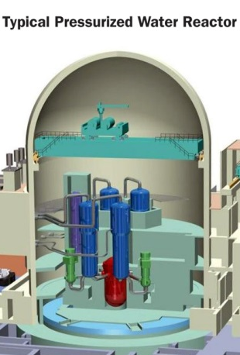
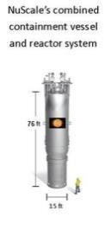
Size Comparison
*Source: NRC
30

Slide 31
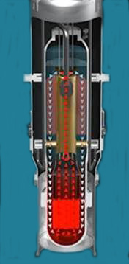
Coolant Flow Driven By Physics
Convection – energy from the nuclear reaction heats the primary reactor coolant causing it to rise by convection and natural buoyancy through the riser, much like a chimney effect
Conduction – heat is transferred through the walls of the tubes in the steam generator, heating the water (secondary coolant) inside them to turn it to steam. Primary water cools.
Gravity – colder (denser) primary coolant “falls” to bottom of reactor pressure vessel, cycle continues

Slide 32

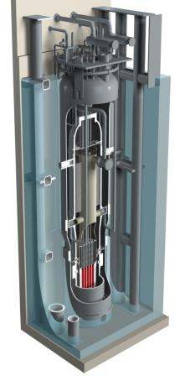
NuScale Announces Major Breakthrough in Safety
Wall Street Journal - April 16, 2013
  NuScale design has achieved the “Triple Crown” for nuclear plant safety. The plant can safely shut-down and self-cool, indefinitely, with:
        No Operator Action
        No AC or DC Power
        No Additional Water
  VIDEO
  Safety valves align in their safest configuration on loss of all plant power.
  Details of the Alternate System Fail-safe concept were presented to the NRC in December 2012.

Slide 33
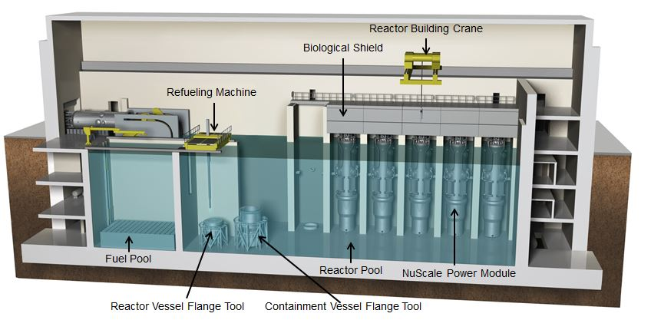
Reactor Building Cross Section

Slide 34
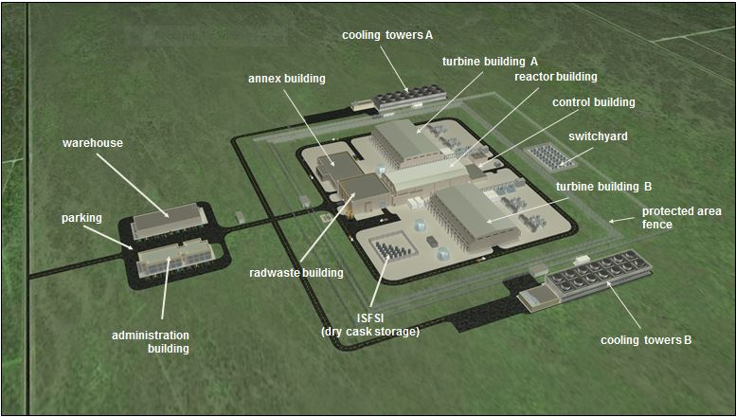
Site Overview

Slide 35
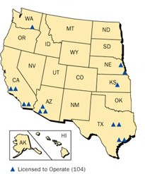
The Genesis of Project WIN
June 2010: Idaho Governor Butch Otter became Chair of Western Governors Association (WGA) and sponsored Western nuclear energy policy
June 2011: “The Future of Nuclear Energy:
Shaping a Western Policy” published:
discusses SMR’s explicitly
Feb 2012: Otter creates Idaho Leadership in
Nuclear Energy (LINE) Commission
June 2012: Utah Governor Gary Herbert
becomes WGA Chair and sponsors development
of a 10-year energy plan-patterned after Utah 10-year plan
June 2013: WGA 10-yr plan unveiled with stated goal to “Find ways to accelerate the introduction of SMRs into the marketplace.”

Slide 36
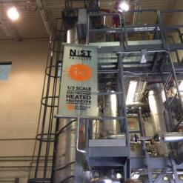
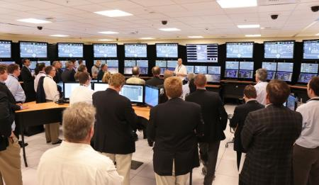
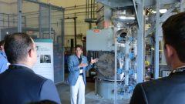
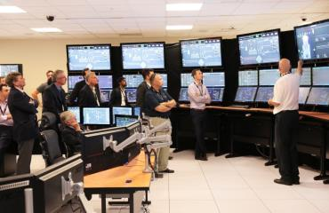
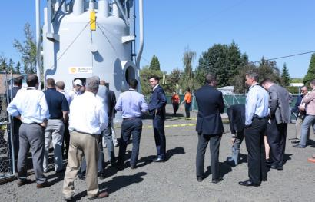
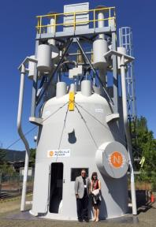
NuEx Tours – NIST, Control Room Simulator and UMM

