Slide 1
Update on Office of Nuclear Energy Programs
Ray Furstenau
Acting Assistant Secretary for Nuclear Energy

Slide 2
NE Mission
The Office of Nuclear Energy’s mission is to advance nuclear power as a resource capable of meeting the Nation’s clean energy, environmental, and national security needs by resolving technical, cost, safety, proliferation resistance, and security barriers through research, development, and demonstration (RD&D). NE supports the diverse civilian nuclear energy programs of the U.S. government, leading federal RD&D efforts in nuclear energy technologies, including generation, safety, waste storage and management, and security technologies.

Slide 3
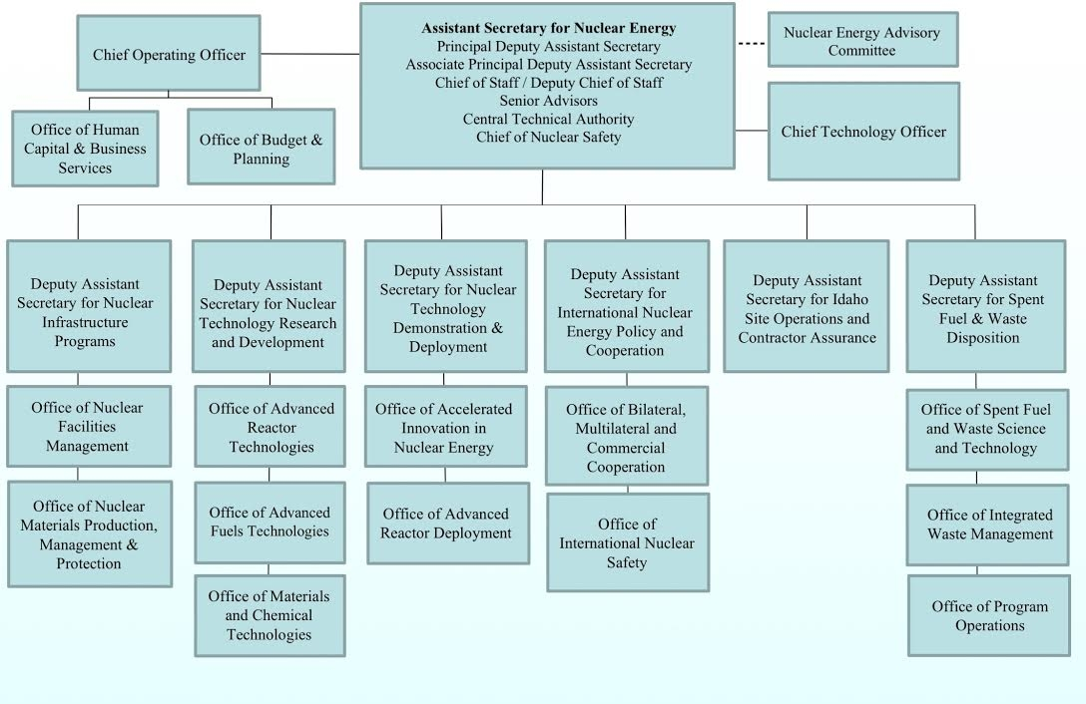
Organization Chart

Slide 4
FY 2015 – FY 2017 Request
Dollars in Thousands

Slide 5
Major Programmatic Responsibilities
Sustaining the Current Fleet of Light Water Reactors
Deploying Small Modular Reactors
Demonstrating Advanced Reactors
Nuclear Waste Management
Nuclear Science User Facilities and Enabling Capabilities

Slide 6
Top Leadership Challenges
Premature Retirement of Some Current Nuclear Power Plants
Path Forward on Advanced Reactor Development
Deployment of Small Modular Reactors
Long-term Management of Spent Nuclear Fuel and High-Level Radioactive Waste
Stewardship of the Nuclear Infrastructure at the INL

Slide 7
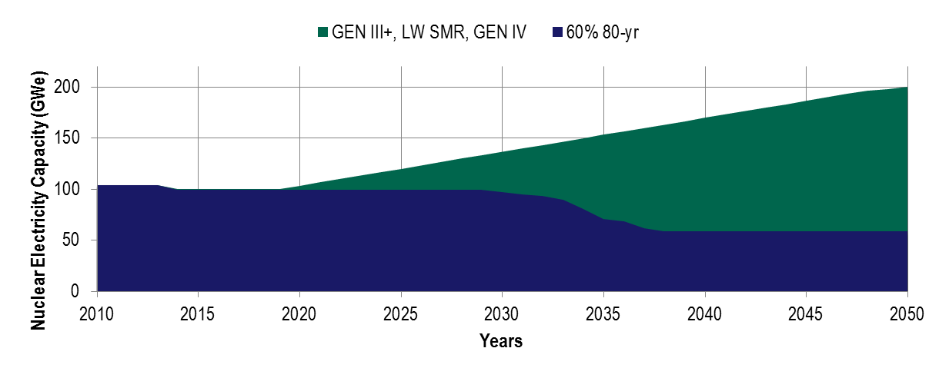
Sustaining the Current Fleet of Light Water Reactors… and Beyond
The partitioning between GEN III+, SMRs, and GEN IV depend on the availability of the technologies and supply-chain considerations
Life extension to 80 yrs for 60% of current capacity (younger and larger units)
LWR LIFE EXTENSION (80 yrs)
ADVANCED REACTORS
NUCLEAR HYBRID ENERGY
SUSTAINABLE FUEL CYCLE
GEOLOGIC REPOSITORY
LWR LIFE EXTENSION (60 yrs)
USED FUEL STORAGE
ADVANCED LWR BASED
SYSTEMS & COMPONENTS
SMALL MODULAR REACTORS
2010
2020
2030
2040

Slide 8
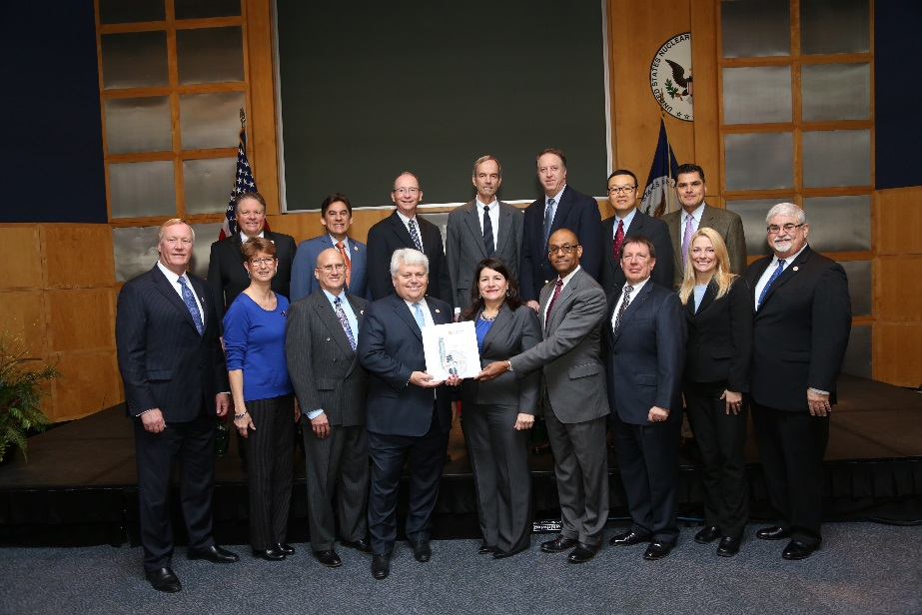
Deploying Small
Modular Reactors
NuScale
  Design Certification Application (DCA) Design Submitted to the NRC in January 2017:
    NuScale’s DCA consists of nearly 12,000 pages of technical information
    NRC is expected to take approximately 60 days to complete a docketing review to determine if additional information is required prior to commencing their review
    Once docketed, NRC has targeted completing the DCA review and approval process within 40 months (≈May 2020)
TVA Siting
  Submitted Early Site Permit Application to NRC
    The NRC review officially commenced on January 3 and will be completed in approximately 30 months.
NuScale/UAMPS Siting
  Site use agreement obtained for a site on the INL reservation
  UAMPS identified a preferred site on the INL in August 2016
Submittal of NuScale DCA to NRC on January 12, 2017

Slide 9
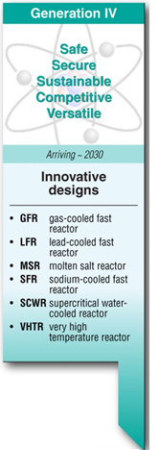
Demonstrating Advanced Reactors
There has been increasing interest in advanced non-light water reactors and the benefits they can provide toward clean energy and energy security needs.
DOE initiatives have included:
  Development of a vision and strategy for advanced reactors
  Establishment of the Gateway for Accelerated Innovation in Nuclear (GAIN)
  Providing cost shared support for reactor concepts.
  Conduct of a Test/Demonstration Advanced Reactor Planning Study
These initiatives support the need for new nuclear capacity that will be needed in the 2030 to 2050 time frame.
2030

Slide 10
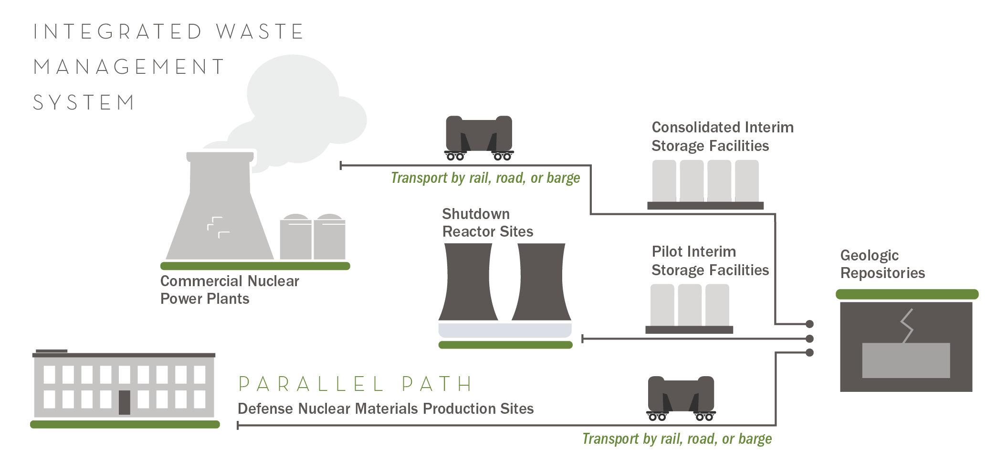
Nuclear Waste Management

Slide 11
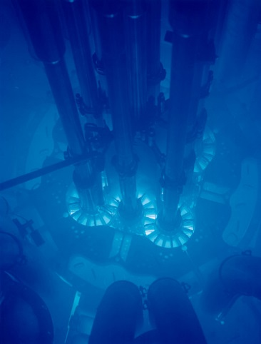
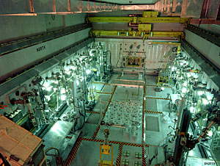
Nuclear Science User Facilities and Enabling Capabilities
Hot Fuel Examination Facility
Advanced Test Reactor
Transient Reactor Test Facility
Provides the research community a means to conduct cutting-edge nuclear energy R&D by providing access to unique irradiation and post-irradiation examination capabilities, located at Idaho National Laboratory and various partner facilities.

Slide 12
Questions?
More information can be found at: energy.gov/ne

