Slide 1

UAMPS Carbon Free Power Project (CFPP)
Briefing to Idaho Governor’s LINE Commission
January 17, 2017

Slide 2
Overview
Description of UAMPS
Carbon Free Power Project
Need for Project
Project Siting Process
Funding

Slide 3
Description of UAMPS
UAMPS is an Energy Services Interlocal Agency
  Created in 1980 under State of Utah statutes
  47 members in 7 Western states
    Most are municipal electric utilities
    Offer an array of various services and projects
      Members free to develop their own projects w/o the group

Slide 4
UAMPS Organization
Project-Based
  17 projects of various categories
Energy Services
  Assist members in their energy needs
Not-for-Profit

Slide 5
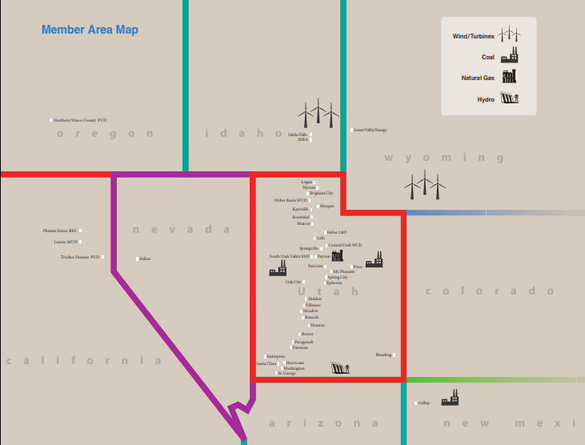

Slide 6
Carbon emitting resources=Regulatory Risk

Slide 7
UAMPS’ Concerns
Future of Coal fueled generation
  Clean Air Act
  Clean Power Plan
Future of power market
  Derivative of coal fueled generation
Future of natural gas fueled generation
  What is the end-goal for C02 reduction?
  Fuel price volatility

Slide 8
What is the CFPP?
Carbon Free Power Project - UAMPS effort, to examine how to de-risk UAMPS’ exposure to carbon regulation
Three pronged approach - Investigation of Nuclear Small Modular Reactors, Energy Efficiency, and Distributed Generation (Rooftop Solar)
  Pursue Above 3 Resources:
    Industry is shifting towards cleaner forms of electricity production, which is characteristic to all 3 of the above resource options.
Developing this resource option by additional work on submitting an application to the Nuclear Regulatory Commission to ultimately construct and operate the CFPP Project

Slide 9
UAMPS’ Approach to
Environmental Regulation
Manage risk associated with environmental compliance obligations
New Resource Option Feasibility – A cost competitive resource that will meet environmental compliance over its expected lifespan.
  Coal - Every indication is that existing coal resources will not be competitive due to proposed and future regulations.
  Natural Gas – Possible growing environmental compliance obligations surrounding natural gas generation.
  Nuclear - Poses no risk of greenhouse gas compliance costs and other environmental compliance are minimized by NuScale’s technology.

Slide 10
Past/Present Environmental Regulatory Pressures
Clean Power Plan
  Regulates CO2 from existing UAMPS carbon resources, but suggests a very tough regulatory environment for new carbon resources
  Compliance cost impact on existing coal plants uncertain
Clean Power Plan was stayed by the U.S. Supreme Court in February 2016
  Trump unlikely to implement the Clean Power Plan

Slide 12
WHY SMRs?
Environmental Impacts:
  No greenhouse gas (GHG) emissions when generating electricity
  Lifecycle GHG emission much lower than comparable alternative (NGCC)
  Much smaller environmental footprint/impact than alternative carbon free generating resources (utility scale wind and solar)

Slide 13
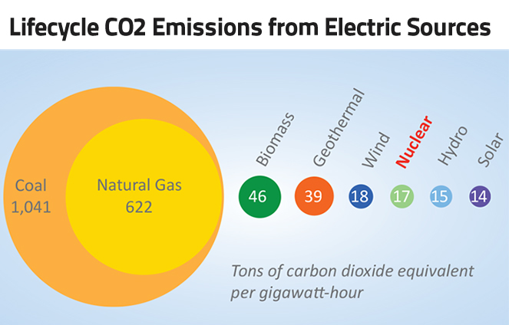

Slide 14
Carbon emitting resources=Regulatory Risk

Slide 15
WHY the CFPP?

Slide 16
WHY the CFPP?

Slide 17
Carbon Free Power Project
Need for a reliable replacement for carbon dioxide emitting generation sources
  Energy Efficiency
    Customer satisfaction with correct incentives
    Customer makes subsidized (?) capital investment
  Rooftop solar or other distributed generation
    Feed-in tariff with Member (local utility) or UAMPS
    Customer makes subsidized (?) capital investment
  NuScale Modular Reactors
    Baseload with flexibility resource
    Safety
    Scalable & with load following capability

Slide 18
Why the CFPP?—Concluding remarks
NuScale’s technology has promise to be a cost competitive resource with reduced exposure to future environmental regulations (GHG regulation)
  Reduced environmental footprint - reduced environmental exposure
Future GHG regulations are uncertain at present—but increased regulatory pressure on carbon emitting resources is certain
  These regulatory pressures will result in compliance costs
  Magnitude of these costs will be known as CFPP development proceeds
These environmental compliance costs have the potential to make UAMPS’ existing carbon emitting resources and coal based market purchases uneconomic

Slide 19
Site Selection

Slide 20
Objective & Methodology
Objective of the Siting Study is to identify a nuclear power plant site that:
  Meets UAMPS’ needs
  Satisfies applicable Nuclear Regulatory Commission (NRC) site suitability requirements
  Is consistent with National Environmental Policy Act (NEPA) requirements regarding the consideration of alternative sites

Slide 21
Region of Interest (ROI)
dRFTT
Consistent with UAMPS’ needs
ROI is located within 25 miles of the PacifiCorp Transmission Network in Idaho and Utah
ROI encompasses the majority of UAMPS members and load centers

Slide 22
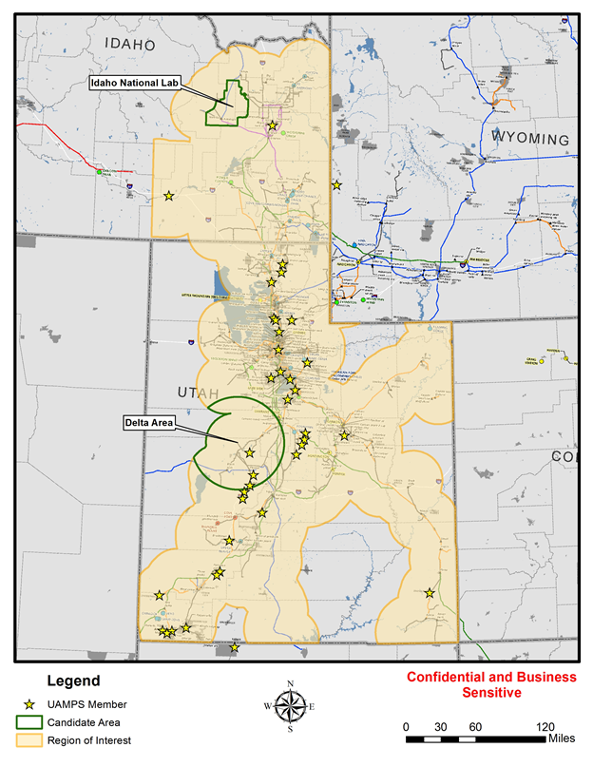
Candidate Areas
Two candidate areas: the Idaho National Laboratory (INL) and the Delta area.
Rationale for selection of INL:
  Readily available land and resources;
  Existing Infrastructure;
  Is a secure site;
  Additional benefit of DOE support of the project;
  Knowledge base of workforce to support the plant.
Rationale for selection of the Delta Area:
  UAMPS members have an interest in developing this area for a power project;
  Development would provide economic benefits to the area;
  Access to PacifiCorp Transmission Network.

Slide 23
UAMPS SMR Siting Study Timeline
2 Candidate Areas Identified – November 2015
19 Potential Sites Identified – November 2015
9 Candidate Sites Identified – December 2015
4 Acceptable Sites Identified – January 2016
INL/DOE Review of Acceptable Sites – February/March 2016
Field Review of Acceptable Sites – March 2016
Preferred Site Identified – March 2016
  Feedback solicited and received on the four acceptable sites from the Tribes
Siting Study Report Completed – July 2016

Slide 24
Avoidance Areas
  Active Rail Line
  Airports
  Areas of Critical Environmental Concern
  Cooperative Wildlife Management Units
  Designated Federal and State Lands
  Existing Facilities within INL
  High Population Density
  Mines
  NWI Wetlands
  Peak Ground Acceleration (PGA)
  100 Year Floods
  Sage Grouse activities
  BLM land
  Quaternary faults
  Volcanic Hazard Zones
  INL Land Use Committee advice on cultural areas

Slide 25
Evaluation of Sites
Potential Sites
19 Potential Sites evaluated using Screening Criteria
9 Candidate Sites were selected to move forward
  7 from within INL and 2 from within Delta Area
Candidate Sites
9 Candidate Sites evaluated using the General Site Criteria
4 Acceptable Sites were selected to move forward (all within INL)
Acceptable Sites
4 Acceptable Sites evaluated using additional/refined criteria
Independent evaluation performed by INL/DOE
Field review of the 4 sites was performed
Preferred Site selected based on the additional evaluations

Slide 26
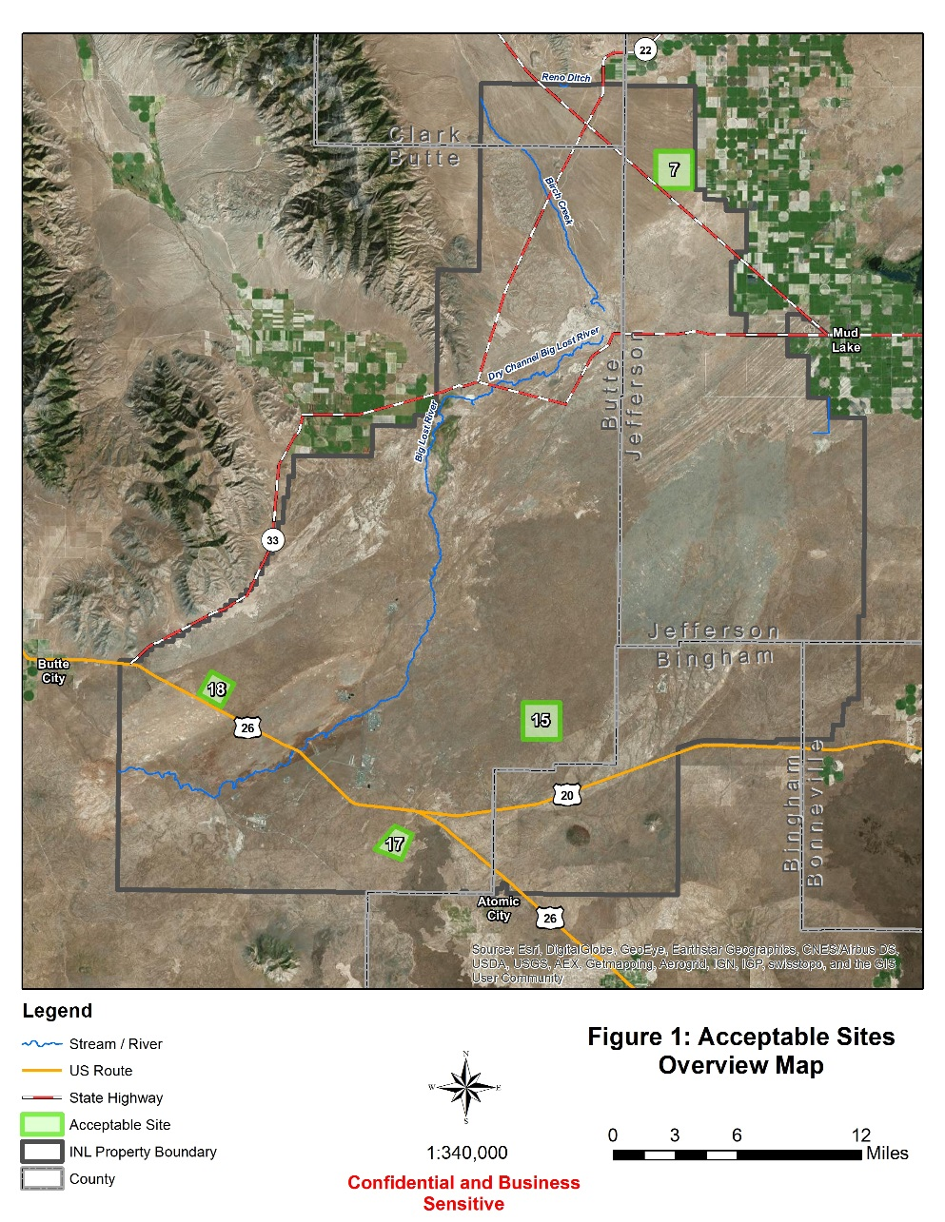
Four Acceptable Sites

Slide 27

Ranking of Acceptable Sites
Evaluation | Site Ranking
 | 7 | 15 | 17 | 18
Volcanic Hazards
Transportation
Transmission
Synergies with INL
Flooding
Cooling Water Supply
Ecology / Environmental
Site Layout Flexibility
Seismic
Logistics of Const. / Operation

Slide 28
Preferred Site Recommendations
Site 7 should be deferred due to seismic concerns.
Suggest deferring Site 15 due to number of issues (highlighted in orange on graph).
Sites 17 and 18 present fewer challenges and are both viable for consideration
  Site 17 presents the least challenges and should be considered for development

Slide 29
CFPP Transmission
UAMPS has undertaken a high-level analysis of the existing transmission system for the INL site
UAMPS has submitted an interconnection request to PacifiCorp order to understand the transmission line upgrades necessary for the CFPP
CFPP transmission will be studied by NTTG technical working group
UAMPS objectives for CFPP Transmission:
  Minimize environmental disturbance (co-location with existing lines)
  Coordinate with PacifiCorp and Idaho Power on transmission planning for the area

Slide 30
Site Selection Process
Next steps
  Continue engagement with Shoshone – Bannock Tribes in consultation process
  Idaho State government offices
    Idaho Governor’s Office
    Idaho Attorney General’s Office
    Idaho Department of Environmental Quality
    Idaho Department of Water Resources
    Idaho Department of Commerce
      Regional economic development

Slide 31
Regional Economic Development Potential
~1000 construction jobs at its peak, for about 2-3 years
  Example: Welders, riggers, pipefitters, masons, carpenters, millwrights, sheet metal workers, electricians, ironworkers, security
Once plant is operational;
  About 360 workers with average salaries of $85/000/yr
    Example: Certified operators, electrical, mechanical maintenance, administrative, security
Eastern Idaho economic benefits from related industries
UAMPS will give preference to local individuals that are qualified for plant positions

Slide 32
Funding
Participant Based
  Budget assessment
Financial
  Tax-exempt
  Taxable
  Guaranteed
Department of Energy Assistance
  Cooperative Agreement funding
  Load guarantees
  Nuclear Production Tax Credits

Slide 33
Schedule
Plant Licensing: 2017- 2022
Site Mobilization, Construction & Startup: 2020 – 2026
Commercial Operations: 2026

Slide 34


Slide 35
Ted Rampton
General Manager UAMPS CFPP
Ted@UAMPS.com
801-214-6425
www.uamps.com

Slide 36
Acknowledgment & Disclaimer
This material is based upon work supported by the Department of Energy under Award Number DE-NE0008369.
This report was prepared as an account of work sponsored by an agency of the United States (U.S.) Government. Neither the U.S. Government nor any agency thereof, nor any of their employees, makes any warranty, express or implied, or assumes any legal liability or responsibility for the accuracy, completeness, or usefulness of any information, apparatus, product, or process disclosed, or represents that its use would not infringe privately owned rights. Reference herein to any specific commercial product, process, or service by trade name, trademark, manufacturer, or otherwise does not necessarily constitute or imply its endorsement, recommendation, or favoring by the U.S. Government or any agency thereof. The views and opinions of authors expressed herein do not necessarily state or reflect those of the U.S. Government or any agency thereof.

