Slide 1
Leadership in Nuclear Energy Commission Update on Idaho Cleanup Project
Jack Zimmerman
Manager
Idaho Cleanup Project
January 17, 2016

Slide 2
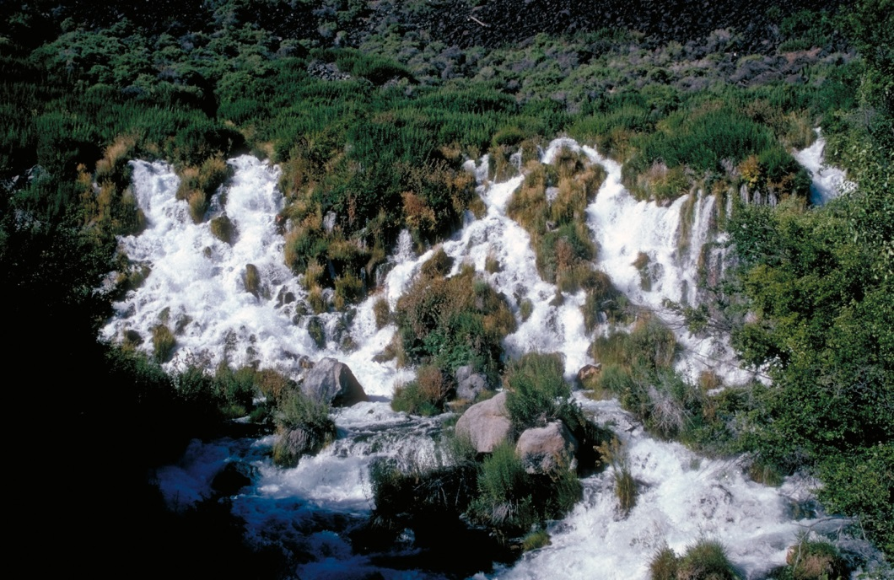
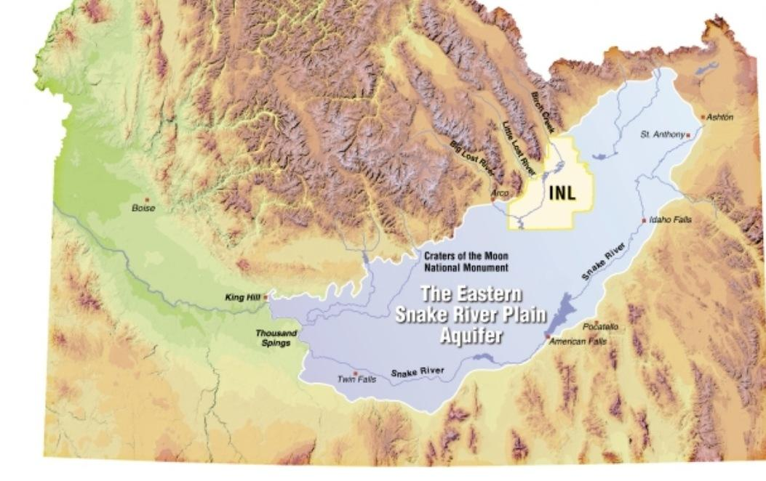
Cleanup Priorities
Protect workers, the public and the environment.
Protect the Snake River Plain Aquifer.
Comply with all laws, regulations and regulatory agreements.
Primary Cleanup Agreements:
Idaho Settlement Agreement
Federal Facility Agreement/Consent Order
Notice of Non-Compliance/Consent Order
Site Treatment Plan

Slide 3
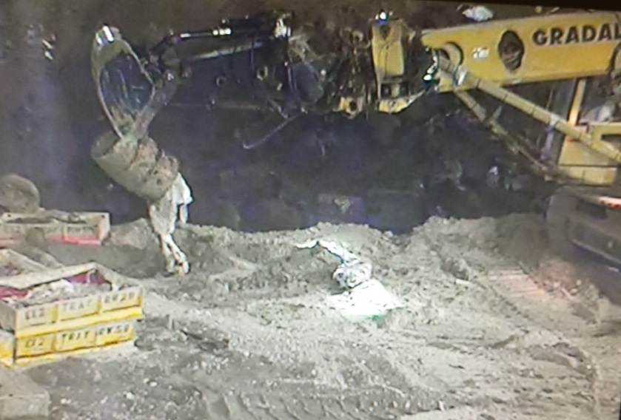
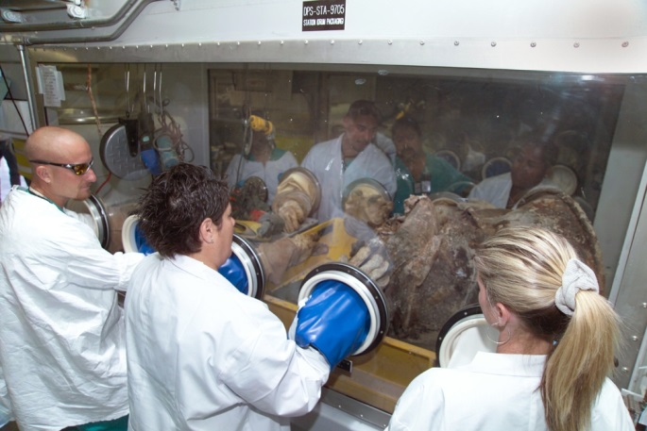
Buried Waste Exhumation
A specially-equipped backhoe excavates targeted buried waste (left); workers sort through the waste (right), which is then characterized, repackaged and eventually shipped off-site for disposal.
Through the Accelerated Retrieval Project (“ARP”), DOE’s contractors have successfully removed over 7,500 cubic meters of “targeted buried waste” from the Subsurface Disposal Area – that is the equivalent of nearly 36,000 55-gallon drums of waste.
The “targeted waste” contains the highest concentrations of organic solvents and transuranic nuclides of all the waste in the burial ground. Once exhumed, the waste is characterized, repackaged and shipped off-site for disposal.
Under an agreement with the State of Idaho, DOE will exhume a combined area of 5.69 acres from the 97-acre burial ground. We are currently ahead of schedule to meet the deadline of completing exhumation by the end of 2023.

Slide 4
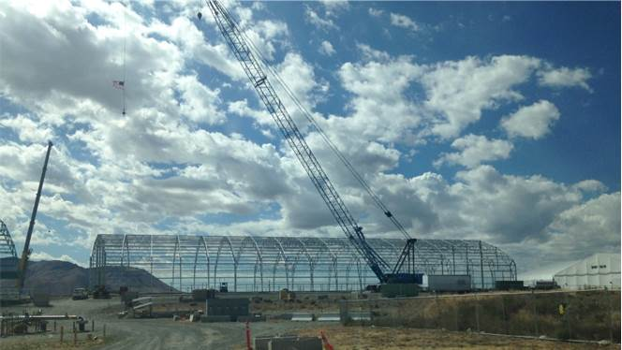
Buried Waste Exhumation (cont.)
Construction is underway on ARP IX, the final retrieval enclosure that will allow completion of the exhumation of targeted buried waste.
The final ARP enclosure facility – ARP IX – is currently under construction by North Wind Services, Inc., an Idaho Falls-based small business, and is expected to be completed later this year.
Waste exhumation in ARP VIII is currently about 67 percent complete, and is expected to be finished by the end of this year.

Slide 5
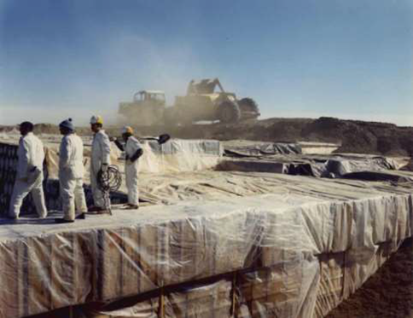
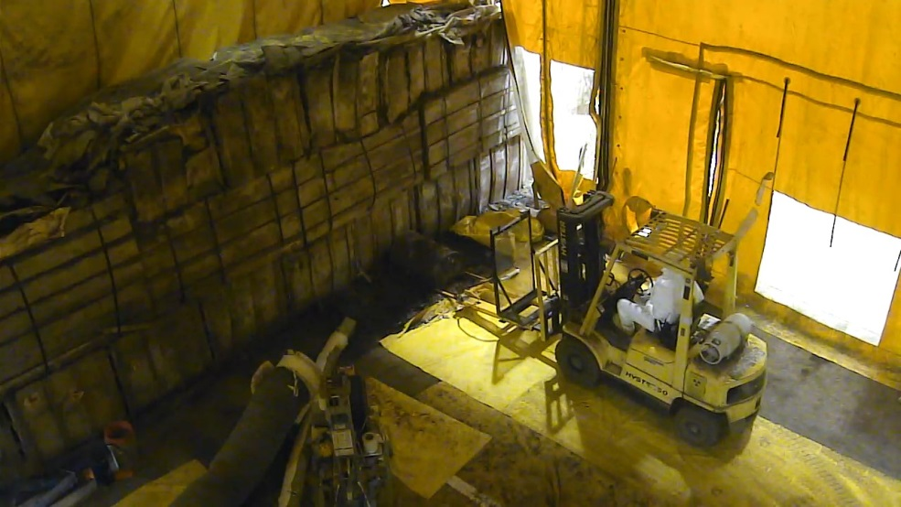
Stored Transuranic Waste
Before and after: transuranic waste was stacked on plywood over an asphalt pad, then covered with dirt in the 1971 time period (left). Immediately below, these are the last boxes of waste left to be retrieved of the estimated 65,000 cubic meters of stored transuranic waste.
Nearly all of the estimated 65,000 cubic meters of stored transuranic waste has been retrieved from beneath the earthen berms, characterized, repackaged and prepared for certification for off-site disposal. There are currently 35 boxes left to be retrieved, and that is expected to be completed by March of 2017.
Over 50,000 cubic meters of waste has been shipped off-site for disposal.

Slide 6
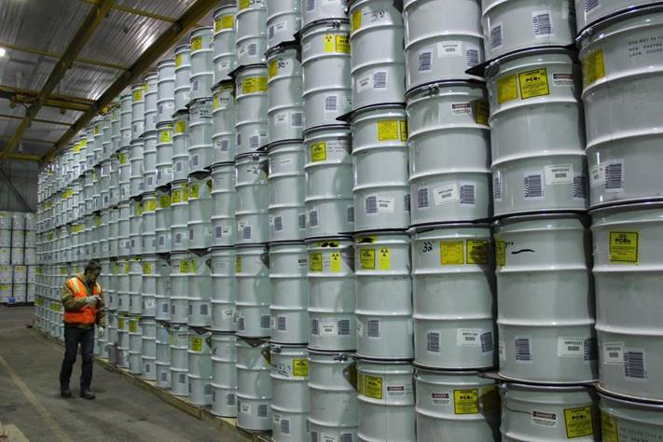
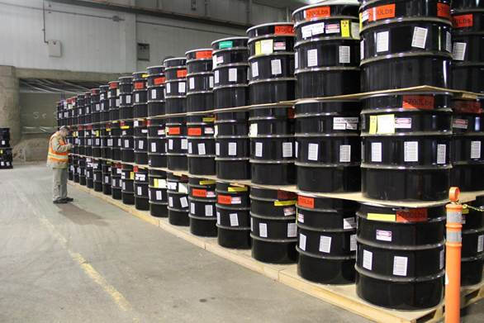
Stored Transuranic Waste (cont.)
The white drums (far right) are 55-gallon drums, the black are 100-gallon product drums of waste, both certified ready to ship to WIPP for disposal.
With the closure of the Waste Isolation Pilot Plant in New Mexico, the Idaho Site has been unable to ship waste since 2014. There is the equivalent of approximately 820 shipments of contact-handled waste and 90 shipments of remote-handled waste that were certified ready to ship to WIPP currently in storage at the Idaho Site.
The Idaho Settlement Agreement requires all transuranic waste to be removed from the state by the end of 2018, a deadline that is currently at risk.
WIPP has resumed waste emplacement, using waste already stored on site. The current expectation is that the Idaho Site will be able to resume shipments to WIPP in 2017.

Slide 7
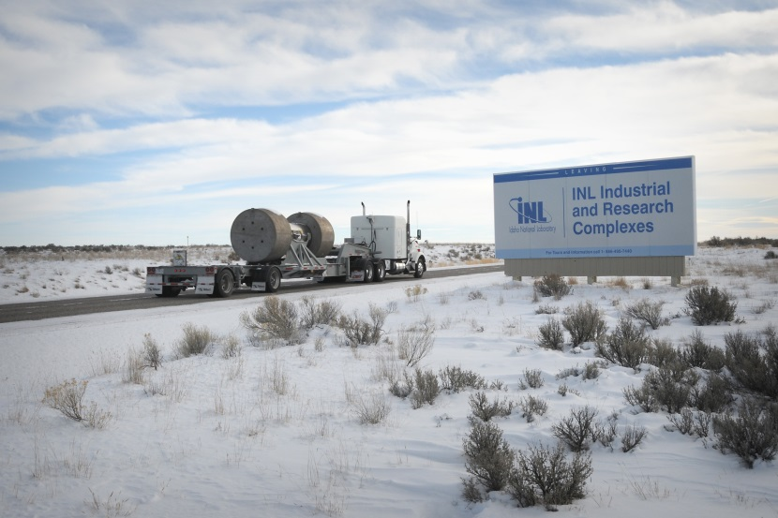
Stored Transuranic Waste (cont.)
Remote-handled waste shipments to WIPP are currently on hold.
Due largely to ventilation constraints, the rate of shipments to WIPP will be considerably lower than the rate prior to the accidents that closed the facility.
A permanent ventilation upgrade at WIPP is expected to be completed in 2021, allowing a higher shipping rate.
WIPP waste emplacement operations will initially focus on contact-handled waste.

Slide 8
Liquid Radioactive Waste
About 900,000 gallons of liquid radioactive waste remain stored at the Idaho Site, left over from the decontamination activities of the reprocessing facilities.
This waste, which has a high sodium content, was scheduled to be solidified in the Integrated Waste Treatment Unit (IWTU) and the storage tanks emptied, cleaned and closed by the end of 2012 under a Consent Order.
This diagram shows the flow sheet for how the IWTU is designed to treat the 900,000 gallons of liquid radioactive waste now stored in stainless steel underground tanks at the Idaho Nuclear Technology and Engineering Center. Contractor Fluor Idaho has developed a four-phased approach to identify and resolve the technical and process problems that have prevented start-up of the IWTU treatment facility .

Slide 9
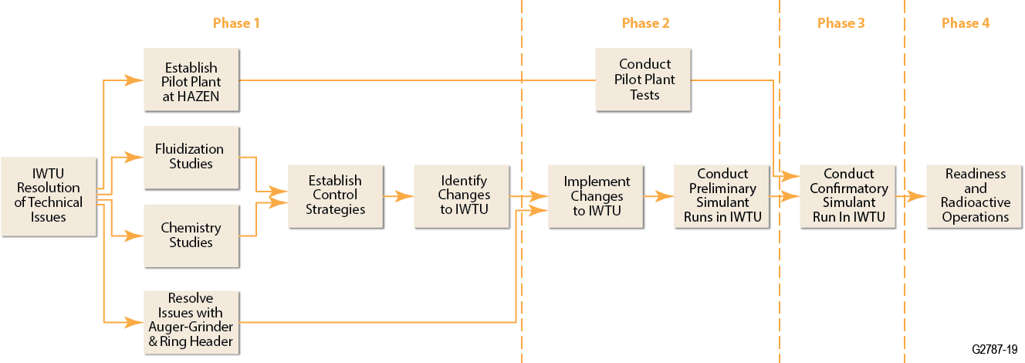
Fluor Idaho Approach to Start-Up of IWTU
Phase 1
Phase 2
Phase 3
Phase 4
Chart shows how Flour Idaho and DOE intend to proceed with start-up of radioactive waste treatment at the IWTU. The process will be driven by success in each phase, so there is currently no timeline associated with each phase. Fluor is currently in the early portion of Phase 2.

Slide 10
Issues, Solutions for Starting Liquid Waste Treatment
This chart summarizes the major technical issues that have prevented the beginning of waste treatment in IWTU, and Fluor Idaho and DOE’s planned approaches to resolve each issue.

Slide 11
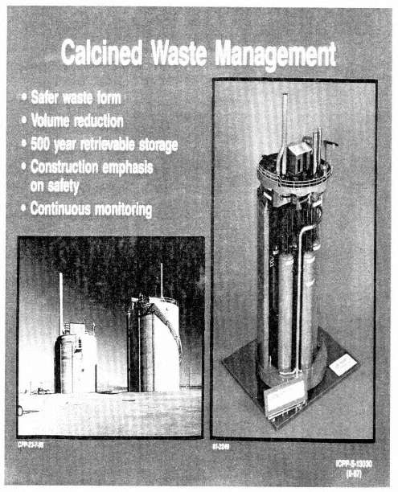
High-Level Waste
There are about 4,400 cubic meters of “calcined,” high-level waste in storage at the Idaho Site.
Under the Idaho Settlement Agreement, the waste must be treated and “road ready” to leave the state by 2035.
A Record of Decision was issued in 2007 that determined that DOE would use Hot Isostatic Pressing to treat calcined material for disposal.
However, an alternatives analysis completed in 2016 suggests that this decision be reviewed.
DOE and Fluor Idaho are focusing currently on a project to demonstrate the calcine waste can be safely retrieved and transferred.
“Calcined” high-level waste is stored in stainless steel canisters encased in concrete bins (above).

Slide 12
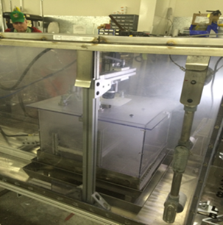
Remote-Handled Waste Project
Spritzing reaction chamber, used to treat sodium-contaminated waste.
DOE-ID has agreed under the Site Treatment Plan to an enforceable schedule for treatment of legacy remote handled mixed low-level waste.
The schedule includes treating 24 cubic meters of mixed waste by September 30, 2018 and concludes with the treatment of all legacy remote-handled mixed waste at INL by 2045.
The treatment plan includes significant facility upgrades to the hot cell in 2024 through 2027, and in 2040 through 2043.

Slide 13
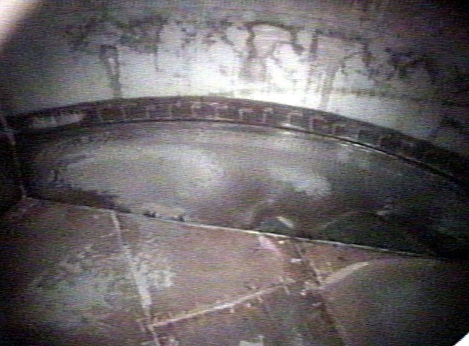
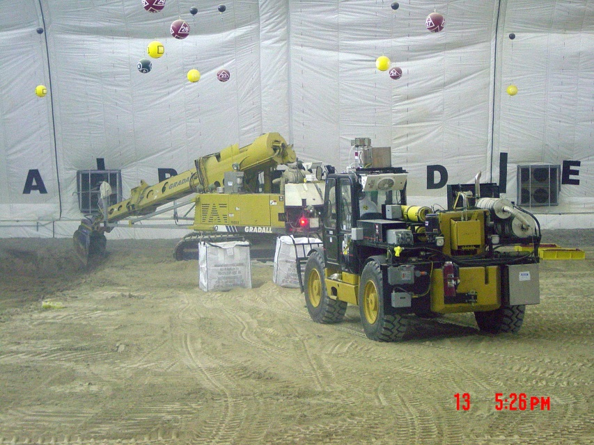
Idaho Cleanup Accomplishments
Using specially-equipped excavators, our contractors have safely exhumed over 7,500 cubic meters of targeted buried waste (near right).
The photo at far right shows how clean an emptied high-level waste tank is after washing.
In addition to the exhumation of over 7,500 cubic meters of targeted buried waste at a pace well ahead of the regulatory schedule, DOE’s contractors have also removed 243,205 pounds of volatile organic vapors from the Vadose Zone above the aquifer.
We have safely emptied, cleaned and closed 11 of 15 high-level waste storage tanks on site.
Over 50,000 cubic meters of the original 65,000 cubic meter inventory of stored transuranic waste has been safely and efficiently retrieved, repackaged, characterized and shipped off-site for disposal.

Slide 14
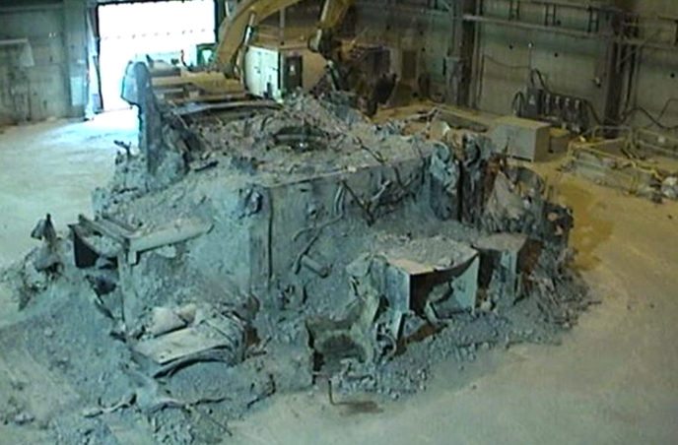
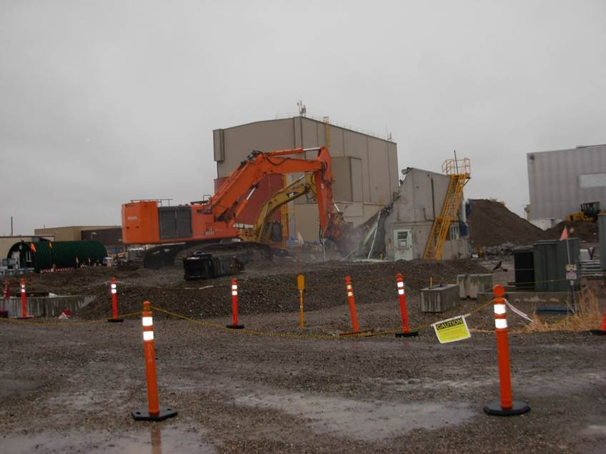
Idaho Cleanup Accomplishments (continued)
Among facilities decontaminated, decommissioned and demolished at the Idaho Site were this nuclear reactor (left) and the Sodium Boiler Building (right) at the Materials and Fuels Complex.
Our contractors have decommissioned over 200 contaminated buildings and structures, including three nuclear reactors, the largest hot cell in North America and facilities at the former spent nuclear fuel reprocessing facility.
Contractors completed CERCLA prescribed cleanup activities at five of the 10 Waste Area Groups on site.
The Department has invested over $8.4 billion in cleanup and waste management activities in Idaho over the past 20 years. This investment has resulted in a safer aquifer, significantly less waste in Idaho, and safer storage of the waste that remains.

