Slide 1
Idaho Cleanup Project Update
Jack Zimmerman
Deputy Manager
Idaho Cleanup Project
April 21, 2017

Slide 2
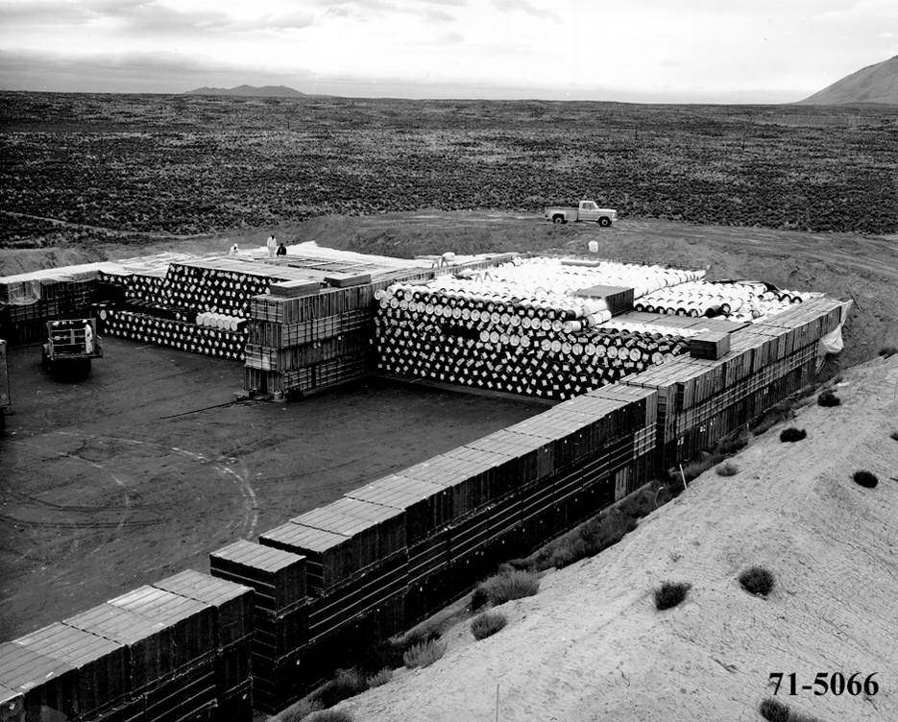
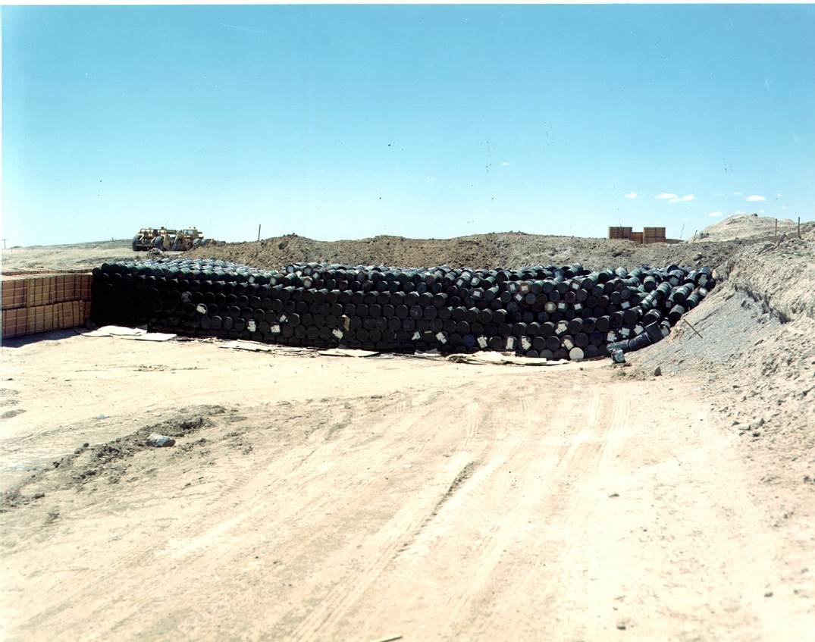
Stored Transuranic Waste
Background:
From 1970 to 1984, DOE’s Idaho Site received and stored about 65,000 cubic meters of transuranic waste from other sites.
Waste was stacked on an asphalt pad, then covered with an earthen berm.
In the 1990s, a large retrieval building was constructed over the berm.
In 2003 DOE’s contractor began the task of retrieving the waste so it could be characterized, repackaged, certified and shipped off-site for disposal.

Slide 3
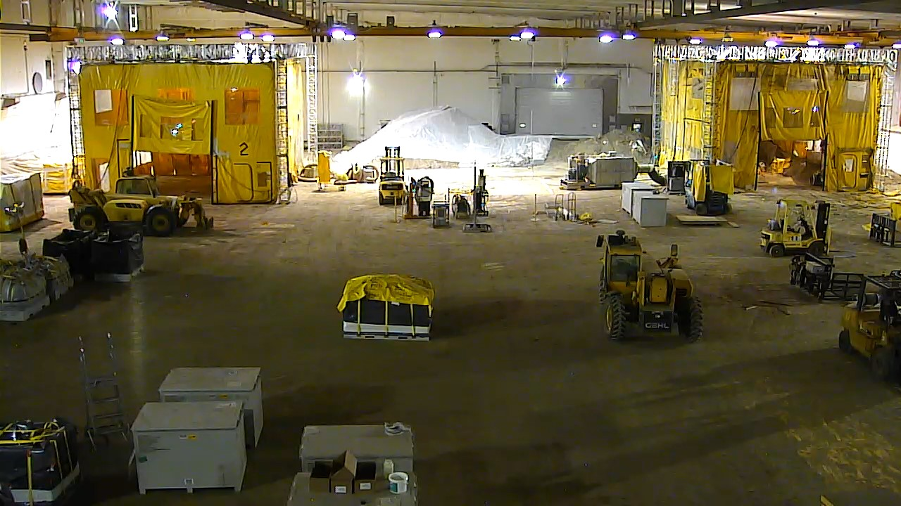
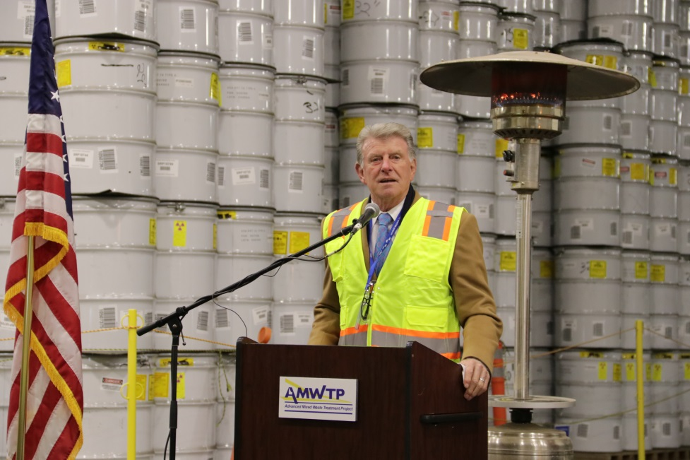
Completion of Stored Waste Retrieval
The last of the 65,000 cubic meters of stored transuranic waste was retrieved in February of this year.
Idaho Gov. Otter and other state officials attended
celebration on
March 2, 2017.
The last box remaining to be retrieved (above); Gov. Otter at ceremony marking completion (left).

Slide 4
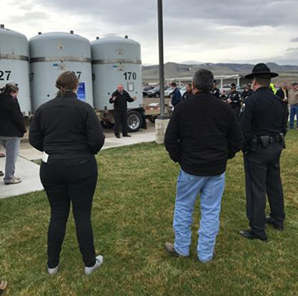
Shipping Transuranic Waste
Background:
DOE’s Idaho Site is the largest shipper of transuranic (TRU) waste to the Waste Isolation Pilot Plant (WIPP) in New Mexico for disposal.
The Idaho Site has shipped more than 51,000 cubic meters of waste to WIPP and other licensed facilities for off-site disposal.
In 2014, an underground fire and a radiation release at WIPP caused the repository to temporarily close. Consequently, shipments from Idaho to WIPP ceased in February, 2014.
Idaho State trooper Tony Anderson talks to attendees at the kick-off of the WIPP Road Show for the western corridor shipping route at Fort Hall on March 27, 2017.

Slide 5
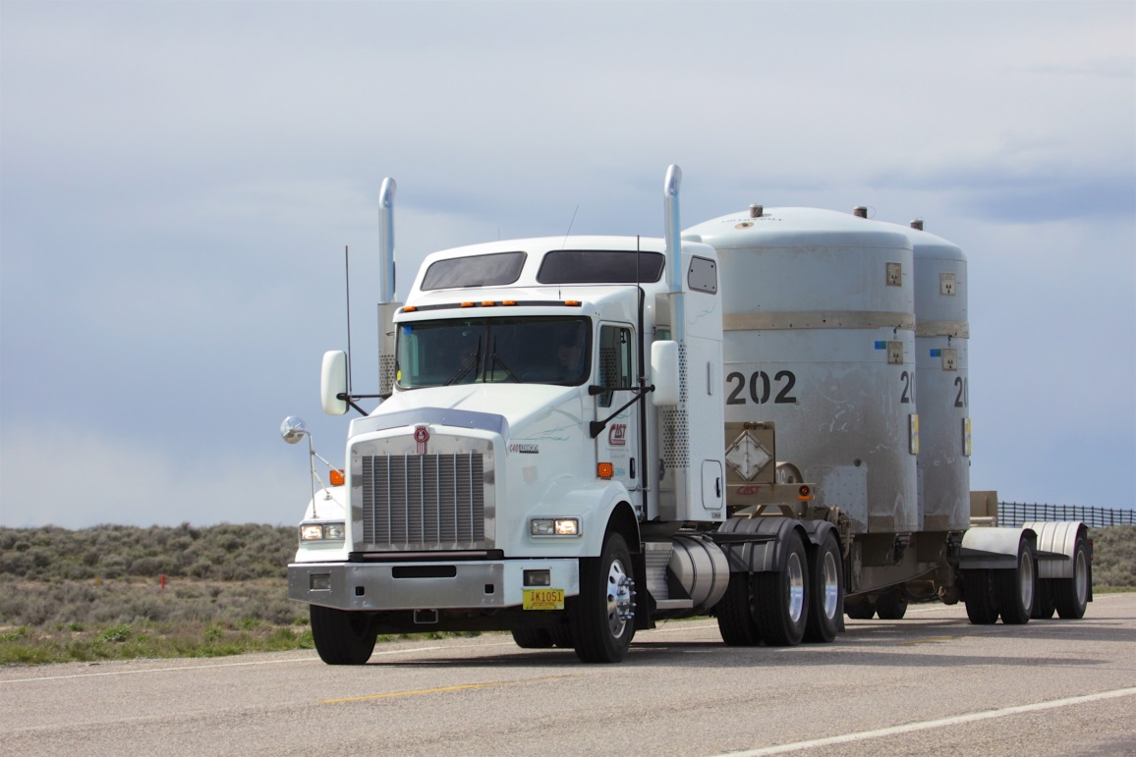
Resuming WIPP Shipments
After a three-year hiatus, Idaho resumed shipping to WIPP on April 6, 2017.
DOE resumed shipping transuranic waste from the Idaho Site to WIPP on April 6, 2017. We are anticipating 60 more shipments to WIPP between now and next January.
We are in the process of verifying that all previously certified containers meet the new criteria for safe disposal at WIPP.
We also have about 10,300 cubic meters of waste that remain to be treated and shipped for disposal.

Slide 6
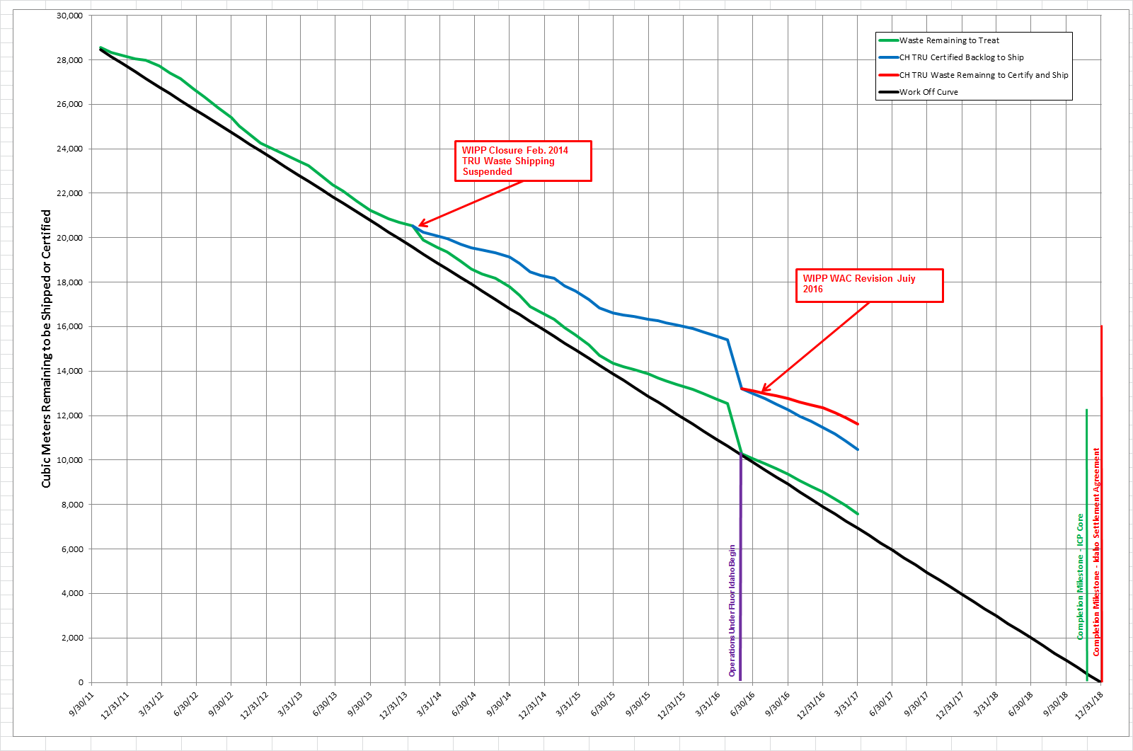
Settlement Agreement TRU Production Status
Notes:
28,700 m³ estimated remaining inventory as of Oct. 1, 2011 *Counts cargo container void volume, which is not reported for Regulatory compliance.
Re-evaluation of the volume remaining to process on May 31, 2016 was 10,300m³, which excludes overpack volumes (e.g. cargo containers, overpacked drums, overpacked boxes, etc.)
Projection of current production demonstrates risk to compliance with ISA
Projection shows completion near Dec. 31, 2018 if current production rate is increased
Does not account for increasing difficulty of waste to be treated or increasing facility downtime
Total Production through March 31, 2017 – 20,012m³
Remaining Volume to Process – 8,688m³
Volume Remaining to Treat – 7,566m³
Challenges Facing Project Today:
Facility Availability --With North Box Line on-line, Jan. 5, 2017 the facility availability issues have been resolved.
Feed Availability – Due to limited amount of characterized waste in front of treatment processes.
Challenging Waste – High fissile, Roaster Oxides, Oversized Containers, etc.

Slide 7
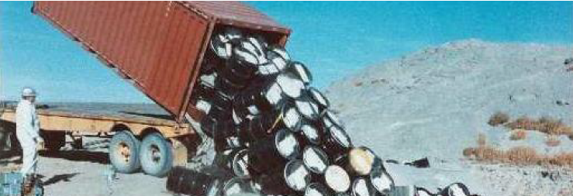
Buried Transuranic Waste
Background:
From 1954 to 1970, the Atomic Energy Commission’s contractors disposed of both transuranic and mixed low-level radioactive waste in unlined pits and trenches at the Idaho Site.
Under cleanup agreements reached with the State of Idaho and the Environmental Protection Agency, DOE and its contractors must remove targeted transuranic waste from at least 5.7 acres of the burial ground, and must retrieve and ship at least 7,485 cubic meters of targeted waste out of Idaho by the end of 2023.
The agreements also require a cap over the burial ground, and continued monitoring and evaluation of the burial site and the aquifer.

Slide 8
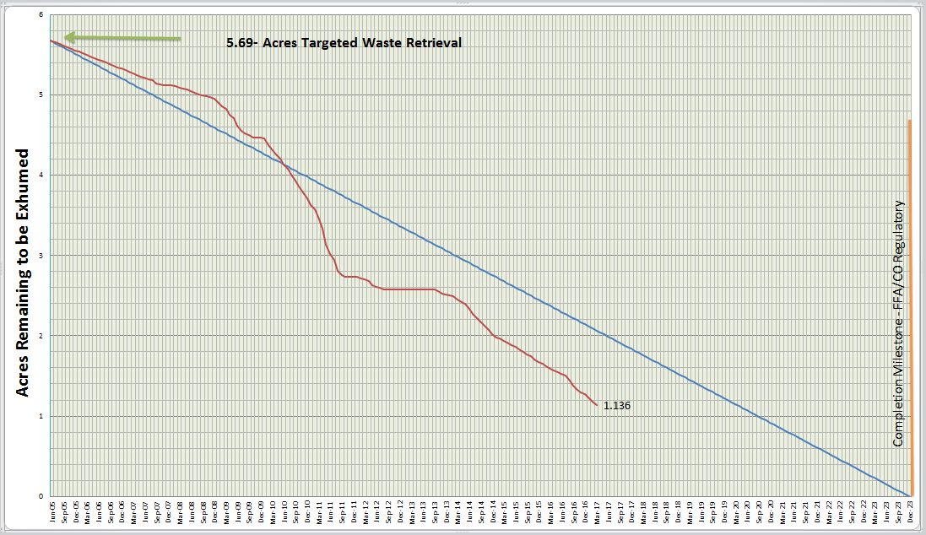
Buried Waste Exhumation
Retrieval of targeted buried waste remains ahead of schedule.
Construction of the last retrieval enclosure should be finished this spring.
Design work has begun on the cap for the burial ground.

Slide 9
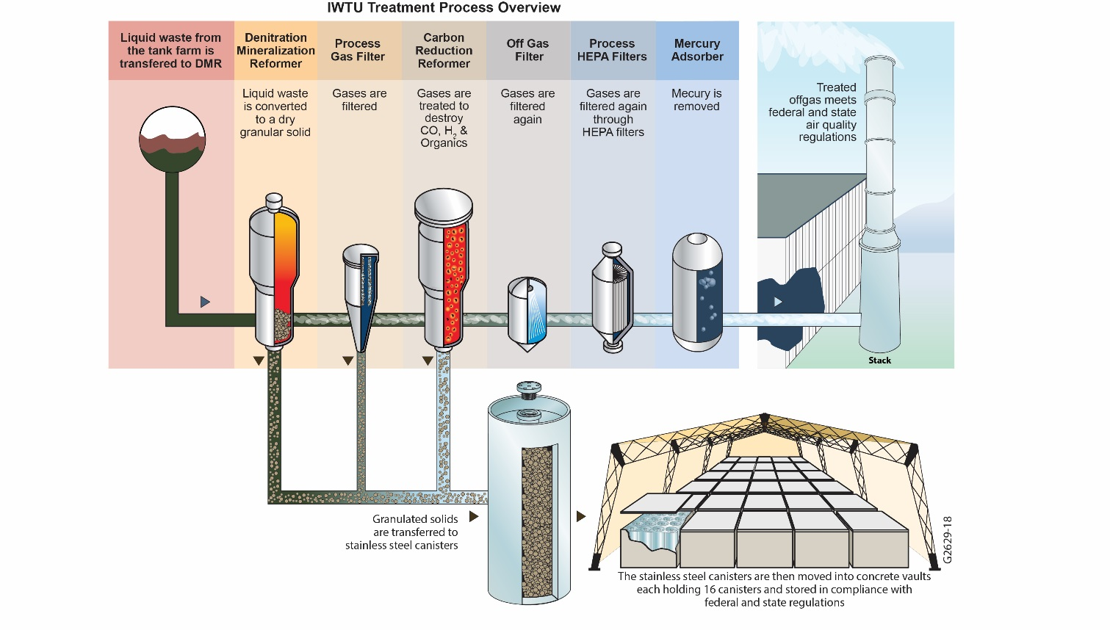
Liquid Waste Treatment
Background:
There are about 900,000 gallons of liquid radioactive waste stored in three stainless steel underground tanks at the Idaho Nuclear Technology and Engineering Center.
Our regulatory agreements required this waste be solidified and the liquid waste tanks closed by December 31, 2012.
The Integrated Waste Treatment Unit was constructed to treat the waste, but design and mechanical problems have prevented the beginning of waste treatment.

Slide 10
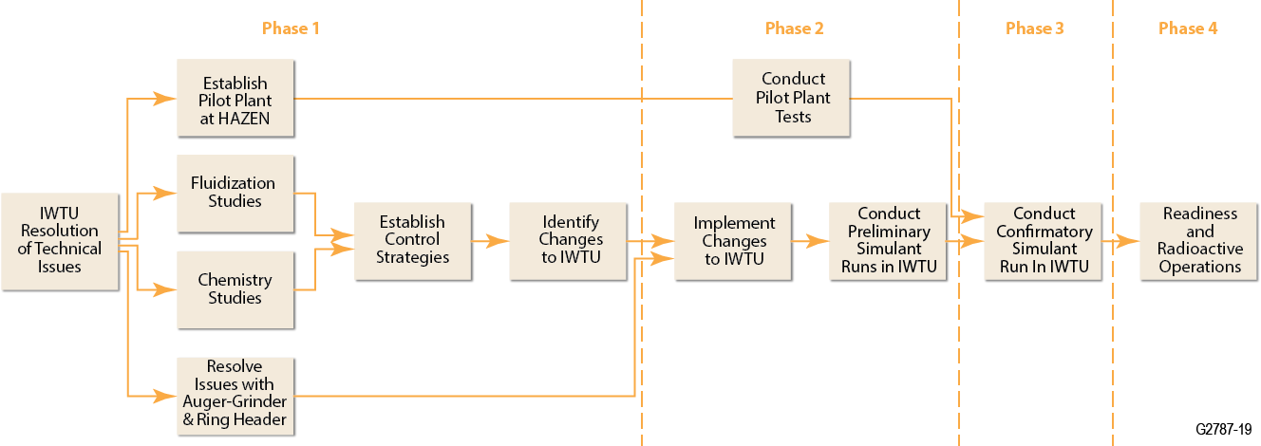
Fluor Idaho IWTU Phased Approach
Phase 1
Phase 2
Phase 3
Phase 4
COMPLETE
In Progress
Completed Phase 1 in late October and are making notable progress during Phase 2.

Slide 11
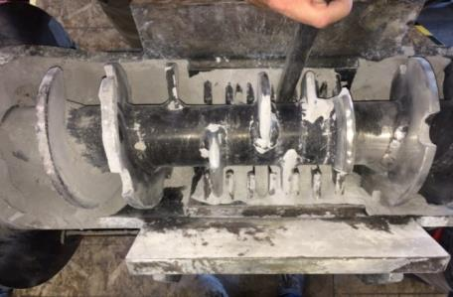
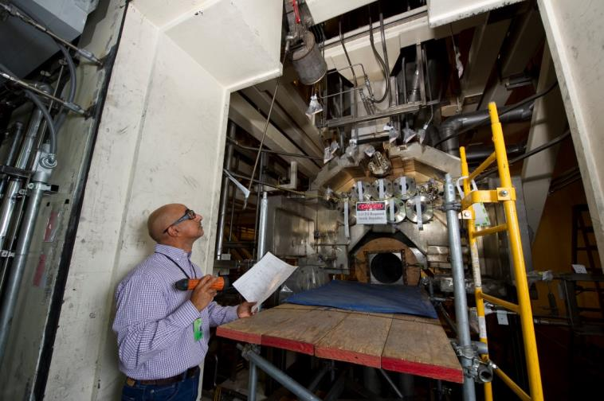
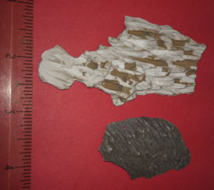
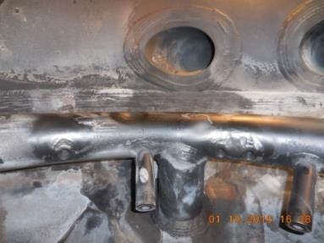
Phase 1 Results Are Shaping Phase 2 Activities
The IWTU challenges can be broken down into two distinct areas:
Chemical/fluidization – mainly associated with “sand castling,” the fluidization process, and wall scale in the Denitration Mineralization Reformer (DMR).
Mechanical/equipment –primarily in relation to the auger-grinder and ring header.

Slide 12
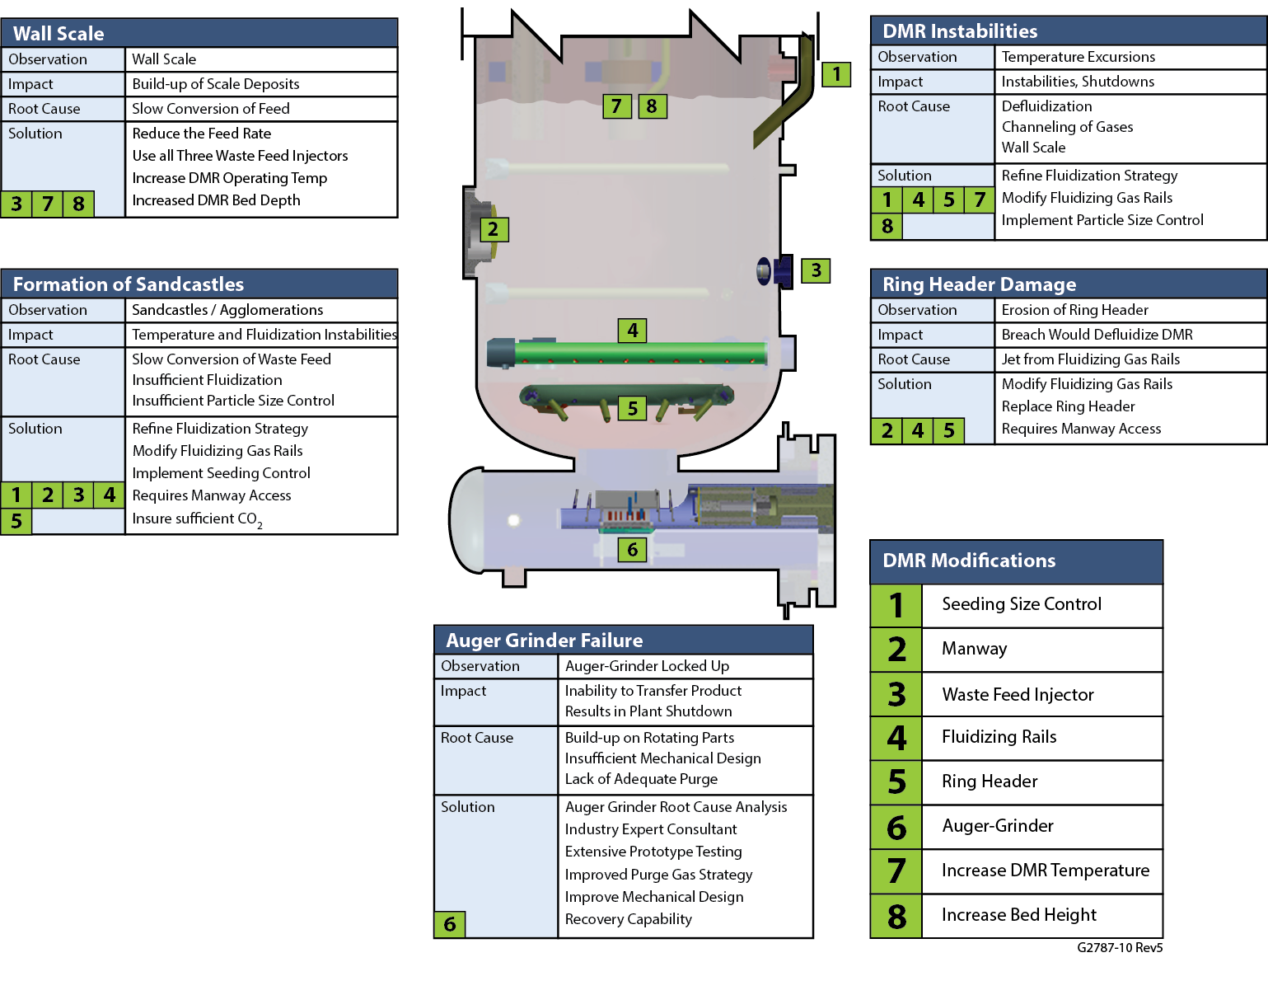
Issues Addressed by Simulant Runs – All Issues with DMR
Mike Swain/Leo Thompson
Runs
1-3
Runs
1-3
Run
2
Runs
1-3
Auger-Grinder:
Primary Focus of Simulant Run 1
Run
1

Slide 13
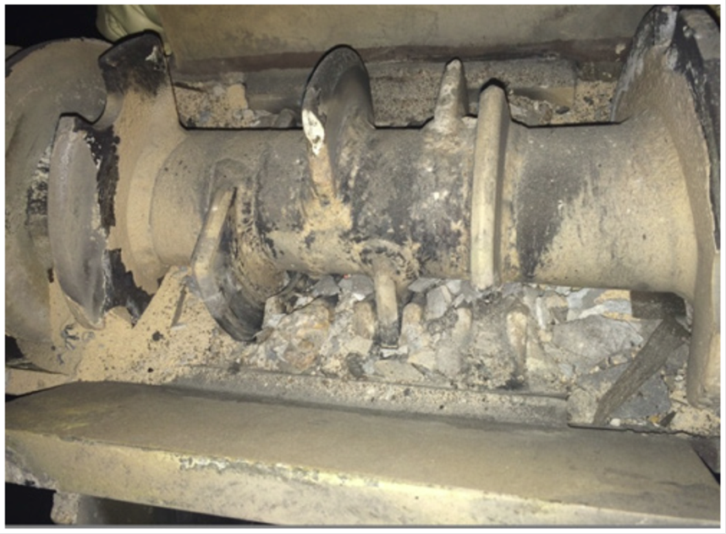
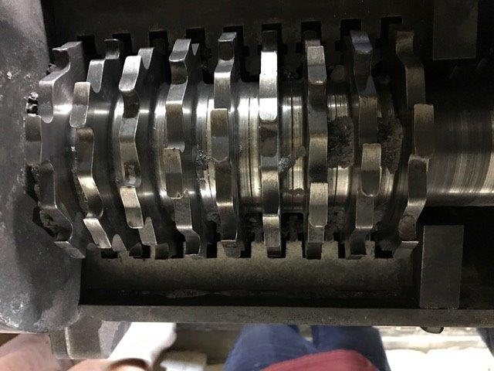
Resolution of Mechanical/Equipment Challenges
In past waste simulant runs, the auger-grinder performed poorly or failed.
  A cementitious material formed inside the auger-grinder causing it to seize.
A modified auger-grinder was fabricated with more aggressive blades and a higher horsepower motor.
  Simulant Run 1 of Phase 2 showed significant performance improvements with respect to torque and flow.
Original design of auger-grinder after May, 2016 simulant run (above)
Newly designed auger-grinder after March, 2017 simulant run (right).

Slide 14
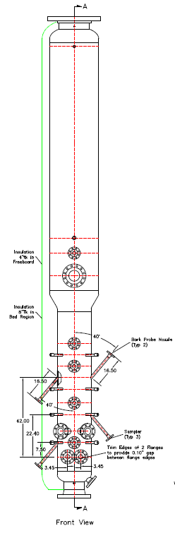
Use of Hazen to Resolve Chemical/Physical Challenges
Testing at Hazen, Colo. facility using a 2-inch-diameter DMR bench-scale unit and an 18-inch diameter DMR pilot plant:
  Allows testing waste feed rates and determining the optimum rate for simulant conversion to a solid.
  Allows better understanding of the correlation between feed rate and wall scale formation.
  Supports larger-scale study of fluidization and temperature variations inside the reaction vessel.
18-in dia
DMR
vessel
design
(Above) 18-in diameter DMR vessel (left) and Process Gas Filter (right)

Slide 15
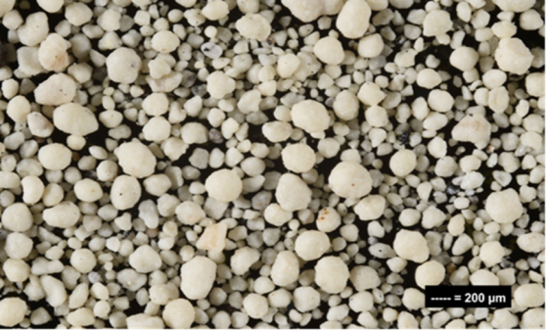
Phase II, Simulant Run 1
The primary objective of Phase II, Simulant Run 1 was to test the new auger-grinder.
  Newly redesigned auger-grinder operated as designed.
  More than 18,000 gallons of simulant were converted to a granular solid and were successfully transferred by the auger-grinder.
  No indication of cementation or seizing.
Some of the same chemistry/physical challenges within the DMR were noted during Simulant Run 1, however this was anticipated.
  Such issues will be addressed through equipment modifications, replacement, and additions during the outage, and tested during Simulant Run 2.
Product generated during most recent simulant run.

Slide 16
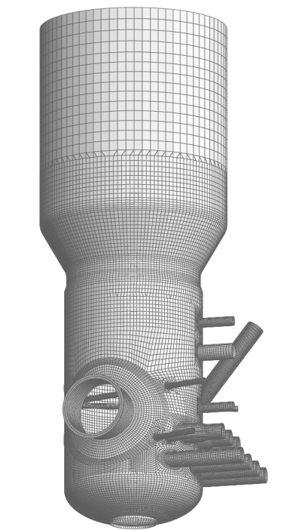
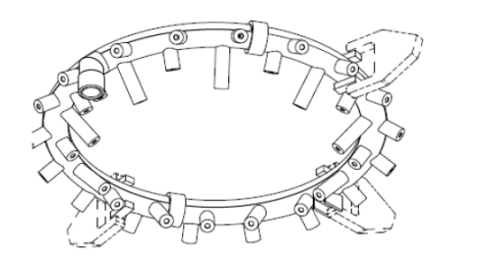
Upcoming Mechanical/Equipment Changes
During this spring/summer, the DMR will be modified to allow access to the interior of the vessel.
The ring header, damaged due to fluidizing jet impingement during the December 2015 simulant run, needs to be replaced.
A gas heater, associated piping, and controls will be installed to allow the introduction of carbon dioxide and nitrogen gases inside the DMR ring header.
  Will improve the chemical reactions and fluidization of media and granular waste product.
Manway
Access
Ring Header

Slide 17
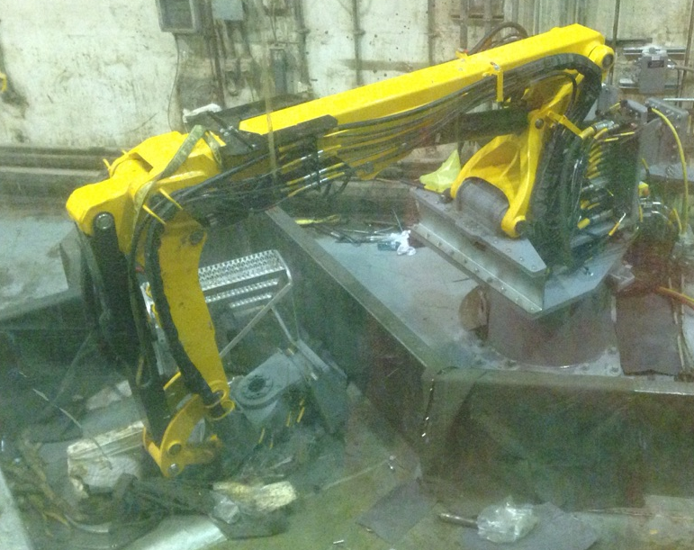
Future of Advanced Mixed Waste Treatment Plant
New equipment, like this Brokk 4000 robotic arm, could be utilized in a continuing AMWTP future mission to treat waste from off-site.
Treatment of Idaho transuranic waste will be completed by Dec. 31, 2018.
DOE has identified quantities of transuranic waste at other DOE sites that could be treated at AMWTP prior to shipment to WIPP for disposal.
Using AMWTP treatment capabilities could be more economical than constructing comparable treatment capabilities at these sites around the country.
DOE continues to review internal studies on potential for using AMWTP to treat off-site wastes after the Idaho mission is complete.

Slide 18
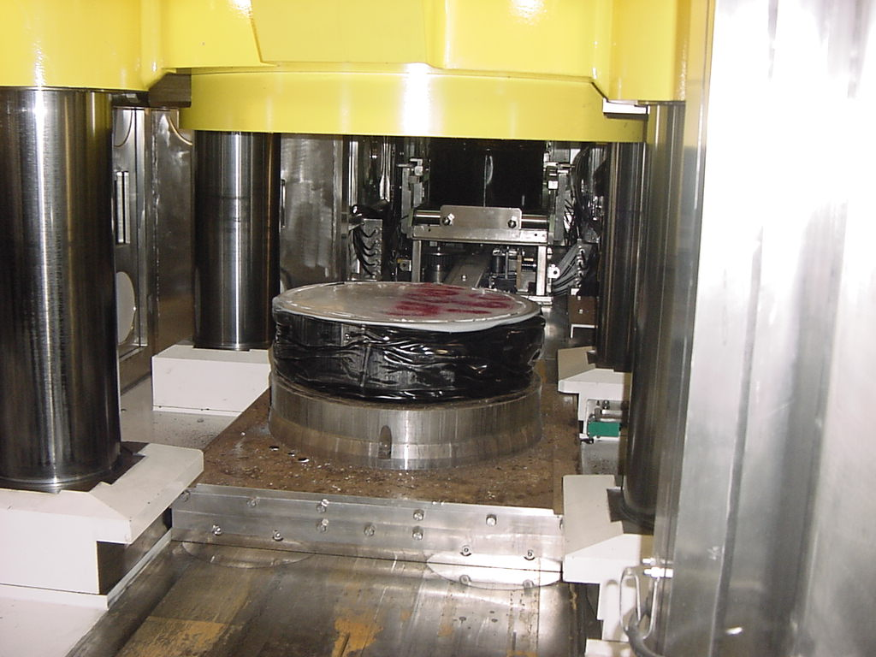
Future of Advanced Mixed Waste Treatment Plant
The Idaho Settlement Agreement allows DOE to treat out-of-state waste from other facilities at AMWTP, as long as it is treated within 6 months of receipt, and shipped out of Idaho within 6 months of treatment.
Senior DOE management will determine, with appropriate government and other stakeholder input, whether to pursue future mission.
AMWTP waste compactor is key element of plant’s ability to treat transuranic wastes for off-site disposal.

