Slide 1
GAIN Gateway for Accelerated Innovation in Nuclear
Dr. Rita Baranwal Director, GAIN
LINE Commission Meeting
April 21, 2017

Slide 2
“There’s a way to do it better. Find it.”
- Thomas Edison
@GAINnuclear

Slide 3
Things we’ll talk about today
What is GAIN?
Activities To Date
Recent Successes
Versatile Test Reactor
Future Activities
@GAINnuclear

Slide 4
What is the GAIN Initiative? Gateway for Accelerated Innovation in Nuclear
What are the issues?
What do we need to do?
What is the DOE initiative?
Time to market is too long
Facilities needed for RD&D are expensive
Capabilities at government sites have not been easily accessible
Technology readiness levels vary
Some innovators require assistance with regulatory processes
Provide nuclear innovators and investors with single point of access into DOE complex
Provide focused research opportunities and dedicated industry engagement
Expand upon DOE’s work with Nuclear Regulatory Commission (NRC)
Public-private partnership, dedicated to accelerating innovative nuclear energy technologies time to market
DOE recognizes the magnitude of the need, the associated sense of urgency and the benefits of a strong and agile public-private partnership in achieving the national goals.
Notes:
National and global demand for nuclear energy is increasing and U.S. global leadership is eroding
There is a sense of urgency with respect to the deployment of the innovative nuclear energy technologies
An effective private-public partnership is required to achieve the goals

Slide 5
GAIN Vision
By 2030,
The U.S. nuclear industry is equipped to lead the world in development of innovative nuclear technologies to supply urgently needed abundant clean energy both domestically and globally.
GAIN is,
A public-private partnership framework aims at rapid and cost-effective development of innovative nuclear energy technologies towards market readiness.
@GAINnuclear

Slide 6
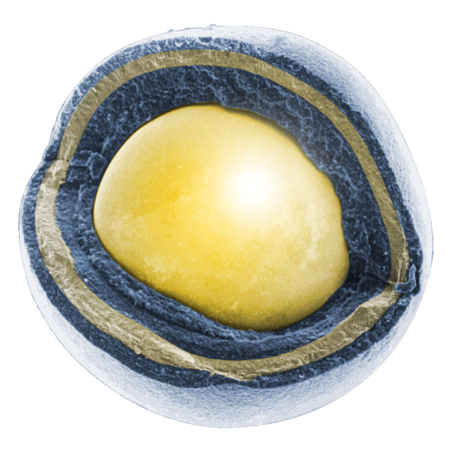
GAIN Mission
Mission:
Provide the nuclear energy industry with access to technical, regulatory and financial support necessary to move innovative nuclear energy technologies toward commercialization in an accelerated and cost-effective fashion
GAIN is:
The organization principle for relevant, federally-funded nuclear energy RD&D programs.
@GAINnuclear
TRISO Fuel Particle

Slide 7
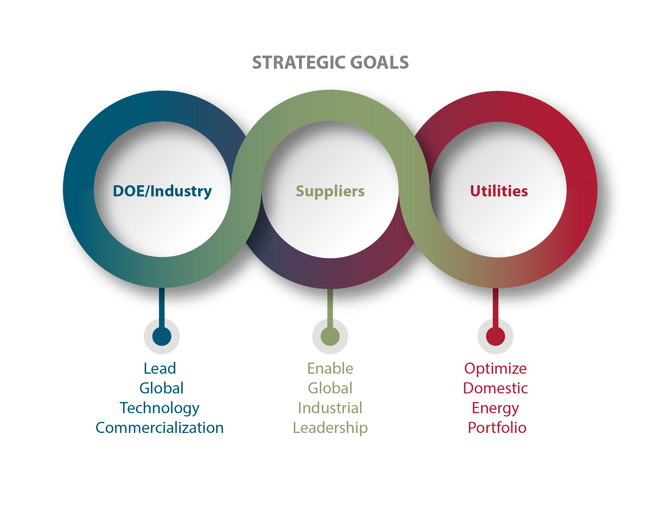
GAIN Initiative: Simultaneous Achievement of Three Strategic Goals
@GAINnuclear
Notes:
National and global demand for nuclear energy is increasing and U.S. global leadership is eroding
There is a sense of urgency with respect to the deployment of the innovative nuclear energy technologies
An effective private-public partnership is required to achieve the goals
Achievement of GAIN’s Strategic Goals will bridge the gap between technology leadership and industrial leadership.

Slide 8
GAIN Organization

Slide 9
GAIN: Organizing Principle for DOE-NE RD&D Programs Through Comprehensive Systems Analysis
@GAINnuclear

Slide 10
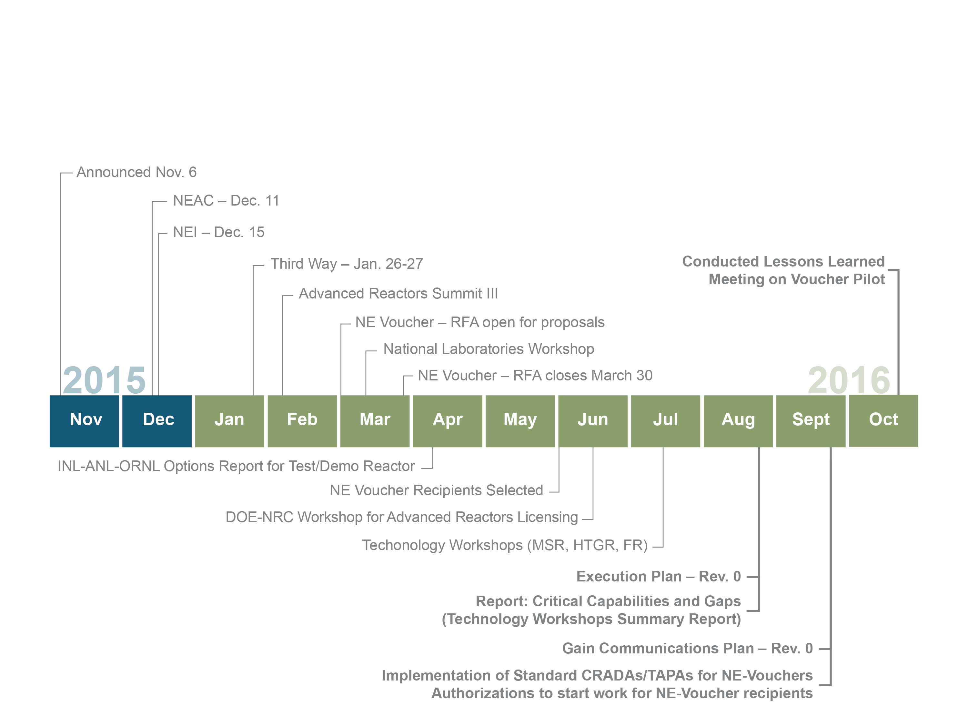
GAIN First Year Successes
@GAINnuclear

Slide 11
Activities to Date
GAIN Operations
Established small, agile organization
Issued GAIN Execution Plan
Issued Technology Specific Workshops Summary Report
Implemented Standard CRADAs/TAPAs for NE vouchers
GAIN Outreach
Presented GAIN to multiple conferences/meetings to solicit input from stakeholders
Organized 3 Technology Specific Workshops (with NEI and EPRI) to solicit input on private-sector R&D needs for DOE-NE R&D program
Conducted 2 Modeling & Simulation workshops
Model for additional future workshops
@GAINnuclear

Slide 12
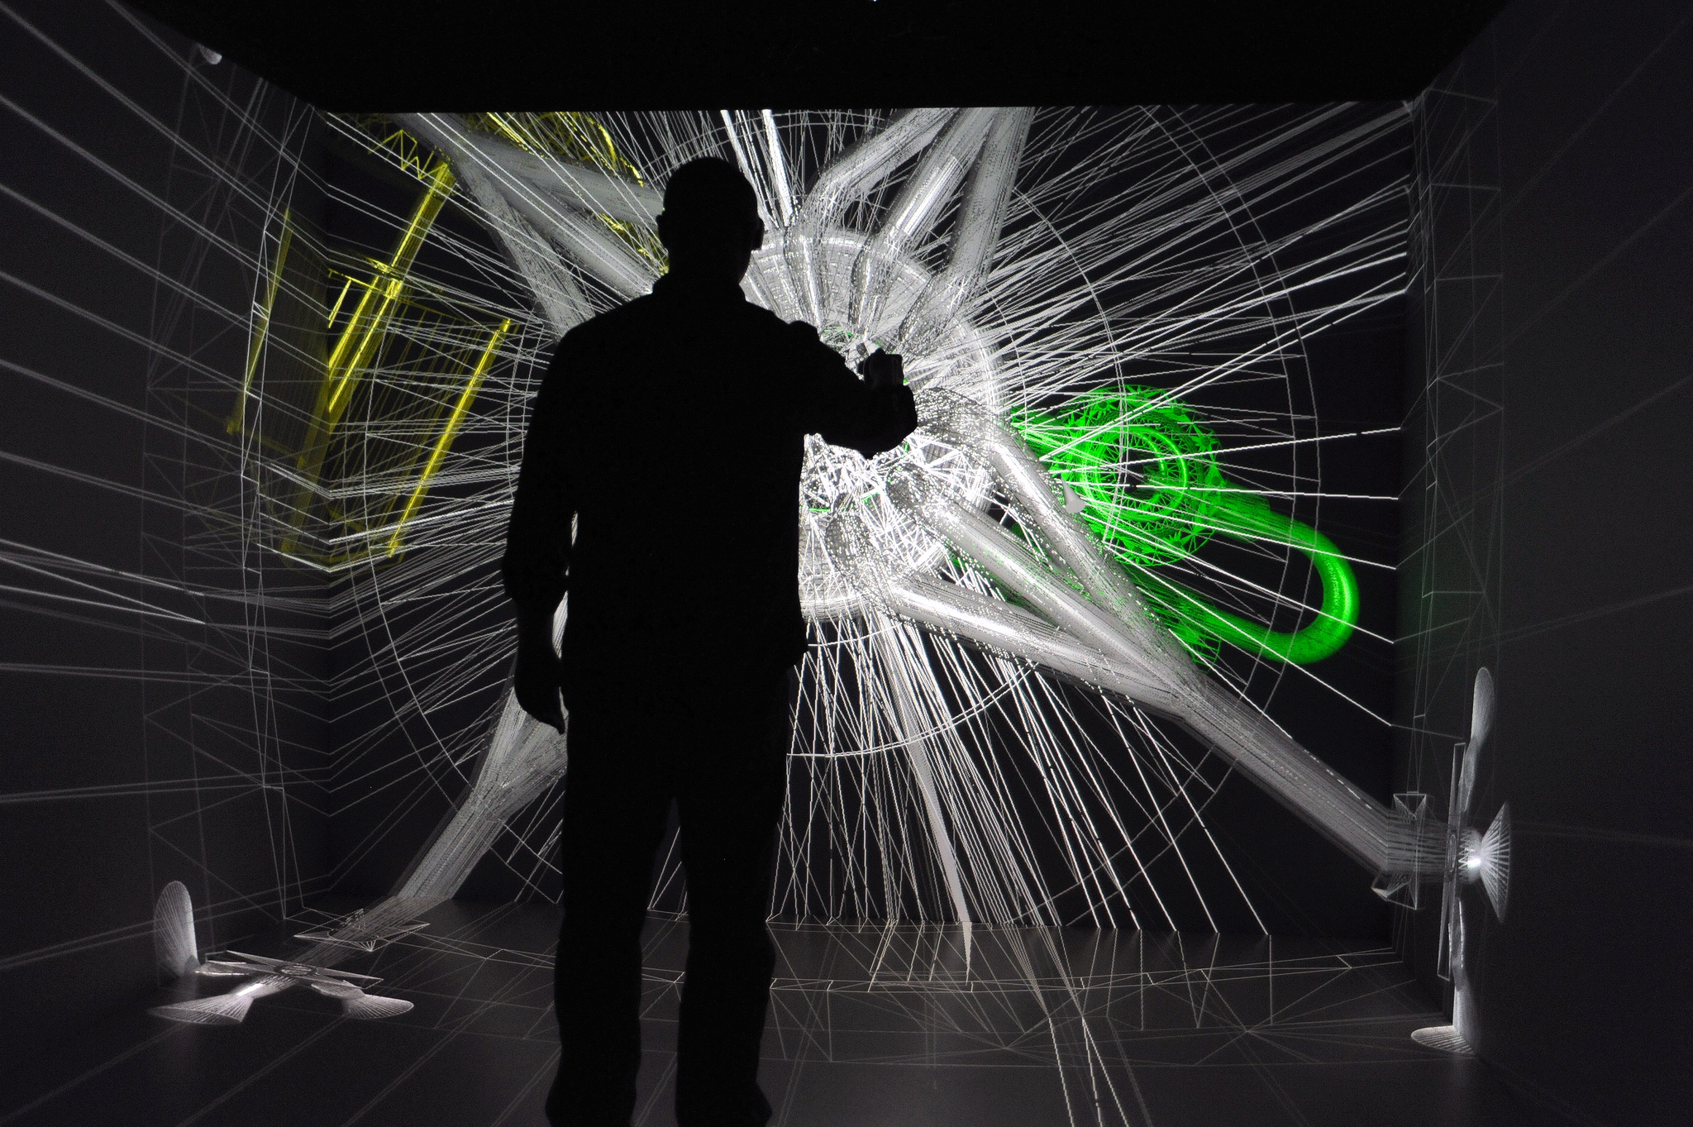
Activities to Date (Continued)
Awarded $2M USD to developers in pilot NE Voucher Program
Initiated industry-led, laboratory-supported expert group for advanced reactor licensing framework development
Submitted FY 2018-2022 DOE-NE RD&D funding request
Engineering teams can use the 3-D Computer-Assisted Virtual Environment (CAVE) at INL's Center for Advanced Energy Studies to tour a virtual nuclear reactor and consider new designs.

Slide 13
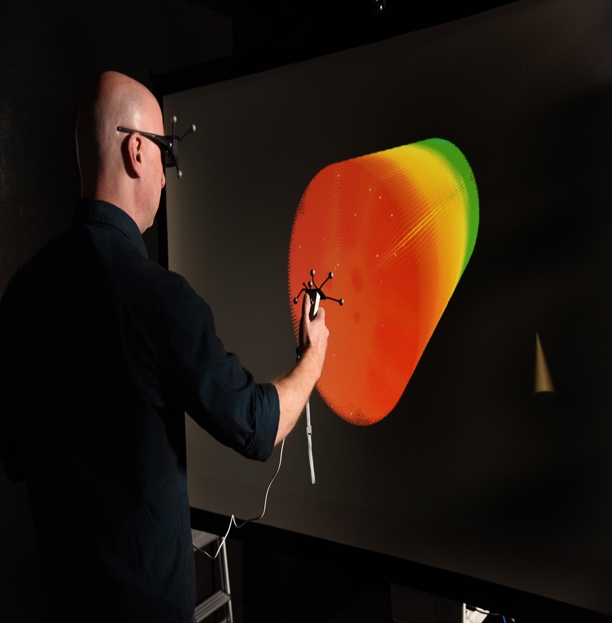
Early Successes: NE Voucher Program
Eight Small Businesses were awarded for the 2016 pilot (~$2M total)
Goal: Assist small businesses in accelerating development and deployment of innovative nuclear technologies by granting access to extensive nuclear research capabilities available at DOE’s national laboratories and Nuclear Science User Facilities (NSUF) partners
2017 voucher call will award ~$4M
32 proposals, 9 with INL partner
A stereo wall, also know as a portable Inexpensive interactive Immersive Interface Station (IQ-Station) at the Center for Advanced Energy Studies (CAES).
@GAINnuclear

Slide 14
NE Voucher recipients | Proposal | Partner Facility
Creare LLC Hanover, NH | Investigation of Materials for Continuous Casting of Metallic Nuclear Fuel | Idaho National Laboratory
Columbia Basin Consulting Group, LLC Kennewick, WA | Lead-Bismuth Small Modular Reactor (SMR) Licensing Development | Pacific Northwest National Laboratory
Terrestrial Energy USA Ltd. New York, NY | Verification of Molten-Salt Properties at High Temperatures | Argonne National Laboratory
Transatomic Power Corporation Cambridge, MA | Optimization and Assessment of the Neutronics and Fuel Cycle Performance of the Transatomic Power Molten Salt Reactor Design | Oak Ridge National Laboratory
Ceramic Tubular Products Rockville, MD | Robust Silicon Carbide Cladding for LWR Application - Corrosion and Irradiation Proof Test of Low Cost Innovations in MIT Research Reactor | Massachusetts Institute of Technology
Oklo Inc. Sunnyvale, CA | Legacy Metal Fuel Data Exploration for Commercial Scale-Up | Argonne National Laboratory/Idaho National Laboratory
CompRex, LLC De Pere, WI | High Efficiency Heat Exchanger for High Temperature and High Pressure Applications | Argonne National Laboratory
BgtL LLC Laramie, WY | High efficiency and low cost thermal energy storage system | Argonne National Laboratory

Slide 15
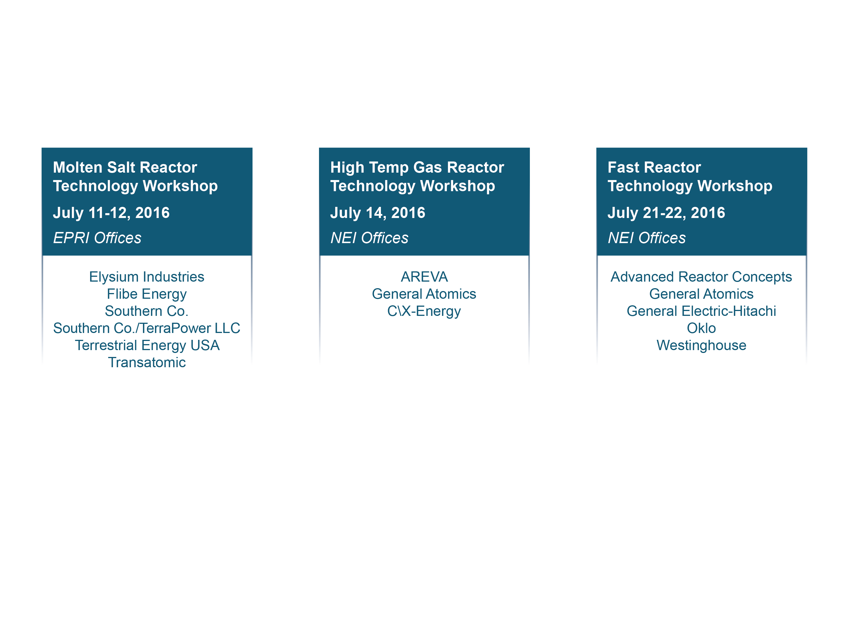
Technology-Specific Workshops
Hosted by GAIN, NEI, and EPRI
Discussed RD&D needs of advanced nuclear energy technologies
Identified technical issues that DOE is uniquely suited to address
@GAINnuclear

Slide 16
Technology-Specific Workshops Collaboration
Formation of Industry-Led, Technology Working Groups (TWGs)
Initial meetings held in September 2016
Molten Salt Reactor
Fast Reactor
High Temperature Gas Reactor
Roles and Responsibilities
EPRI: Engage with subject matter experts & stakeholders
Define gaps in M&S code development and V&V for design and licensing for advanced reactor technologies
NEI: Facilitate and coordinate activities of TWGs with those of NEI Advanced Reactor Working Group (ARWG)
Coordinate with GAIN and EPRI to support working groups
Work with industry, DOE, and NRC to understand issues associated with obtaining 5% < enriched uranium <20%

Slide 17
Technology-Specific Workshops: High-priority recommendations to DOE on cross-cutting RD&D
Access to Applied Technology (AT) documents
Create database of AT-marked documents
Streamline access to AT documents, removing AT designation where appropriate
M&S Code Development and V&V for Design and Licensing
Describe DOE-NE’s advanced M&S tools
Develop plans for additional code development to address gaps
Develop joint strategy with stakeholders for V&V of advanced tools
Develop join strategy with NRC for V&V and usage of advanced tools for licensing analysis
Advanced Reactors Licensing Framework
Accelerate joint work with NRC for advanced reactor licensing
General design criteria
Gradual reduction of licensing risk
Risk-informed and performance-based licensing strategy

Slide 18
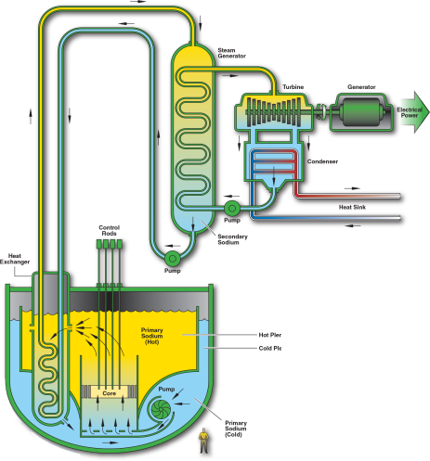
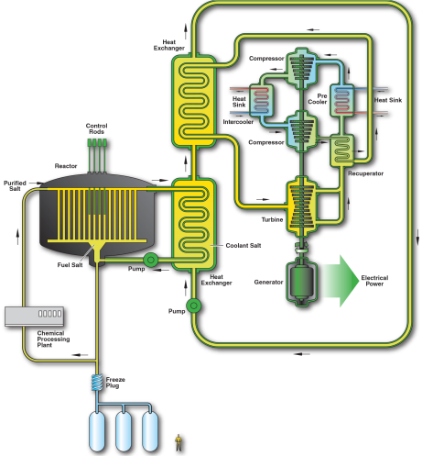
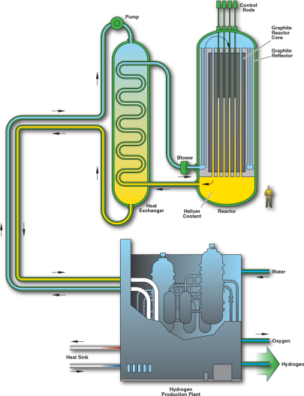
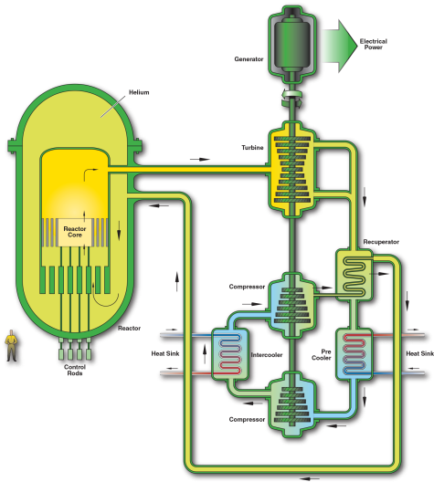
Technology-Specific Workshops: High-priority recommendations to DOE on design-specific technology
Molten Salt Reactor Technology
Identify alternatives to critical-system demonstration for meeting all identified data needs using different and simpler options
Fast Reactor Technology
Complete options and requirements assessment for domestic fast spectrum test reactor
High Temperature Gas Reactor technology
Complete on-going TRISO fuel and graphite qualification program
SFR
MSR
VHTR
GCR
@GAINnuclear

Slide 19
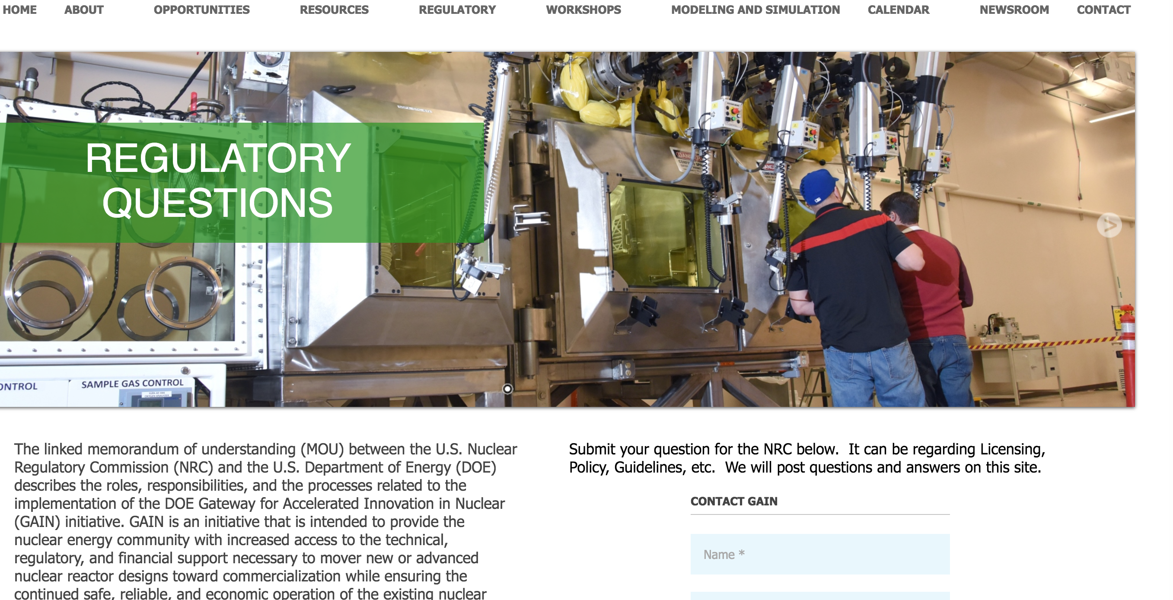
Recent Successes
Regulatory:
MOU between NRC and DOE on GAIN, November 10, 2016
NRC provides DOE and GAIN community with current, accurate information on NRC licensing processes and regulations
GAIN website:
@GAINnuclear

Slide 20
Recent Successes
Facilities:
MOU between DOE and SCK•CEN (Belgian Nuclear Research Centre). Enables collaboration of future irradiations and PIE at:
BR-2
LHMA (Laboratory for High and Medium Activity)
ATR
TREAT
NSUF
Modeling & Simulation Workshops:
In December 2016 and January 2017, GAIN-EPRI hosted workshops focused on computational methods:
Industry outlined its computational needs
DOE outlined its computational abilities
Educated numerous advanced reactor companies on entire suite of national labs’ computational tools
@GAINnuclear

Slide 21
Versatile Test Reactor Options Study
INL, ANL and ORNL held in-depth visits to potential industrial U.S. users from vendor and designer community (INL/MIS-16-40582, Versatile Irradiation Test Reactor User Needs Assessment, November 29, 2016.)
Industry expressed needs that could be served by new fast-spectrum test reactor
qualification of fuel
qualification of fuel manufacturing processes
demonstration of fuel performance
extension of useful lifetime of materials under irradiation
corrosion behavior of materials under irradiation
Nuclear Energy Advisory Committee (NEAC) issued recommendation to proceed with a test reactor.
NEAC used similar process to obtain user feedback on need for new test reactor
@GAINnuclear

Slide 22
Versatile Reactor-based Fast Neutron Source (VRFNS) R&D Mission and Vision
VRFNS Research and Development (R&D) Mission:
Conduct R&D to create a concept for an unparalleled experimental capability to enable understanding of materials performance under extreme irradiation environments
VRFNS R&D Vision:
Through experimental, theoretical and computational advances, provide the materials and fuels science community with unprecedented research capability to enable a comprehensive understanding of the multi-scale and multi-physics performance of materials under extreme radiation environments

Slide 23
VRFNS R&D Scope and Goals
VRFNS R&D Scope
Perform a three-year R&D activity to create a viable Versatile Reactor-based Fast Neutron Source reactor, experimental, and support capability concept and associated cost range
VRFNS R&D Goals
Within 3 years, complete documentation for a Versatile Reactor-based Neutron Fast Source concept demonstrating design, benefits, costs, and risks with associated acquisition strategy, cost estimate and timeline to inform DOE decision before proceeding to procurement

Slide 24
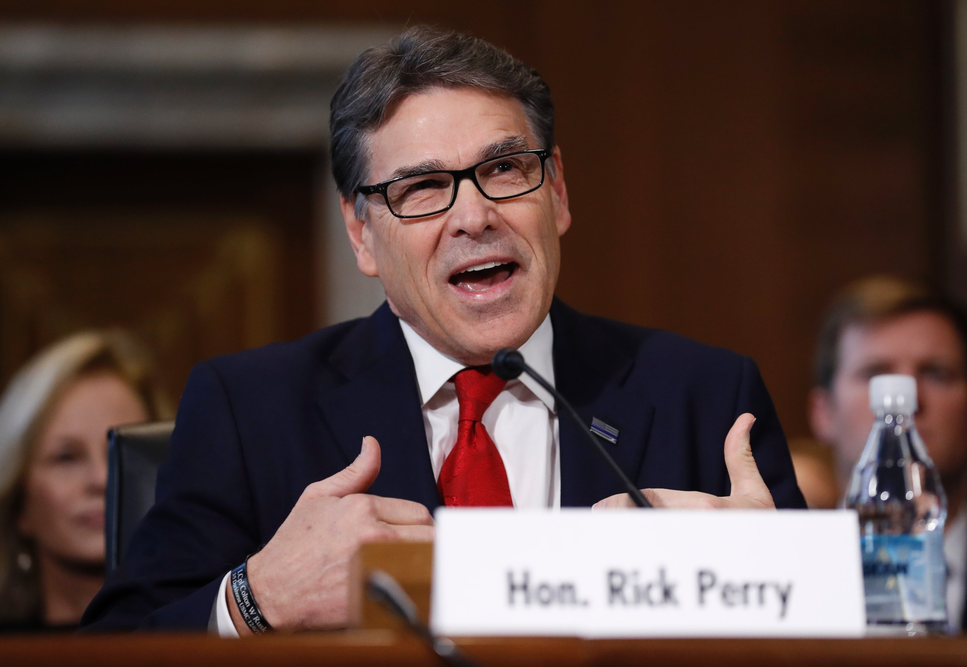
Future Activities 2017
From U.S. Senate Committee on Energy and Natural Resources January 19, 2017 Department of Energy Secretary Nomination Hearing: Responses to Questions for the Record:
Q: I’m interested to hear, what you will do, if confirmed, to work with the bipartisan group of Senators to continue to ensure that DOE is equipped with adequate funding to continue researching and developing these advanced reactor designs.
A: “Nuclear energy is a critical component of America’s energy future, and entrepreneurs are developing promising new technologies that could truly spur a renaissance in the United States and around the world. DOE, through the National Labs complex, maintains unique government facilities that can assist in the development of advanced nuclear energy technologies. The GAIN initiative provides the potential for public-private partnerships to thrive in the future. If I am confirmed, I look forward to learning more about how DOE can support advanced nuclear reactor development.”
Carolyn Kaster/AP Photo
@GAINnuclear

Slide 25
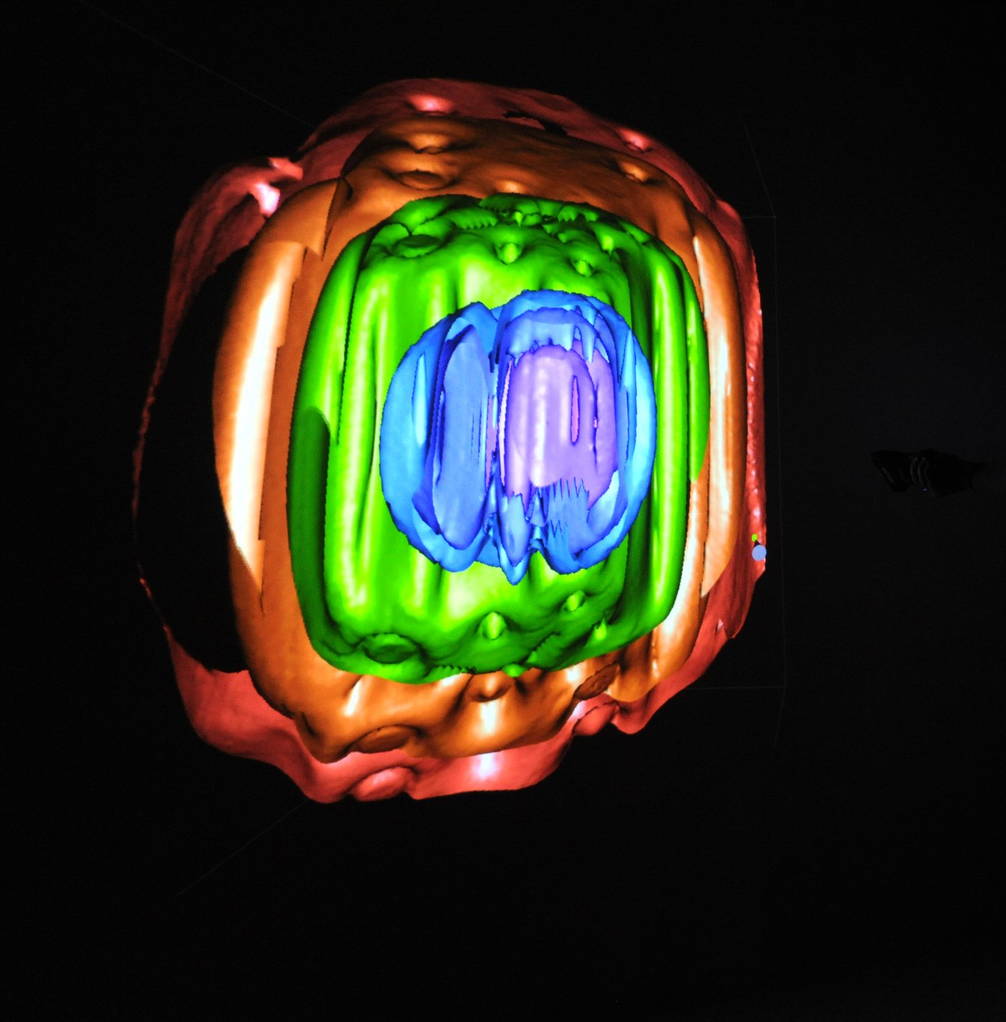
Future Activities 2017
Identify/develop Streamlined Contracting Process
Streamline and tailor DOE contracting mechanisms to meet GAIN goals
Identify candidate project and participants for multi-party CRADA (contracting pilot)
NE Voucher Activities
Second NE Voucher Call: Awards to be made by May 30, 2017
Support development of a flexible fast spectrum test reactor options study based on industry requirements
Neutron Flux Levels Modeling: Neutron flux levels generated in the core of INL's Advanced Test Reactor during operation. Neutron levels are highest in the blue and purple areas, and lower in the orange and red areas.
@GAINnuclear

Slide 26
Future Activities 2017-2018
Workshops:
Fuel Safety Research: May 1-4, 2017 at INL
Enabling Advanced Reactors for the Market: November 14-15,2017
Digital Environments: January 2018
Instrumentation & Controls
Advanced Manufacturing
Database/catalog:
Develop database of historical advanced-reactor documents to support knowledge transfer; facilitate access to key documents through OSTI
Create industry-accessible electronic catalog for modeling and simulation applications
Networking:
Create directory of advanced nuclear developers
@GAINnuclear

Slide 27
“The people who are crazy enough to think they can change the world are the ones who do.”
- Steve Jobs
@GAINnuclear

Slide 28
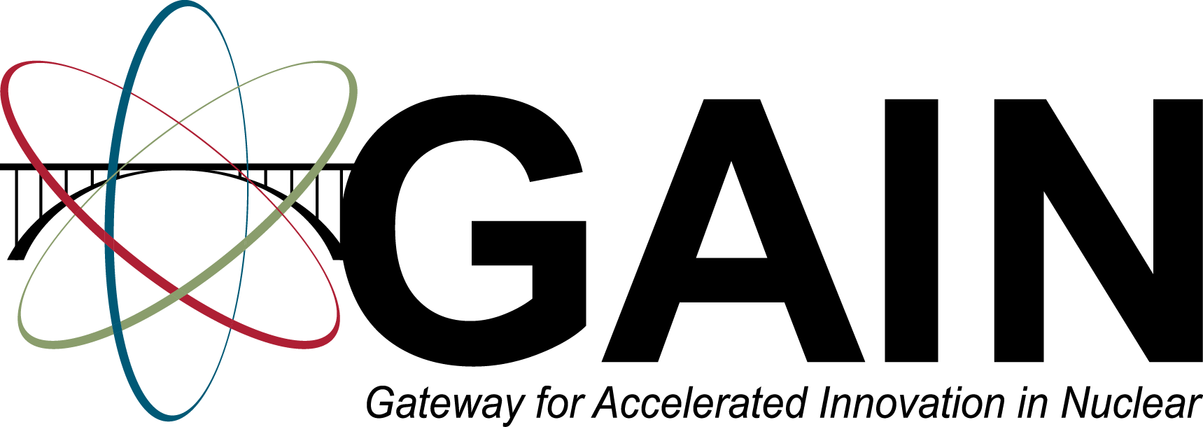
@GAINnuclear
http://gain.inl.gov

