Slide 1
Jennifer Uhle Director of Reactor Safety Programs 4/21/17
NRC Licensing of Advanced Reactors

Slide 2
Contents
A quick summary of the licensing process and NRC plans to be ready to license advanced reactors.
Part 50 and Part 52
Status of Small Modular Reactors
NRC experience with non-LWRs
NRC Vision and Strategy
NRC Readiness Advanced Reactors
Conclusions

Slide 3
Licensing under 10 CFR Parts 50 and 52
Advanced Reactors are expected to be licensed under Part 52 which leads to standard design certification.
Part 50
Part 52
2 Steps by the utility
1 - Construction Permit
2 - Operating License
1 Step for each partner
Vendor - Design Certification
Utility – Combined License
Pros
Can start construction early
Design risk can be shared
Pros
Certified Design is a rule
Licensing scope is reduced
Cons
Construction risk is high
Each plant is one-of-a-kind
Cons
Construction once COL is issued

Slide 4
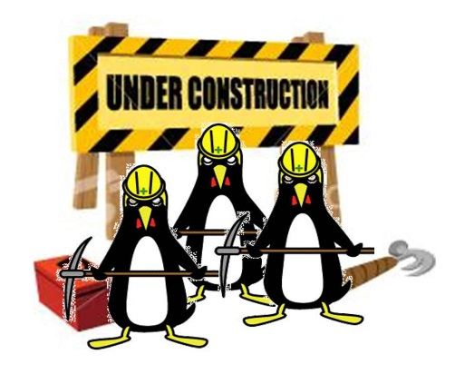
Options in the Licensing Process
The regulatory process is flexible.
Staged Licensing under
Part 52 Subpart E
Construction while
completing the design
with Part 50
Licensing a prototype
Under 50.43(e)(2)
CDA = Conceptual Design Assessment
CDA
Design Certification
Needs a utility and a
site, and is the fastest
way to operation
Uncertainty managed
by additional defense
in depth
Ideal for venture capital funded
programs
However, no design certification is granted
Available under Part 50
and Part 52

Slide 5
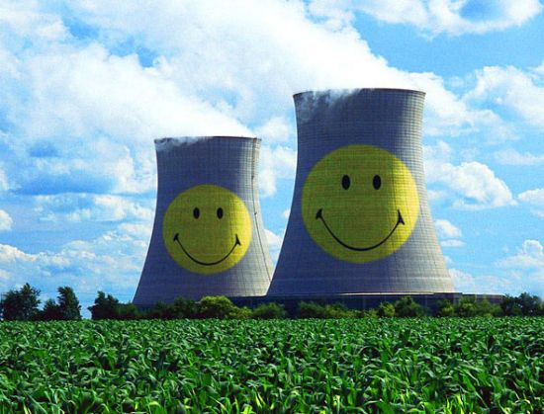
Prototype Plants
Prototype is a first-of-a-kind plant and can be full size.
Additional safety features will be required to protect public health and safety.
Tests can be run and used in further licensing.
Available using Part 50 or Part 52.
NRC is developing guidance for this option.
Notes:
In any one design there may be particular phenomena that are of higher uncertainty. This could definitely kick you out of the fast lane. However, the regulations allow for uncertainty in a phenomenon or feature to be managed by adding additional safety features to the plant. Although this has not been exercised as far as I know, a prototype reactor can be built and operated. It is similar to a first-of-a-kind plant in all features and size, but may include additional safety features to protect the public and the plant staff from the possible consequences of accidents during the testing period. Tests can be run in the plant to supplement the knowledge base which would then allow the additional features to no longer be required, if appropriate. This is available for Part 50 and Part 52. The NRC is developing guidance for this option.
DETAILS
50.2 Defintitions
Prototype plant means a nuclear reactor that is used to test design features, such as the testing required under § 50.43(e). The prototype plant is similar to a first-of-a-kind or standard plant design in all features and size, but may include additional safety features to protect the public and the plant staff from the possible consequences of accidents during the testing period.
50.43 Additional standards and provisions affecting class 103 licenses and certifications for commercial power.
(e) Applications for a design certification, combined license, manufacturing license, or operating license that propose nuclear reactor designs which differ significantly from light-water reactor designs that were licensed before 1997, or use simplified, inherent, passive, or other innovative means to accomplish their safety functions, will be approved only if:
1) (i) The performance of each safety feature of the design has been demonstrated through either analysis, appropriate test programs, experience, or a combination thereof;
(ii) Interdependent effects among the safety features of the design are acceptable, as demonstrated by analysis, appropriate test programs, experience, or a combination thereof; and
(iii) Sufficient data exist on the safety features of the design to assess the analytical tools used for safety analyses over a sufficient range of normal operating conditions, transient conditions, and specified accident sequences, including equilibrium core conditions; or
(2)There has been acceptable testing of a prototype plant over a sufficient range of normal operating conditions, transient conditions, and specified accident sequences, including equilibrium core conditions. If a prototype plant is used to comply with the testing requirements, then the NRC may impose additional requirements on siting, safety features, or operational conditions for the prototype plant to protect the public and the plant staff from the possible consequences of accidents during the testing period.

Slide 6
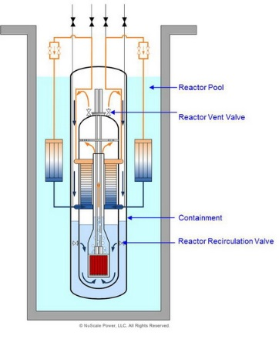
NuScale Small Modular Reactor Design
NRC design review is underway.
Accidents are designed out!
Passive safety
light-water integral pressurized water reactor (iPWR)
Internal helical steam generator
and pressurizer
Electric output of 50 MWe
Up to 12 modules

Slide 7
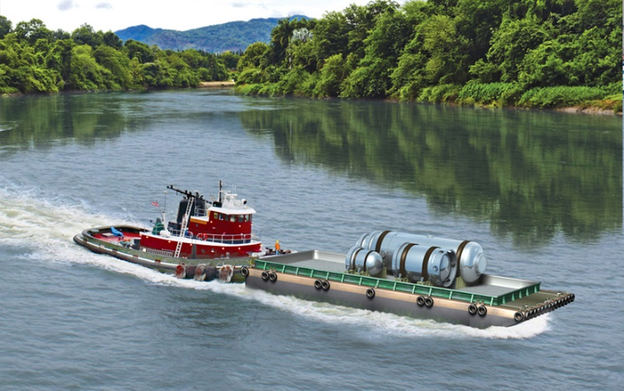
NuScale Construction and Siting
Remote siting is facilitated.
Factory built
Modules delivered by barge, truck, or train

Slide 8
NRC History with Advanced Reactors
The NRC could review and license a non-LWR today.
Between 1951 – 2010, the AEC/NRC reviewed 20 non-LWRs
Liquid metal
Fermi 1 -- CP in 1956, OL in 1963, shutdown in 1972
HTGR
Fort St. Vrain -- CP in 1968, OL in 1973, shutdown in 1989
Peach Bottom -- , CP in 1961, OL in 1966, shutdown in 1974
Thorium fuel cycle in Shippingport, 3rd core
Construction Permit for Clinch River breeder reactor in 1983
Preliminary SERs
PRISM (1990’s), SAFR (1991), mHTGR (1995), ACR-700 (2004), PBMR (2010)
The NRC needs to be efficient, effective and flexible
The NRC issued a CP for SHINE in 2016 (Moly-99 medical isotope facility)

Slide 9
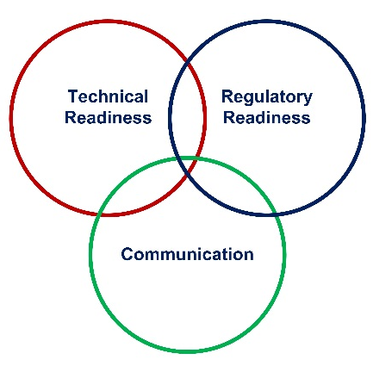
NRC Vision and Strategy
Non-LWR Mission Readiness Roadmap
MISSION
VISION
DOE non-LWR Vision & Goals Alignment Point
STRATEGIC GOAL FOR NON-LWRs
STRATEGIC OBJECTIVES & STRATEGIES
- Near-Term (0-5 yr)
- Mid-Term (5-10 yr)
- Long-Term (10+ yr)
IMPLEMENTATION ACTION PLANS & TASK EXECUTION

Slide 10
NRC Readiness
“Readiness” means that all the elements that NRC needs to conduct its mission are in place and optimized.
People (staff training)
Processes (procedures and guidance)
Tools (computer models)
Policies (emergency preparedness requirements)
Decision Criteria (design-specific review standards)
Transparency and Clarity of Requirements
Communication (workshops)

Slide 11
Conclusions
Idaho National Laboratory plays a key role in the Nation’s deployment of advanced reactors.
Advanced reactor expertise
Experimental facilities
Computer system analysis tools
Fuel qualification facilities
Policy issue resolution
Technical training

Slide 12
QUESTIONS?
CONTACT
Jennifer Uhle
JUhle@jensenjughes.com
202-604-2572
For More Information Visit
www.jensenhughes.com

