Slide 1
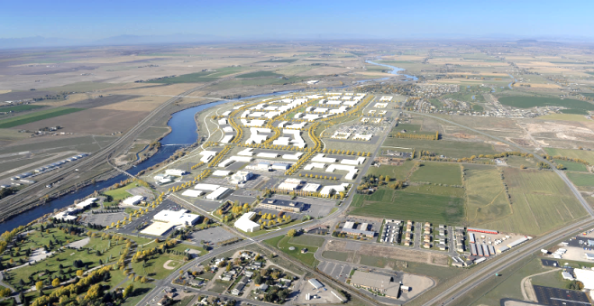
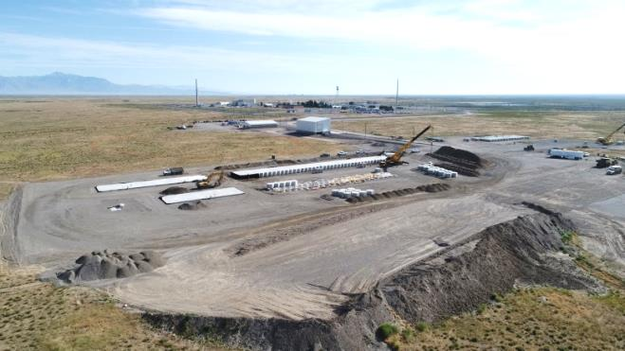
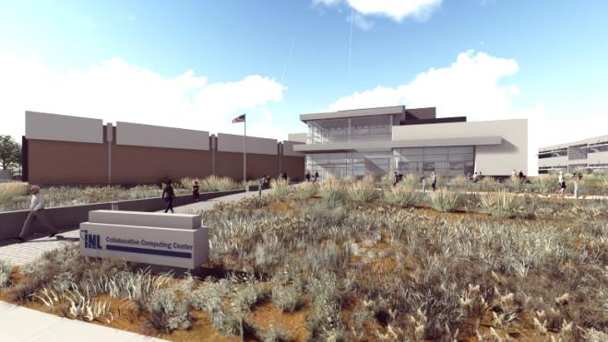
Campus Infrastructure Modernization Overview
Carlo Melbihess
Director, Facilities and Site Services
LINE Commission
October 4, 2017 – Twin Falls, ID

Slide 2
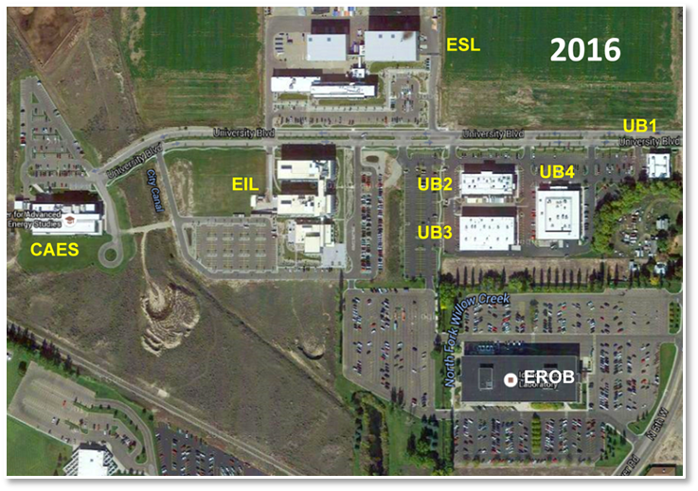
Since 2005, development of INL’s Research and Education Campus has generated distinctive value through new research and development capabilities
2005
Research and Education Campus (REC) – before and today
Addition of the Collaborative Computing Center (C3) and Cybercore Integration Center (CIC), will expand the breadth of our technical expertise, and solidify INL and partner universities abilities to conduct innovative cybersecurity and nuclear energy research through talent development and attraction of high-tech industry partners.

Slide 3
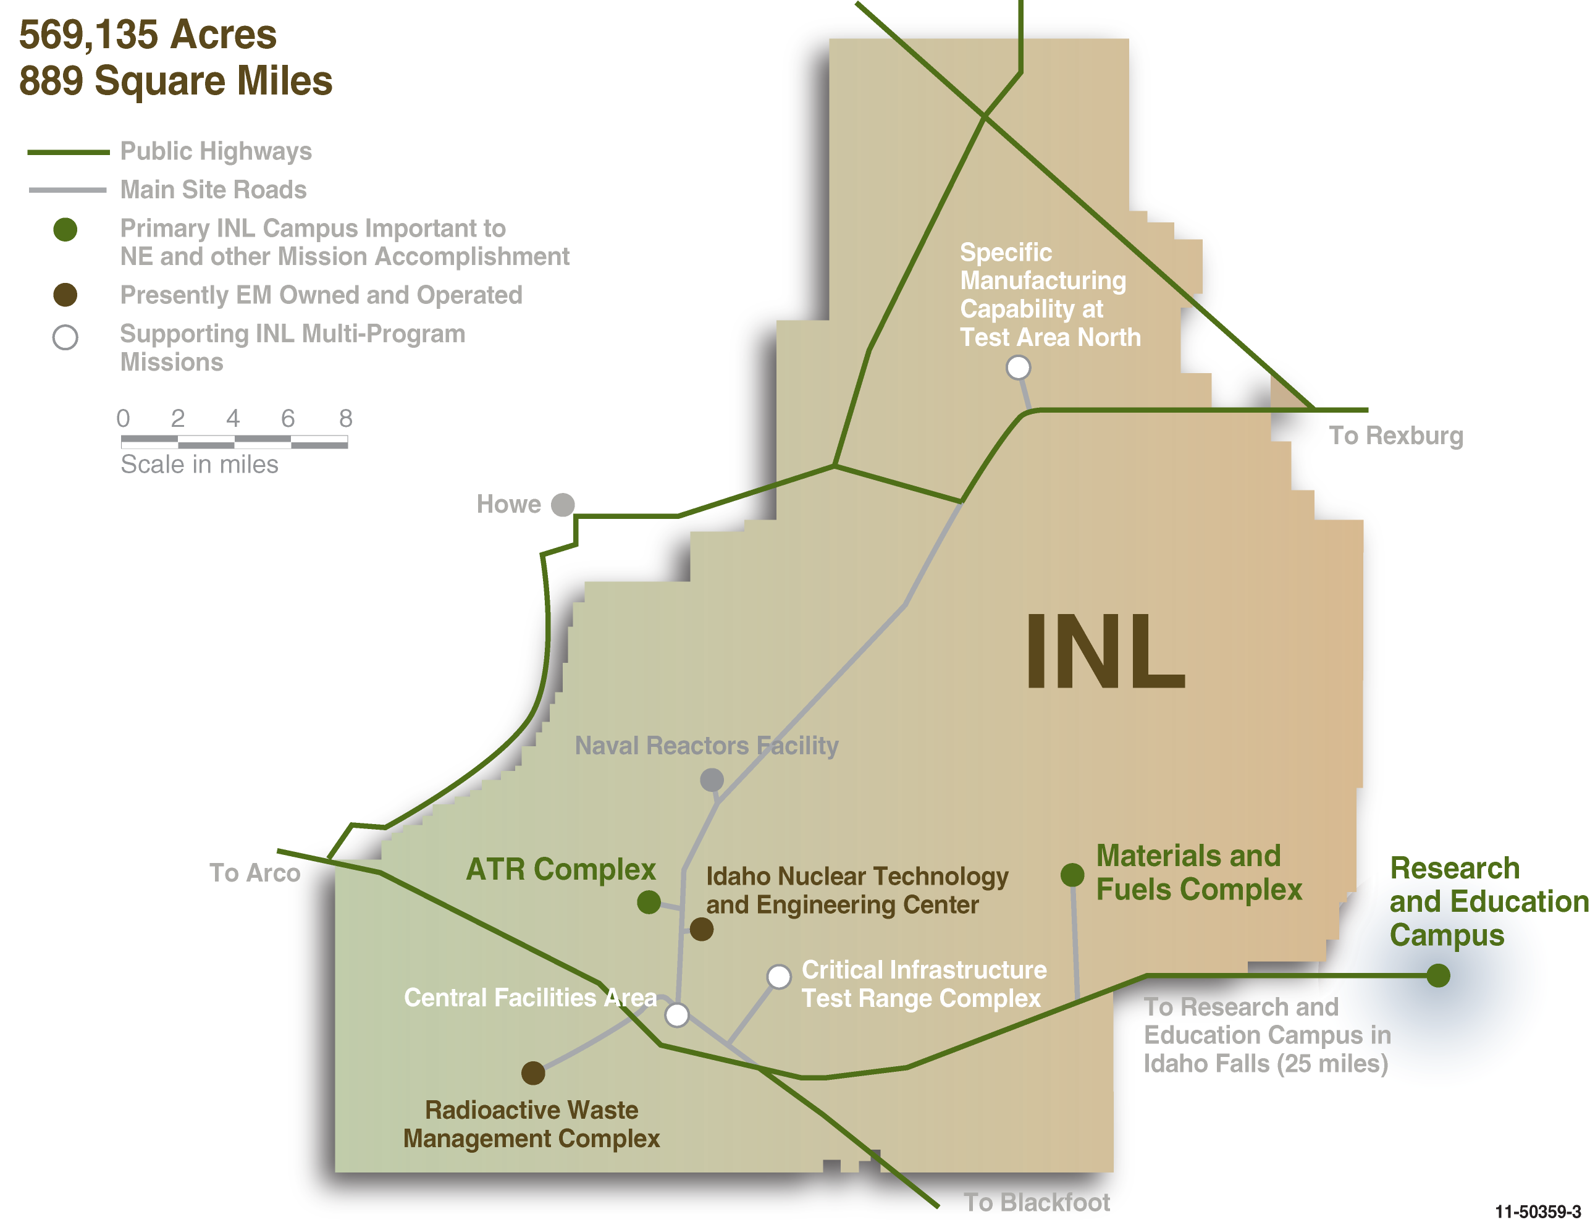
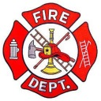
Overall, INL has an impressive infrastructure portfolio with a solid strategic investment plan
$440M
TARGETED OVER 5 YEARS
to improve, modernize & provide new infrastructure capabilities
294
DOE Owned Buildings
4,230 Staff & Subcontractors
22
Contractor Leased Buildings
3.1B
$
RPV
37
Nuclear Facilities (Haz Cat I, II & III)
3.3M
SQ FT
Gross
3 Fire Stations
1 Landfill
1 Museum
47
Radiological Facilities
45
Miles primary roads / 1,350 total other
7
Substations with interfaces to 3 power providers
21
Miles railroad for shipping nuclear fuel
112
Miles high voltage transmission lines

Slide 4
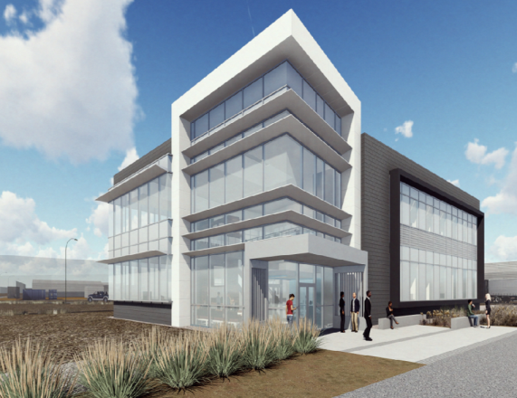
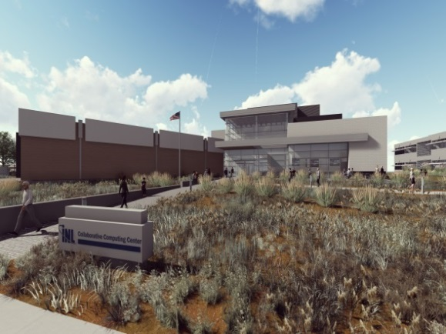
Two capital investments will help expand nuclear energy competitiveness and leadership
A total of ~83,000 sq.. ft.. of new multi-purpose research facilities – RCB and C3, will provide valuable collaboration space for researchers supporting the Gateway for Accelerated Innovation in Nuclear and Nuclear Sciences User Facility work.
Modeling and simulation capabilities will be enhanced and expanded through state-of-the-art high performance computing, visualization, demonstration and testing.
New capabilities will provide new opportunities for partnering with universities and industry, and support “cradle to grave” development and analysis of existing and future nuclear fuel concepts.
RCB will facilitate instrumentation development and bench top prototyping work.
DOE-NE Funded
MFC Research Collaboration Building (RCB)
(FY16-FY19)
Contractor Leased
Collaborative Computing Center (C3)
(FY17-FY19)

Slide 5
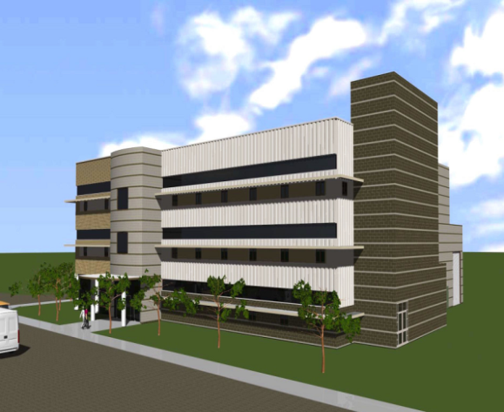
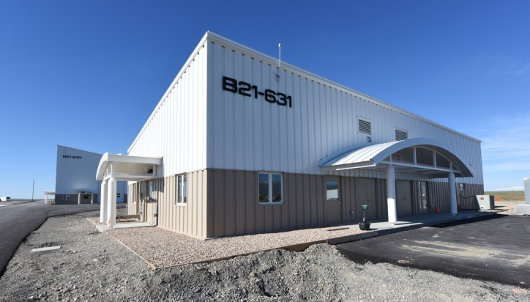
Integrating nuclear fuel cycle solutions requires advanced capabilities for fuel research and remote-handled low-level radioactive waste disposal
SPL completes the post-irradiation examination capabilities at MFC that will enable advanced characterization of the behavior of nuclear fuels and irradiated materials at nanoscale and finer.
Will provide ~20,000-40,000 sq. ft. of new hot cell capabilities and designed for modern-day research tools and instruments.
RHLLW provides replacement disposal capability to support NE and Naval Reactors missions.
Located near ATR and nearing completion, RHLLW includes support buildings, roads, physical security, and disposal vaults with a 20 year disposal and 50 year expansion capacity.
DOE-NE Line Item
Hazard Category 3 Nuclear Facility
Sample Preparation Laboratory (SPL)
FY17-FY22)
DOE-NE & Naval Reactors Line Item
Hazard Category 2 Nuclear Facility
Remote Handled Low Level Waste (RHLLW)
(FY16-FY18)

Slide 6
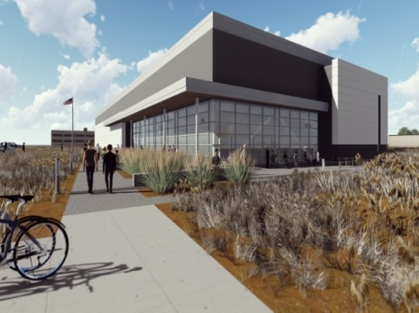
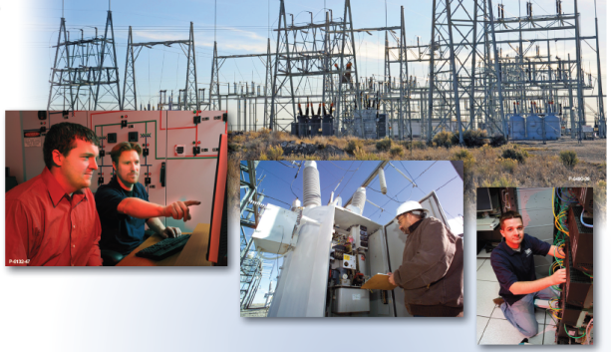
The Cybercore Integration Center will enhance capabilities in cyber-informed science and engineering
CIC provides ~ 80,000 sq. ft. of reconfigurable cyber- and electronic- laboratory and office space on the REC campus.
Special development areas at all levels of security configuration.
Connections to key customer information networks.
Ability to have functional connections to private customers.
Located at CITRC, the National Electric Research, Test, and Evaluation Grid enables full scale testing of new smart grid distribution systems, technologies, and components.
Contractor Leased
Cybercore Integration Center (CIC)
(2017-2019)
Customer Funded
National Electric Research, Test, and Evaluation Grid
(FY16-FY17)
Notes:
Located at CITRC, the National Electric Research, Test, and Evaluation Grid enables full scale testing of new smart grid distribution systems, technologies, and components.
Distribution system voltage classes 12.47 kV, 24.9 kV, and 34.5 kV.
SCADA system, power-line parameter measurement, and distributed load control capabilities at the user locations.
Advanced power network monitoring, and communications network analysis systems.

Slide 7
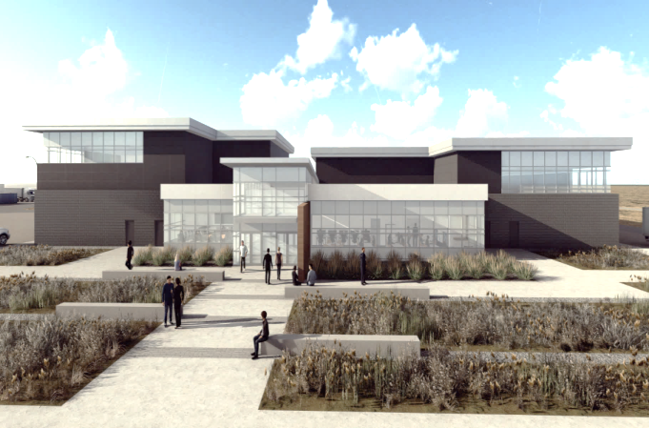
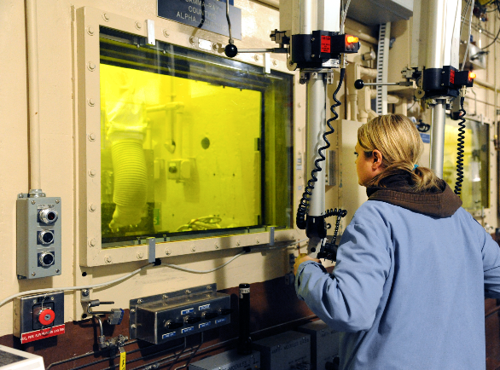
Replacement of aging support infrastructure will ensure the long-term viability of irradiation and examination capabilities
DOE-NE Funded
Advanced Test Reactor Plant Health
A 5-year infrastructure refurbishment and replacement plan for the reactor is underway.
The ~ 18,000 sq. ft. ATR Maintenance Support Building will be used to receive, prepare, stage, assemble, and test materials and equipment in support of ongoing operations and the upcoming reactor core internal change-out.
Materials and Fuels Complex Plant Health
A 5-year investment plan with focus on refurbishment and replacement of master/slave manipulators and hot cell windows & facility control systems.
ATR Maintenance Support Building
(FY17-FY19)
DOE-NE Funded
MFC Mission Critical Facilities
(FY16-FY22)

Slide 8
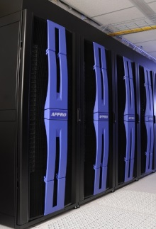
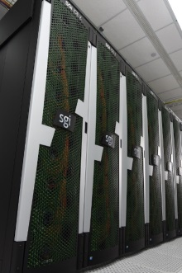
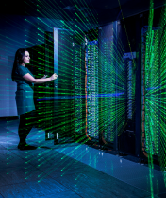
New information technology solutions are improving legacy and meeting future infrastructure needs
C3 and the Idaho Regional Optical Network (IRON)
INL is a key participant and facilitator for advanced regional optical networking with connectivity to Internet2 and the National Lambda Rail – IRON
Essential communication infrastructure modernization includes FY18 upgrades to legacy copper wiring.
We are reducing legacy data center footprint by moving to cloud-based solutions.
Enhanced mobility is now possible through robust broadband and wireless connectivity investments in FY15 through FY21.
Network/Server architecture redesign strategy requires investment for hardware refresh to replace end of life equipment.
High Performance Computing
2011
2014
2019
Fission
Falcon
C3
Next generation HPC
Lab Funded
Falcon Life Expansion Investment
$2M
FY17
1 Petaflop

Slide 9
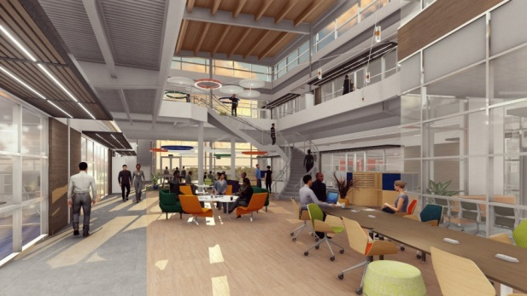
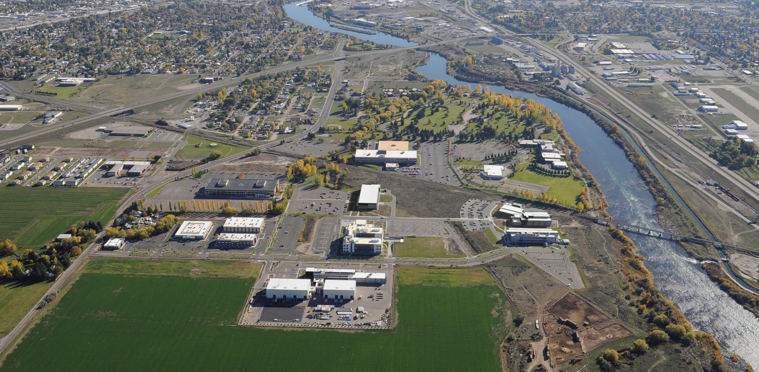
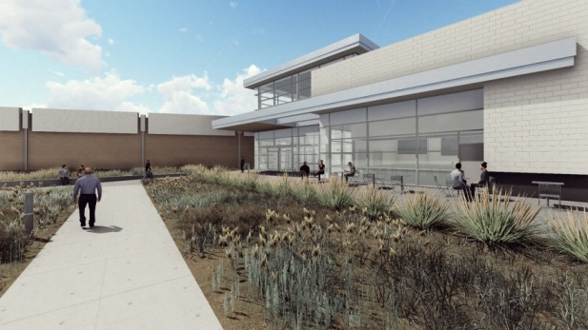
C3 and CIC Progress Report
Key progress areas:
Design is approximately 70% complete.
JE Dunn and Engineered Structures, Inc. (Joint Venture) selected as construction manager.
Lease negotiations nearing completion.
Key near term tasks:
Establishment of Guaranteed Maximum Price (GMP).
Bond sale.
CIC
C3

Slide 10
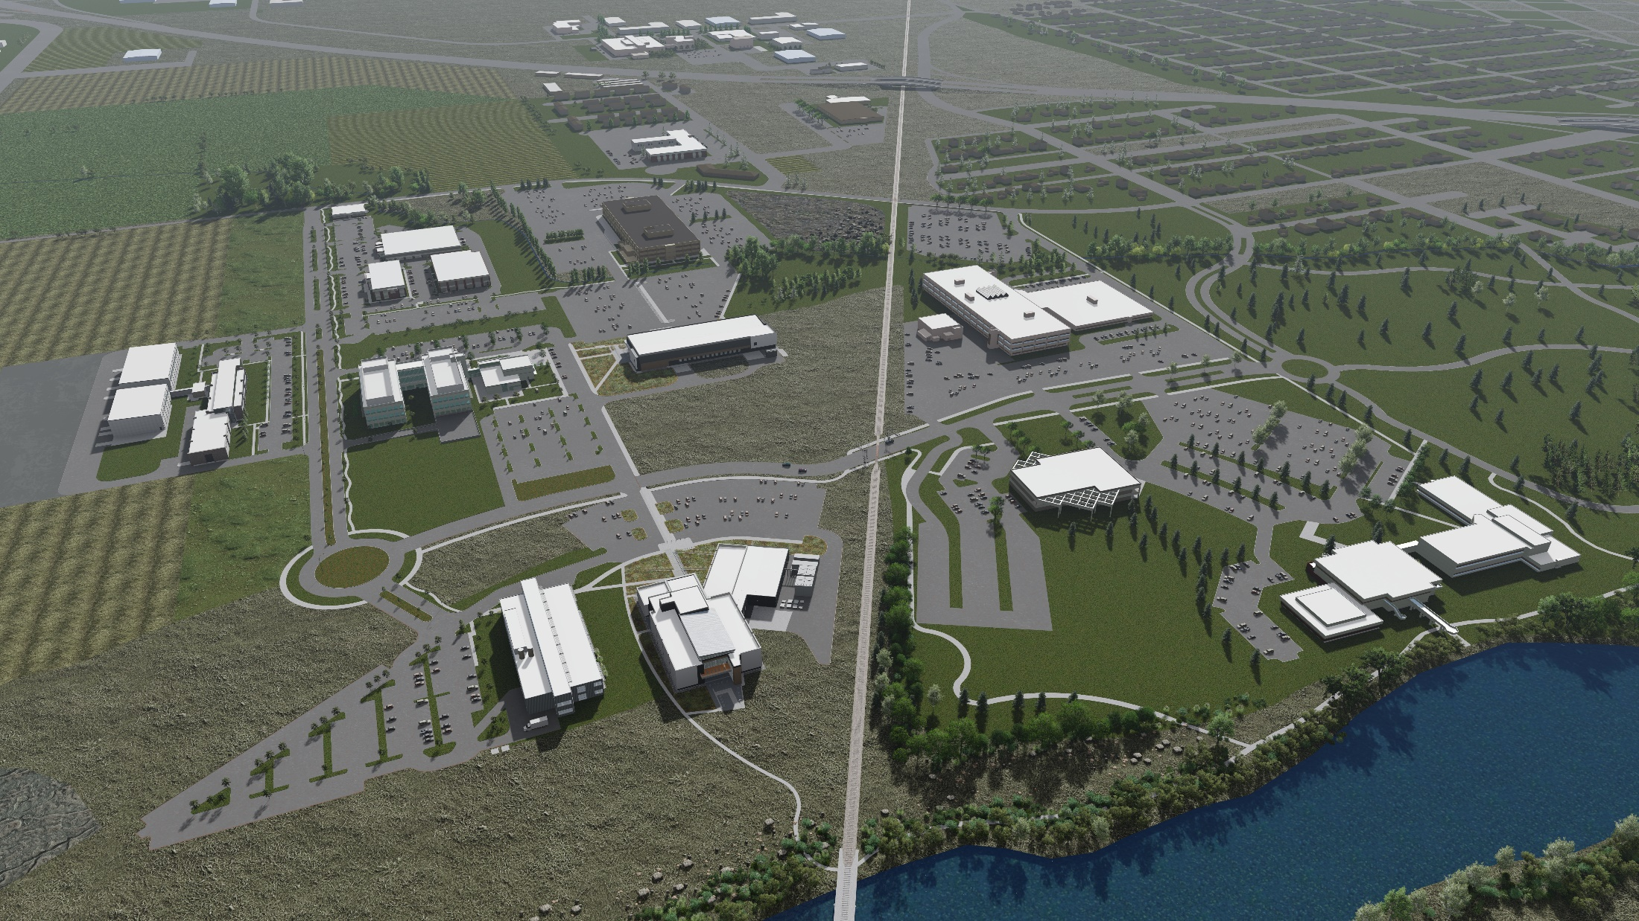
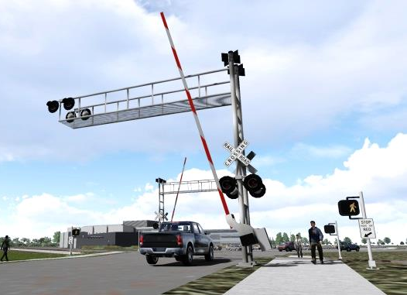
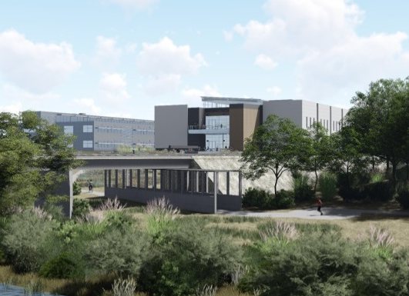
Integrated wayfinding and accessibility is an important natural extension with the ISU campus and City of Idaho Falls greenbelt
New rail crossing
CIC
Greenbelt extension under railroad bridge
C3
Obtaining a pedestrian or emergency vehicle railroad crossing requires agreement with the railroad. A united front and assistance or insight is needed to help run this to ground.

Slide 11
