Slide 1
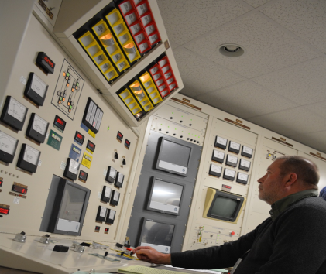
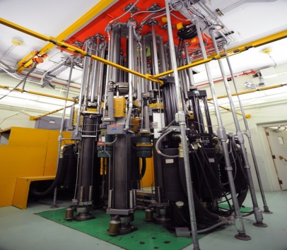
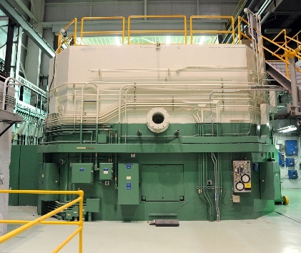
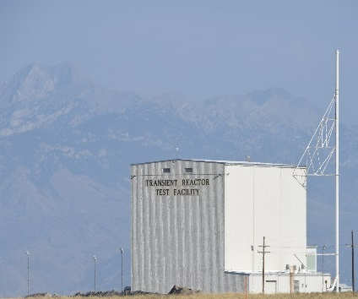
Resumption of Transient Testing Program
Line Commission Status Meeting
John D. Bumgardner
Director, Resumption of Transient Testing Program
October, 4 2017

Slide 2
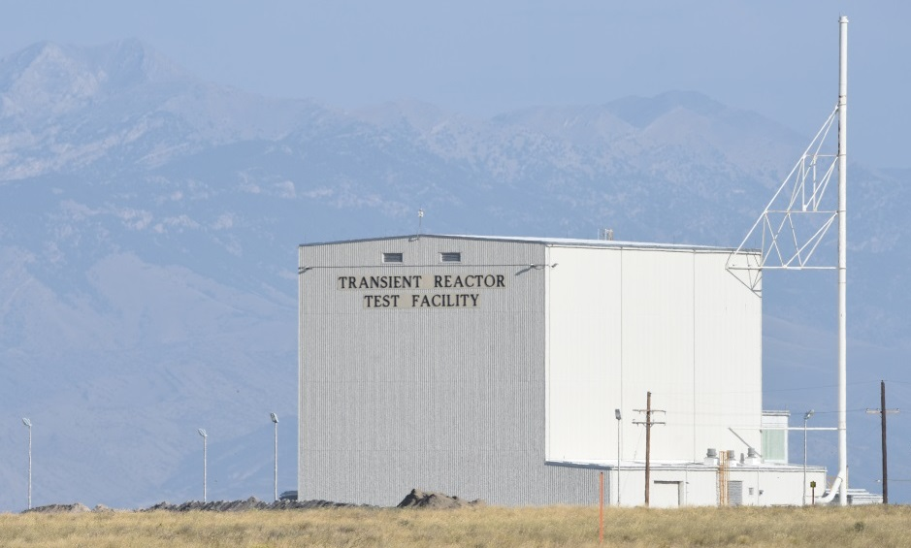
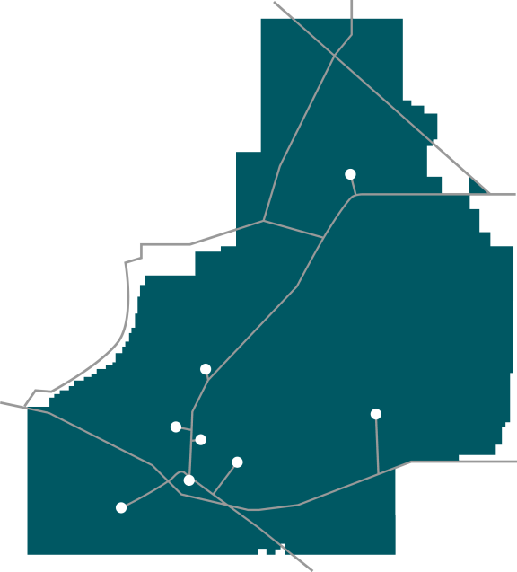
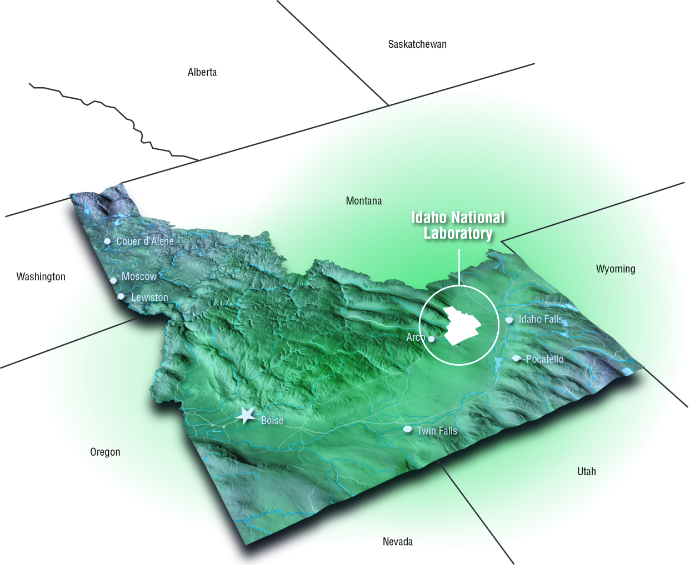
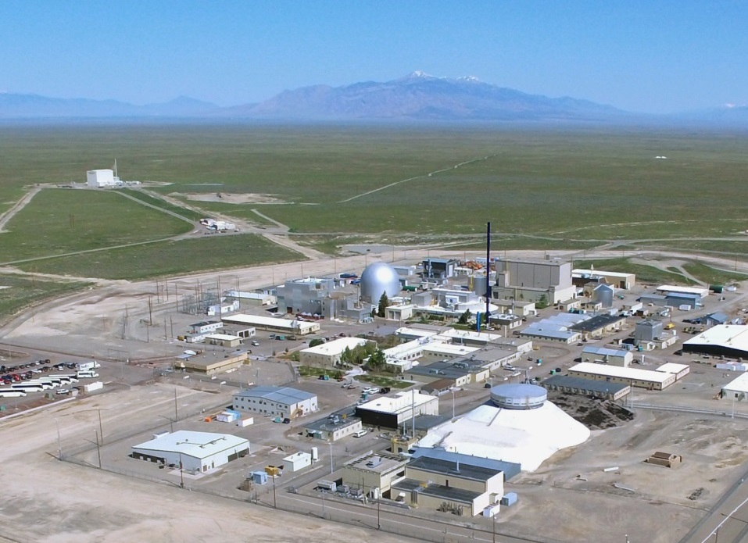
Facility Location
Advanced Test Reactor Complex
Materials and Fuels Complex
TREAT
Materials and Fuels Complex

Slide 3
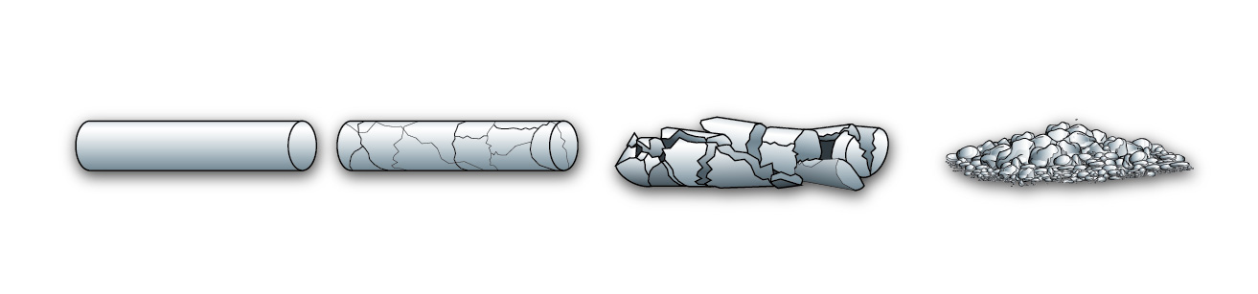
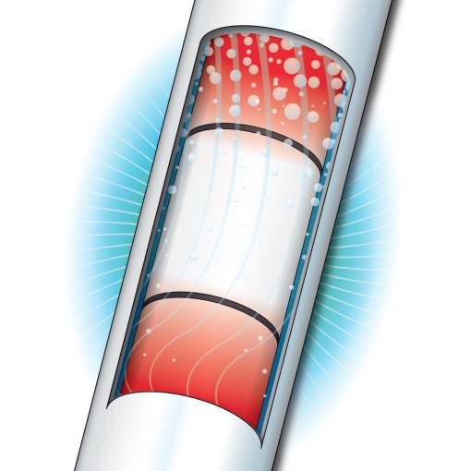
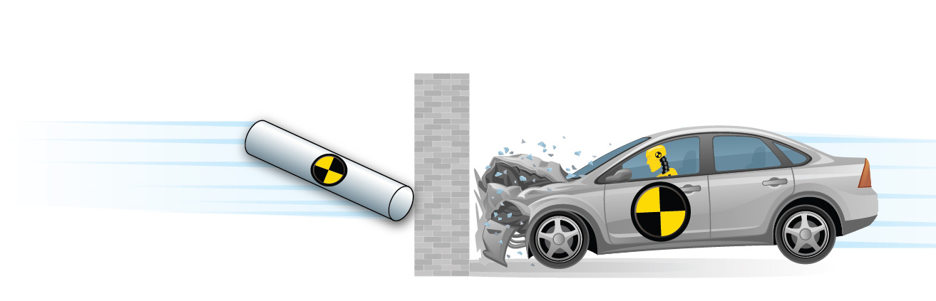

Nuclear Fuels Development Requires Transient Testing for Design Development and Qualification
Nuclear fuel tends to fracture during use or when exposed to a power burst, it is important for the fuel to retain reasonable structural integrity
During a transient test, fuel is exposed to a power to cooling mismatch, driving the fuel to high temperatures
Transient testing fuel and crash testing cars have a lot in common: Design and test for high safety standards

Slide 4
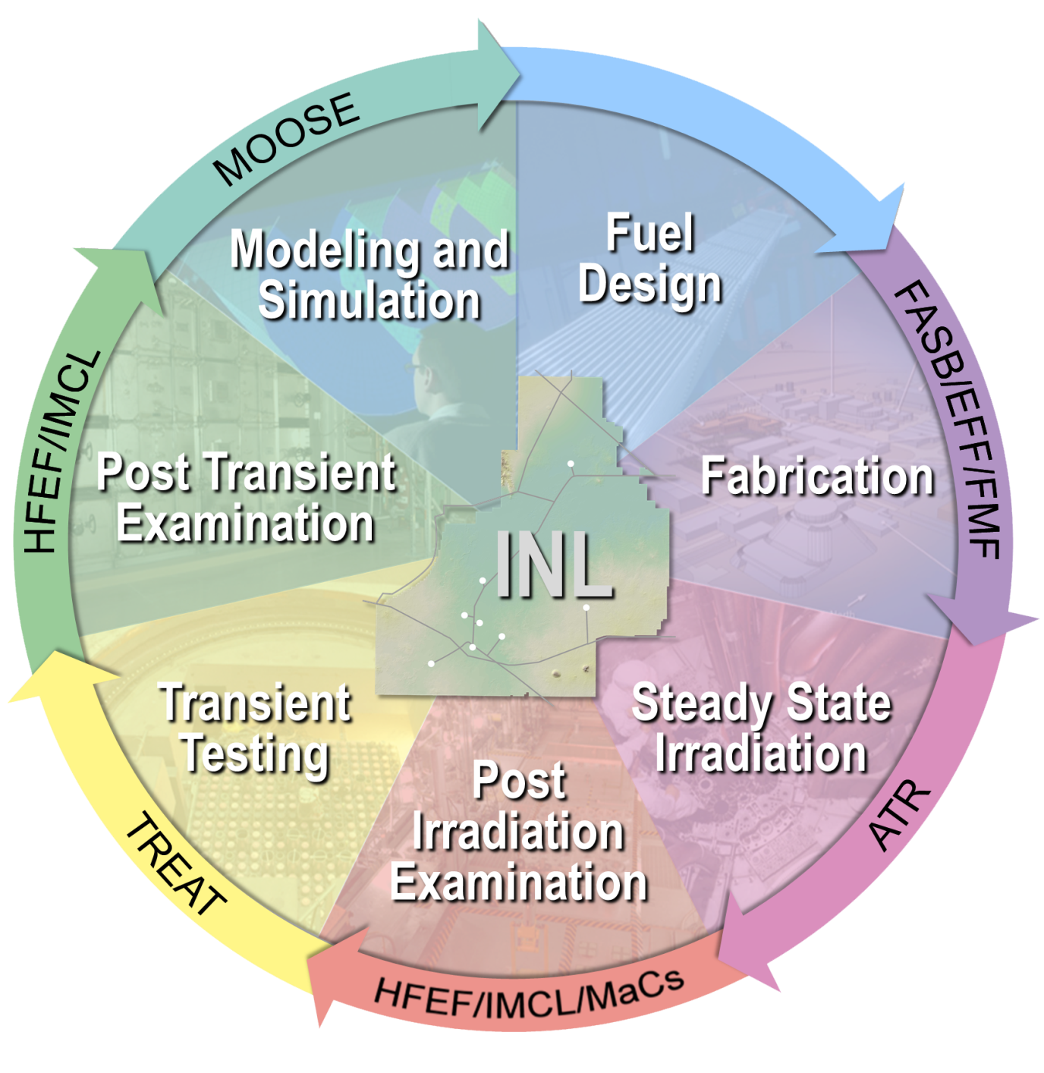
Fuel Development Cycle

Slide 5
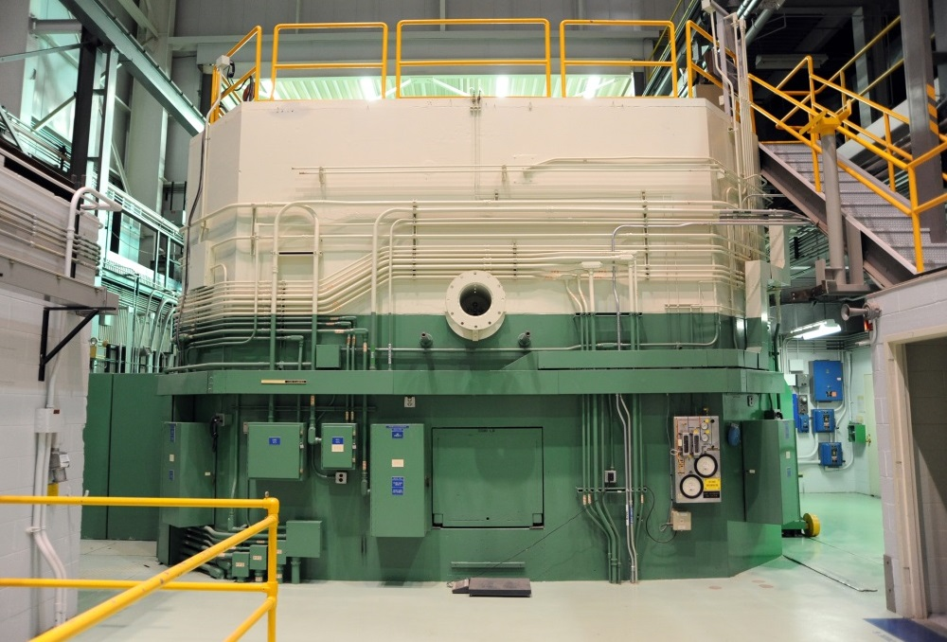
TREAT Reactor
Top of the Reactor
Designed to conduct transient testing of fuels and structural materials.
Operated from 1959 to 1994.
Reactor has performed 6604 reactor startups, 2884 transient irradiations.
Major refurbishment completed in the late 1980’s, and upgraded reactor ran from 1989 to 1994.
Reactor remained fully fueled during standby from 1994 to now, plant left in excellent condition with all required surveillance and maintenance activities performed.
Over 20 GW Peak Transient Power (120 kW Steady-state power) .
Core: 4 ft. high x roughly 6 ft. dia.; surrounded by 2 ft. graphite reflector.
Fuel: 19 x 19 array (approximately 360 fuel elements) of 4 in. X 4 in. fuel and reflector assemblies.
LEU conversion work initiated.
South View of the Reactor

Slide 6
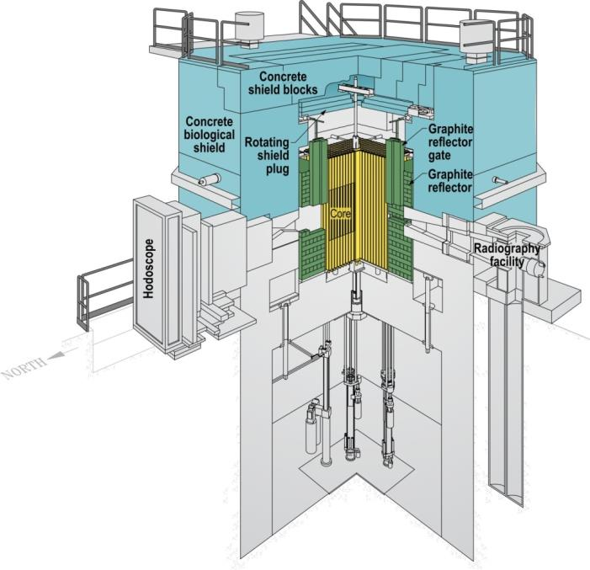
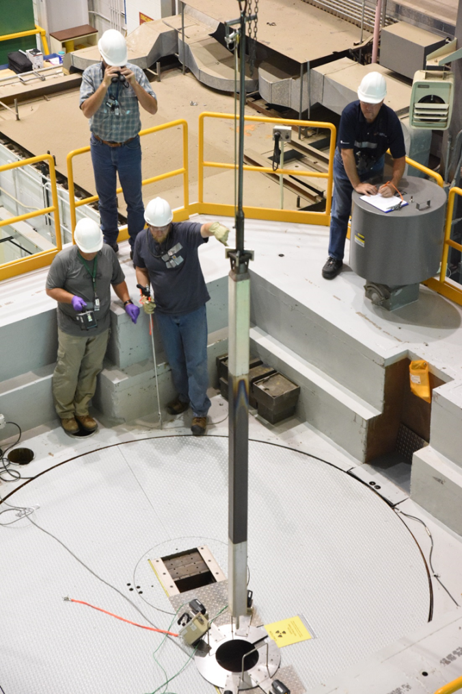
TREAT Configuration and Unique Features
Fuel Assembly Lift from Core

Slide 7
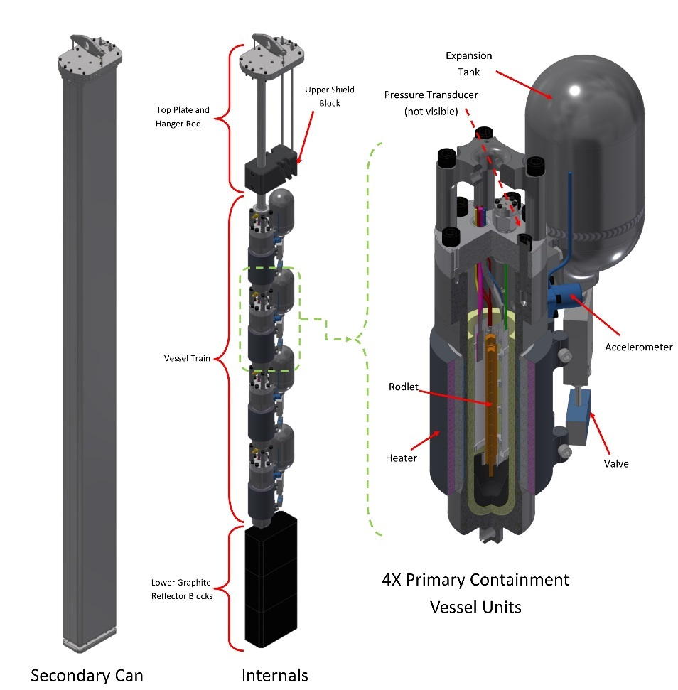
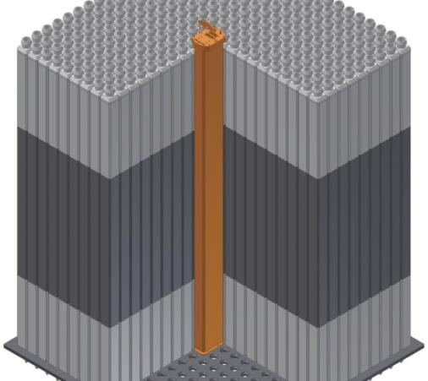
TREAT Experiments
Experiment placement in core
Static Environment Rodlet Transient Test Apparatus (SERTTA)
SERTTA experiment shown in TREAT: secondary containment “can” visible

Slide 8
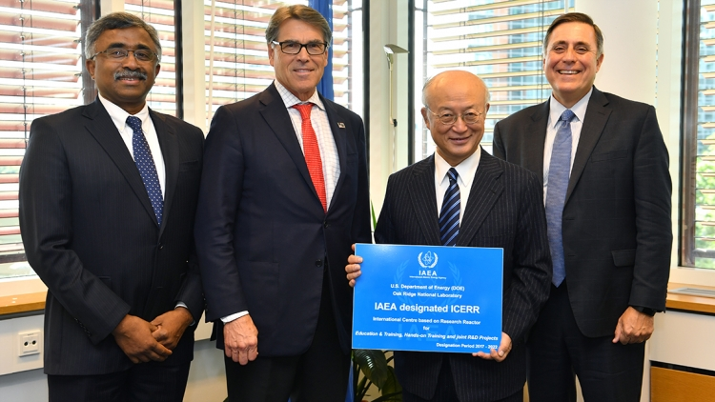
TREAT Brings New World-class Capability to the State of Idaho
Virtually every nuclear reactor technology in use today has benefited from historical experiment programs conducted at TREAT and transient testing will be required for future reactor testing.
In September, Energy Secretary Rick Perry and International Atomic Energy Agency (IAEA) Director General Yukiya Amano celebrated the designation of Oak Ridge National Laboratory (ORNL) and INL as an International Centre based on Research Reactors (ICERR).
Restarting TREAT was much more economical than building a new reactor.

Slide 9

RTTP Recap and Highlights
Managed as a reactor being returned to service following an extended outage.
Relied on operations and maintenance history and experienced operating personnel.
All activities required for restart have been completed:
  Systematic approach used to returning facility systems and equipment to service.
  Procedures and processes revised to current standards.
  Hired and trained full operating staff.
  Thoroughly tested and exercised all equipment and systems supporting reactor operations.
Extremely good safety record with no significant injuries.
Resumption of Transient Testing Program (RTTP) was completed August 31, 2017, more than twelve months ahead of the baseline schedule of September 2018 and for about $17M less than the baseline cost estimate of $75M.

Slide 10
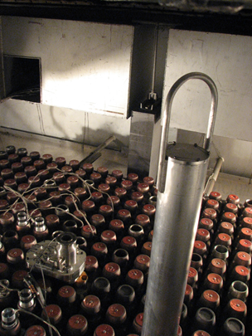
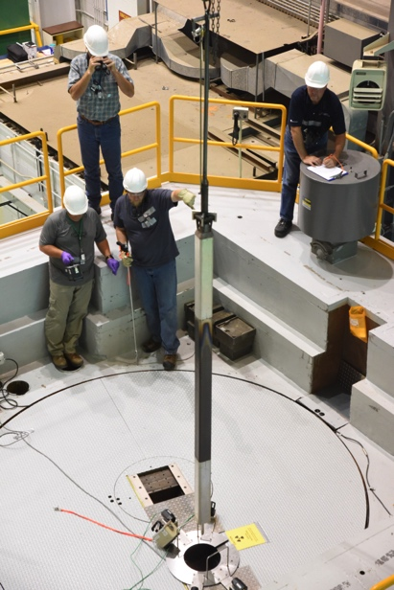
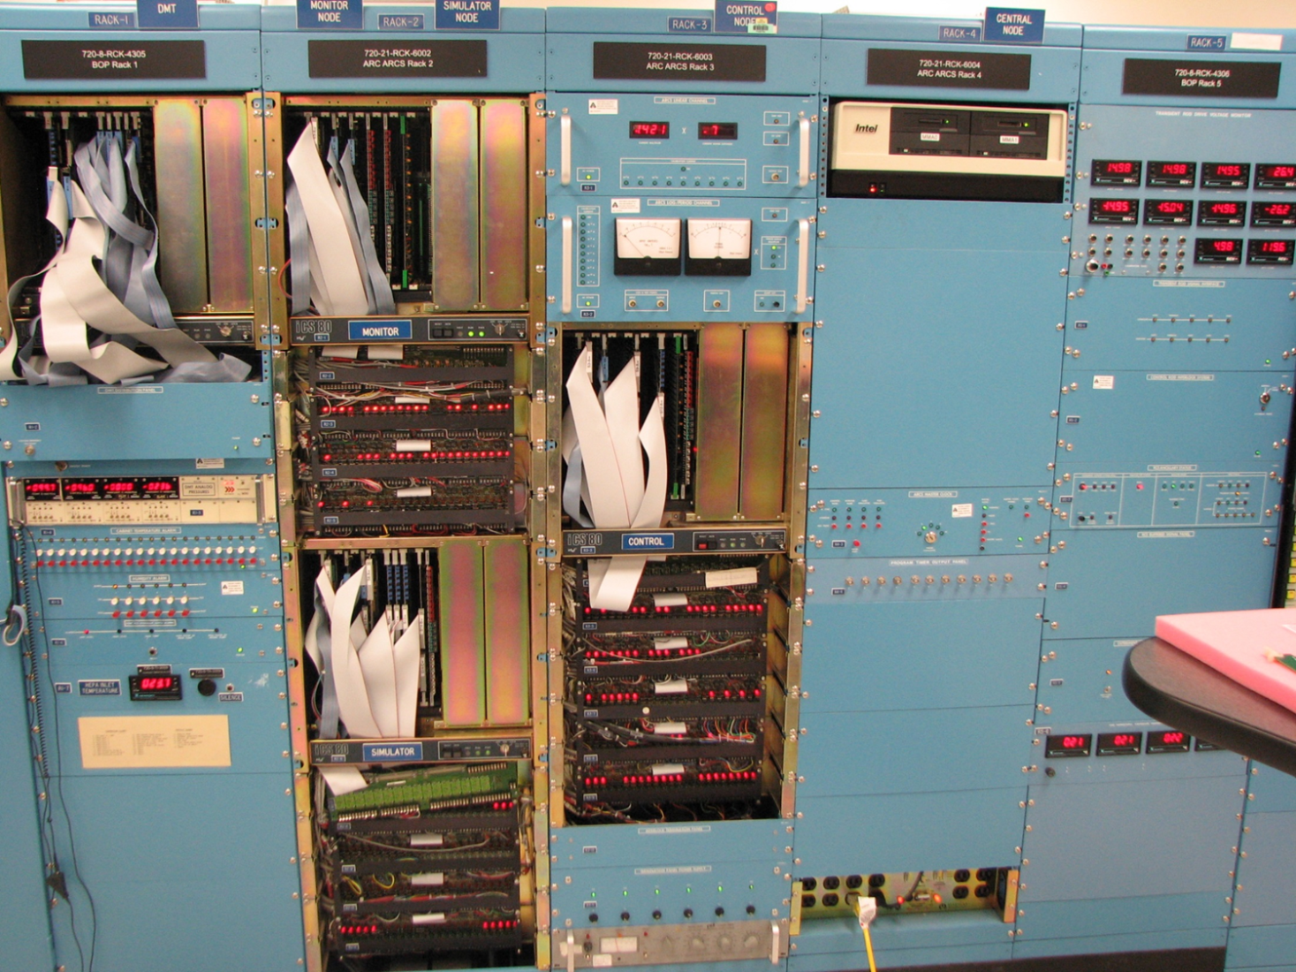

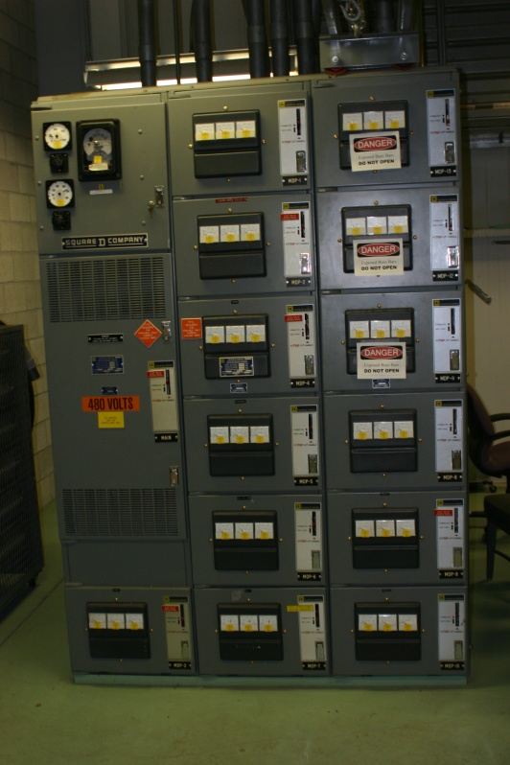
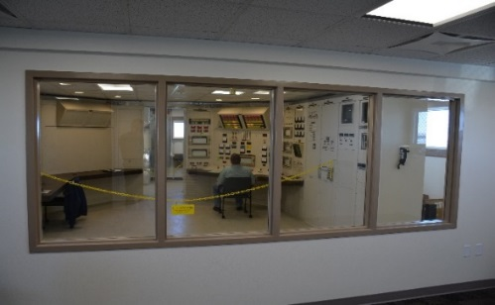
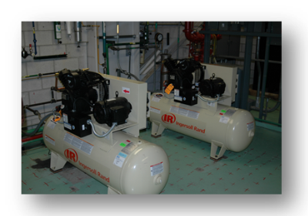
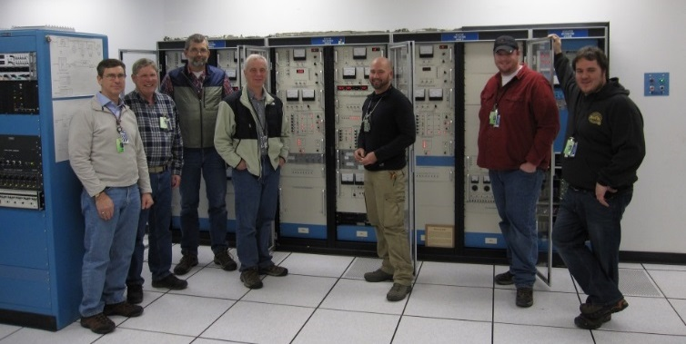
Equipment Readiness Journey

Slide 11
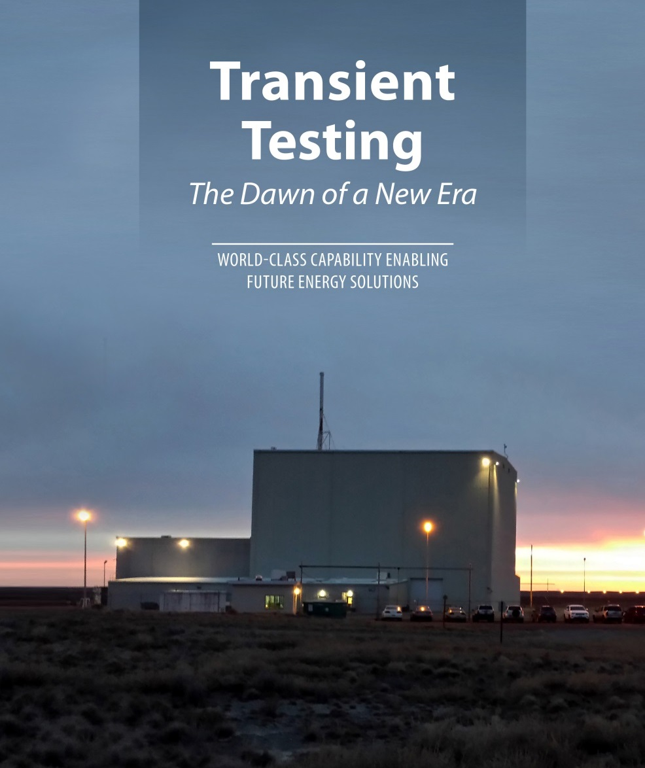
Future of TREAT Operations
Final Reactor preparations for operation are currently taking place.
Next, the Reactor will be operated at low power for startup testing.
Experiments and testing of new cutting edge instruments is expected to commence in calendar year 2018.
There is great interest in use of TREAT, anticipated customers and research are documented on next slide.

Slide 12
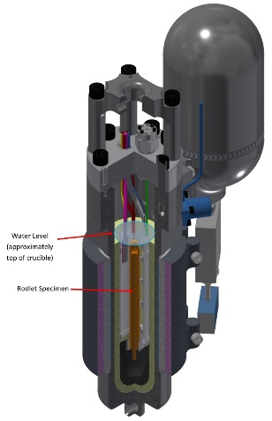

Transient Testing Experiment Readiness
The transient testing program has actively pursued engagement and collaboration with the transient testing and fuel safety community. Formal agreements are in place with:
  Industry: OECD Working Group for Fuel Safety (WGFS), EPRI Regulatory Technical Advisory Committee (Reg-TAC), ATF Program (Areva, GE, Westinghouse)
  Regulators: NRC, IRSN
  International Partners: CEA, NNC, JAEA, Halden, SCK-CEN
  Universities: Wisconsin, Ohio State, Kansas State, Idaho State, Oregon State, Michigan, MIT, Utah State, New Mexico, Florida, North Carolina State, Kansas State
Based on input from this community, an integrating structure is being established to prioritize research activities that meet the broad research needs
  A multi-year program plan outlining proposed research activities is being developed
  Technical Steering Committee composed of international experts representing relevant stakeholders will be established (first meeting tentatively planned for March 2018)
Several high impact fuel safety research projects are being explored through the DOE-GAIN initiative and other DOE programs [Potential Project Partners]
  Transient Testing of ATF concepts [DOE, AREVA, GE, Westinghouse,
  NRC, Utilities tbd]
  LWR Burnup Extension [EPRI, NRC, NSUF]
  Adv. Fast Reactor Fuel Development [DOE, TerraPower]
  New Test Reactor Fuel Qualification [DOE]
  Transient Critical Heat Flux [DOE, IRSN, NRC, MIT]
  Validation of Adv. Modeling and Simulation Codes [DOE + universities and industry]
Research Impacts
  Improved technology for existing LWR fleet through enhanced utilization of existing fuel designs and improved regulatory limits (new experimental data and new analytical tools)
  Enable development and deployment of advanced nuclear fuel technologies by conducting the tests required to establish new fuel safety criteria (failure modes, failure thresholds, radionuclide source term)
Multi-SERTTA vehicle development is under way, providing a prototypic PWR environment for testing fuel.
Fast neutron scintillator testing and refurbishment, supporting the hodoscope return to service for in-situ fuel motion monitoring.

