Slide 1
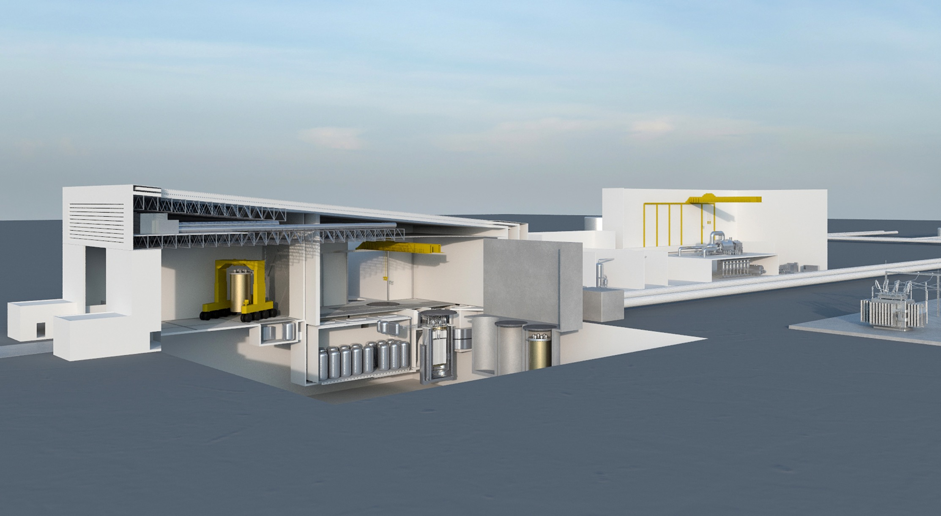
Commercial Deployment of
TEUSA’s Innovative Gen IV Integral Molten Salt Reactor
“Restoring America’s Nuclear Competitive Edge with the
Cost Competitive and Highly Reliable IMSR400”
October 2017
- Private and Confidential -
This Photo by Unknown Author is licensed under CC BY-SA
Notes:
A picture of the PLANT on the cover emphasizes that this is a COMMERCIAL project, not just a Technology.
The pic of the PLANT is better than a picture of a reactor.

Slide 2
TEUSA Core Team
NAME | TEUSA ROLE
Mr. Simon Irish | Director and Chief Executive Officer
Dr. David Hill | Director and Chief Technology Officer
Dr. Ray O. Johnson | Director
Mr. Robin Rickman | VP Business Development
Mr. John Kutsch | VP Business Development
Dr. David LeBlanc | Technical Consultant to TEUSA
Extensive breadth and depth in prior experience and capabilities with a variety of projects including new nuclear plants and nuclear facilities underpinned with a long history of:
New product development
Systems engineering
Component design
Equipment manufacturing
Nuclear construction
Financial engineering
Project management
Notes:
Management philosophy as we described it in our Part 2:
To build on the existing skills and knowledge base already present in the participating companies, experienced personnel will be initially assigned into the ProjectCo1 LLC project to ensure that objectives and milestones are met.
This will give sufficient technical knowledge of the services being provided to competently specify requirements and manage delivery of these services. Over time as the projects are repeated, resources will be recruited to build increased in-house resources and capability.
This will be delivered through a structured training plan and a program of knowledge transfer which will not only build in-house capability but will also ensure that a scalable molten salt reactor technology and operations knowledge base is established in the US.
Staffing – skinny now, as project evolves and we grow, for standing up the project, have we thought through the skills sets we need and that management will include the necessary planning of necessary manning.

Slide 3
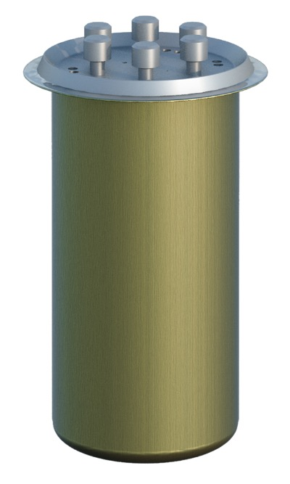
the Integral Molten Salt Reactor – IMSR®
An Advanced Reactor
Liquid-fueled reactor system - fundamentally different
Proven and demonstrated technology
Ran successfully for over 4 years at Oak Ridge National Laboratory
Canadian and US government support
First and only Advanced Reactor to reach the ‘invitation only’ second stage of US Department of Energy loan guarantee program ($1 Bn)
First Advanced Reactor awarded Canadian government grant (C$6 Mn) from Sustainable Development Technology Canada program
Two US government “Gateway for Accelerated Innovation in Nuclear” (GAIN) grant awards ($500k) - US Department of Energy
Patents on IMSR® technology in nationalization phase and part of Company’s broader portfolio of IP rights
Terrestrial Energy’s key commercial claim:
IMSR® power plants are a low cost clean energy alternative to fossil fuel combustion and they can be deployed in the 2020s
Notes:
Private and sovereign capital is today seeking opportunities in Advanced Reactor sector
Est $300 Mn in Terrapower by Bill Gates
$400 Mn by Chinese Government in a sovereign development program
$200 Mn Essel Group investment in LeadCold
$1.5 Bn invested already in US Advanced Reactor Companies
Governments are supporting Advanced Reactor development

Slide 4
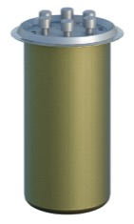
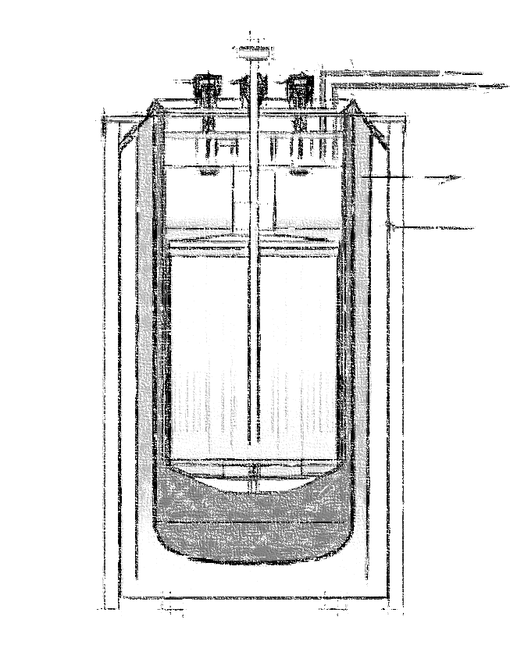
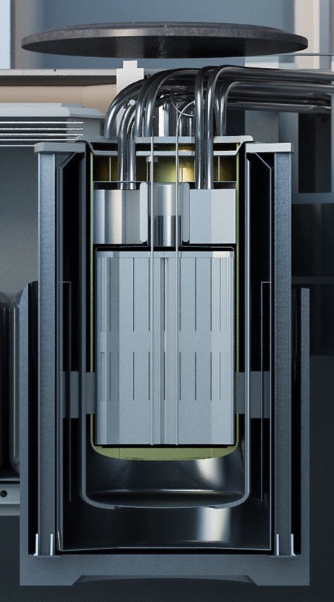
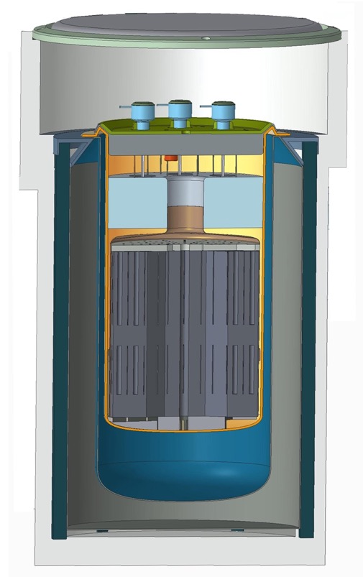
THE INTEGRAL MOLTEN SALT REACTOR (IMSR®)
IMSR® size:
3.6 m x 8 m
(12 ft x 26.7 ft)
IMSR® Core-unit in Containment and Silo
Key innovation is the integration of primary reactor components
Reactor core
Primary heat exchanger
Pumps
..into a sealed reactor vessel within a compact and replaceable unit
For a 7-year operational life
This integral design promises high industrial value through
Inherent safety
Operational simplicity
High capital recovery
Patent applications filed
Primary Heat Exchanger
Flow of salt
Graphite Moderator
400 MWth Core-unit
Guard Vessel and Containment
Operating Silo

Slide 5
IMSR400 Plant Parameter summary

Slide 6
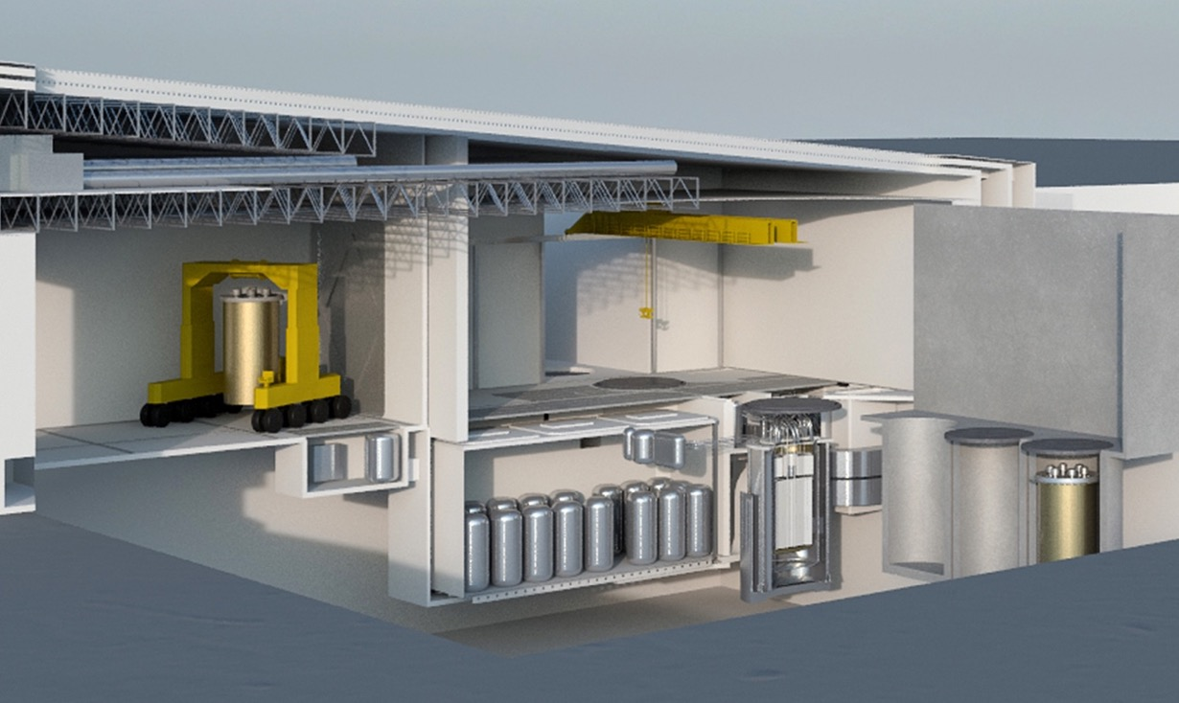
THE IMSR® CORE-UNIT is A SEALED AND REPLACEABLE REACTOR CORE
IRVACS (internal reactor vessel auxiliary cooling system)
Storage silo #2
Operating silo B
Operating silo A
Storage silo #1
Spent Fuel
vault
Storage silo #3
For simple and safe industrial operation

Slide 7
IMSR® PLANT CONSISTS OF NUCLEAR ISLAND & BALANCE-OF-PLANT
IMSR®
Core-unit
Balance-of-Plant
Nuclear Island
IMSR® Nuclear Island produces 600 ºC industrial heat. Balance-of-Plant can be a broad range of industrial applications – not just power provision

Slide 8
IMSR® IS FOR INDUSTRIAL HEAT USE AND ELECTRIC POWER PROVISION
Industrial plant
Thermal storage
Electric power to grid
Thermal power to industrial facilities
IMSR® Nuclear Island produces 600 ºC industrial heat
Balance-of-Plant can be a broad range of industrial applications – not just power provision

Slide 9
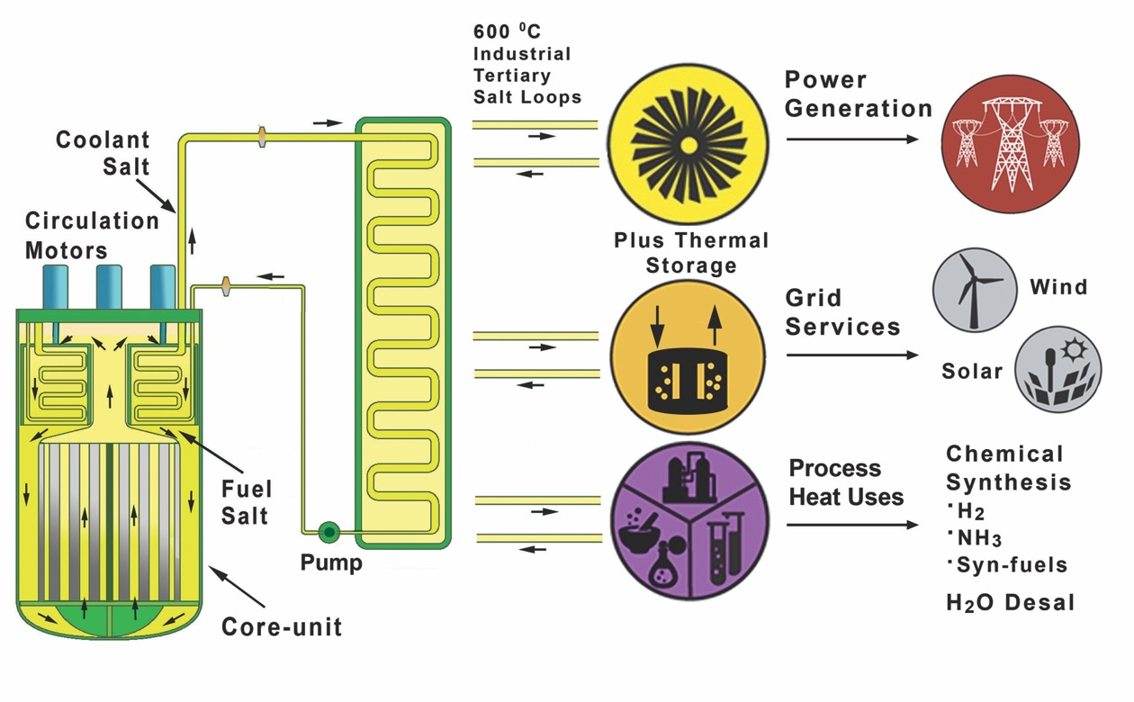
IMSR® IS FOR INDUSTRIAL HEAT USE AND ELECTRIC POWER PROVISION
Boundary of nuclear activity
Many non-nuclear industrial activities
IMSR® Heat
Dispatchable, clean, convenient, cost-competitive IMSR® heat for industrial use
IMSR® heat can couple conveniently with industrial users

Slide 10
IMSR®HAS MANY ADVANTAGES OVER THE CURRENT PRODUCT
ADVANTAGE | IMSR® | PWR
Smaller reactor | 400 MWth | 3,000 MWth
Lower total CAPEX | $700 Mn to $800 Mn | $8,000+ Mn
Lower pressure operation | 1 Atm with many cost, engineering and safety benefits | 172 Atms leading to increased complexity and economic penalty
Highly modular design | Standardization of components for factory production | Non standard and bespoke components
High temperature output | 600 ºC | 290 ºC
High thermal efficiency | 48% thermal efficiency and 40%+ greater revenues for electric power provision | 33% thermal efficiency resulting in low capital efficiency
Load following | Dynamic core and turbine for fast load response | Un-dynamic core and turbine limits use to grid baseload only
Inherent reactor control | Passive power management with many cost, engineering and safety benefits | Active engineered reactor control leading to increased complexity and economic penalty
Passive decay heat management | Passive decay heat management with many cost, engineering and safety benefits | Active decay heat management leading to increased complexity and economic penalty
Broader industrial utility | Heat for many industrial processes and for power generation | Grid baseload power generation only
Higher value product | High-grade heat delivered in the form of a common industrial salt circulating in a low pressure system | Low grade heat circulating in a high pressure system

Slide 11
COMMERCIAL VALUE OF IMSR® POWER PLANTS
Cost competitive
Compared to Conventional Reactor power plants, IMSR® power plants:
Take half the time to build
Require <1/7th of the absolute CAPEX
Provide electric power at half the cost
Provide heat that is cost competitive with a natural gas fueled boiler package
Power and heat that is cost competitive with fossil fuel combustion
Versatile
Dispatchable heat and power
Coupled simply to industrial processes
Heat delivered by common industrial salt
Small land footprint
Low water requirement
Clean
No NOX, SOX or CO2 emissions
Deployable
First deployments in Canada and US in 2020s
Technology proven and demonstrated
Scalable
Modular design for factory production of modular components
Uses fuels and materials from current supply chain
Ordinarily financeable with much lower project risks
<4 year construction time
Credible
Commenced regulatory actions
Secured Canadian and US government funding
Engaged with power utilities
We are deploying IMSR® power plants at a time of escalating global market and policy need for clean and cost-competitive energy

Slide 12
Contact Details
Terrestrial Energy USA Ltd
150 East 58th Street, Suite 2413
NY, New York, 10155
T: +1 (646) 687-8212
E: info@TerrestrialUSA.com
www.TerrestrialUSA.com

