Slide 1
Idaho Cleanup Project Update
Leadership in Nuclear Energy Commission
Jack Zimmerman
Deputy Manager
Idaho Cleanup Project
January 31, 2018

Slide 2
Key Developments
Considerable progress made in addressing start-up issues for Integrated Waste Treatment Unit – next simulant run this spring.
Number of transuranic waste shipments to WIPP have increased, but 2018 deadline is in jeopardy.
Wet to dry movement of spent nuclear fuel on target to meet 2023 milestone.
Future of Advanced Mixed Waste Treatment Plant still under consideration.
Targeted buried waste exhumation remains ahead of schedule.

Slide 3
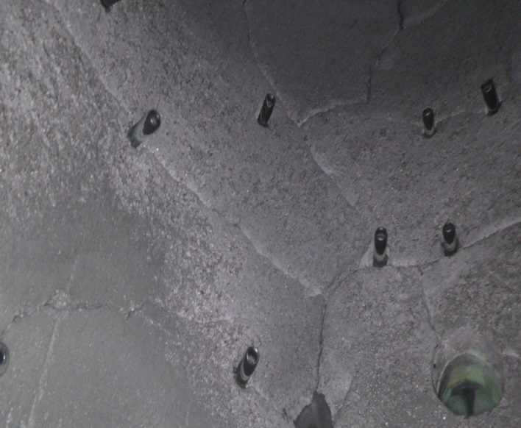
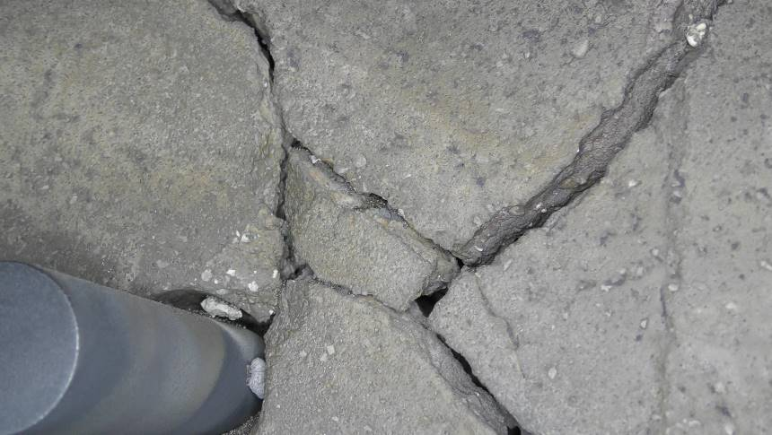
CRR Refractory Repair
Failed castable refractory
Vessel prepared for new brick refractory installation

Slide 4
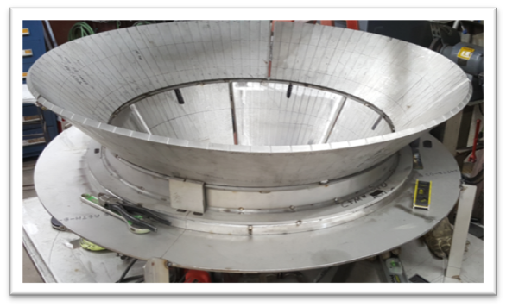
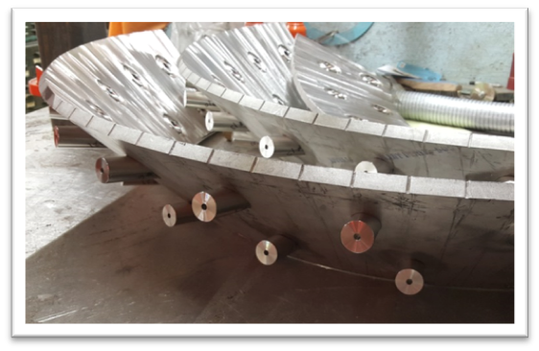
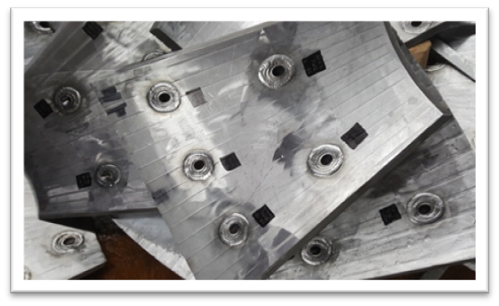
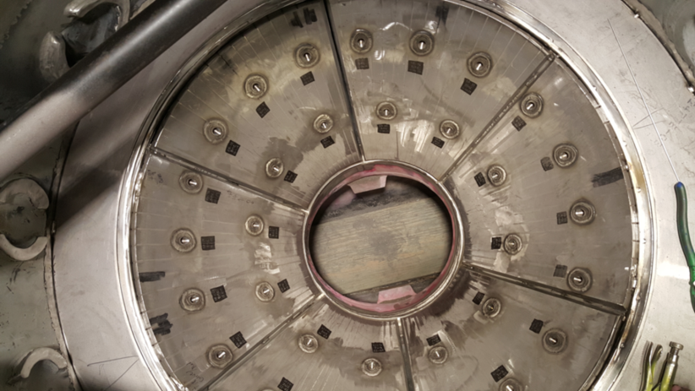
DMR Cone and Double Plenum
Initial fit-up of cone sections
Upper cone sections with nozzles
Lower cone sections
Lower cone sections and plenum divider tacked in place

Slide 5
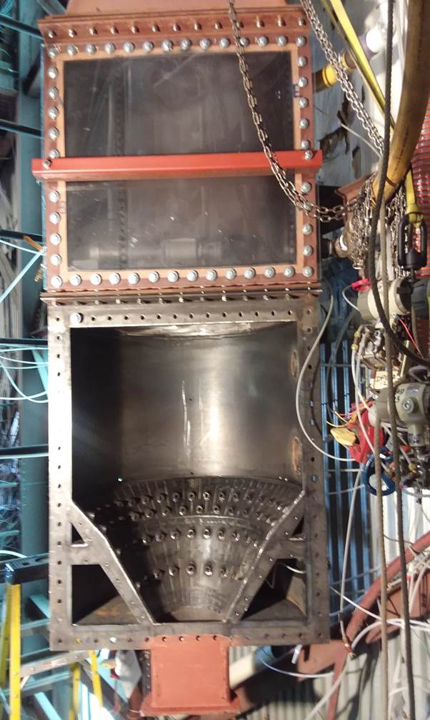
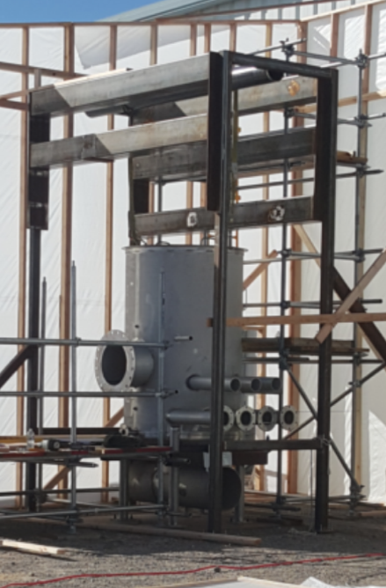
Integrated Waste Treatment Unit
Re-design of Denitration Mineralization Reformer (DMR) considered key to improving fluidization.
Modeling, pilot plant testing, and Particulate Solid Research Inc. testing have all indicated the “double plenum” approach will greatly improve fluidization.
Next simulant run designed to verify that re-design will work.
DMR mockup vessel.
Double Plenum cold flow testing rig at PSRI.

Slide 6
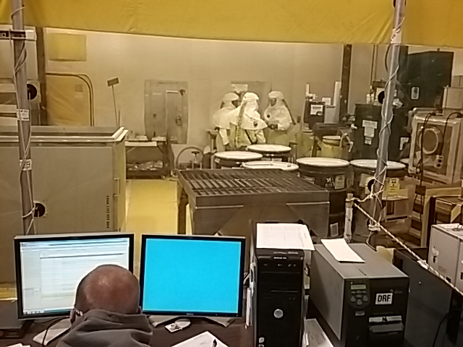
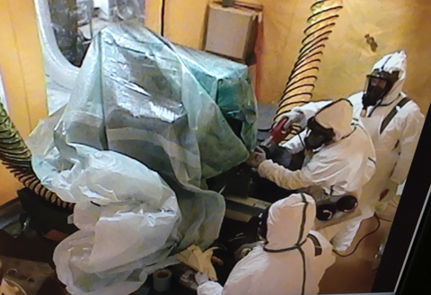
Stored Transuranic Waste
DOE continues to ship both TRU and mixed LLW out of state for safe disposal.
Number of shipments to WIPP increased from two to four per week, beginning in September, 2017.
Still working to re-establish certification authority at Idaho.
DOE considering whether to pursue future mission for Advanced Mixed Waste Treatment Facility, which would involve treatment of waste from out of state facilities and occur pursuant to the 1995 Idaho Settlement Agreement provisions.
Unloading drums from over-pack in WMF-635

Slide 7
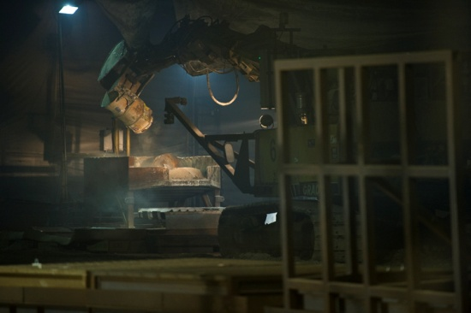
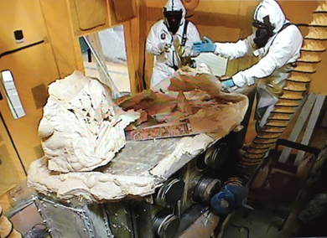
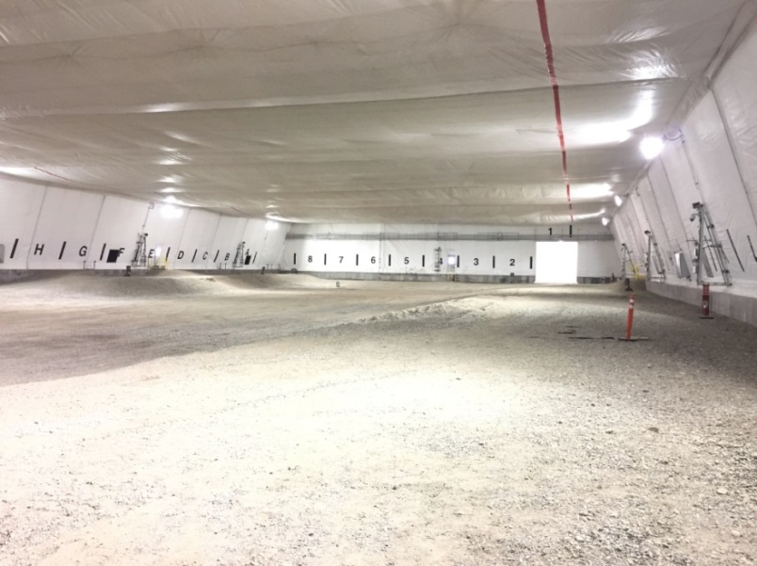
Waste Processing in ARP facilities
Above: Excavator empties non-compactable sludge into trays in ARP V.
Above: Crews unpack large items in ARP -VII
Left: ARP IX Retrieval Enclosure – interior view where roaster oxide processing will occur.

Slide 8
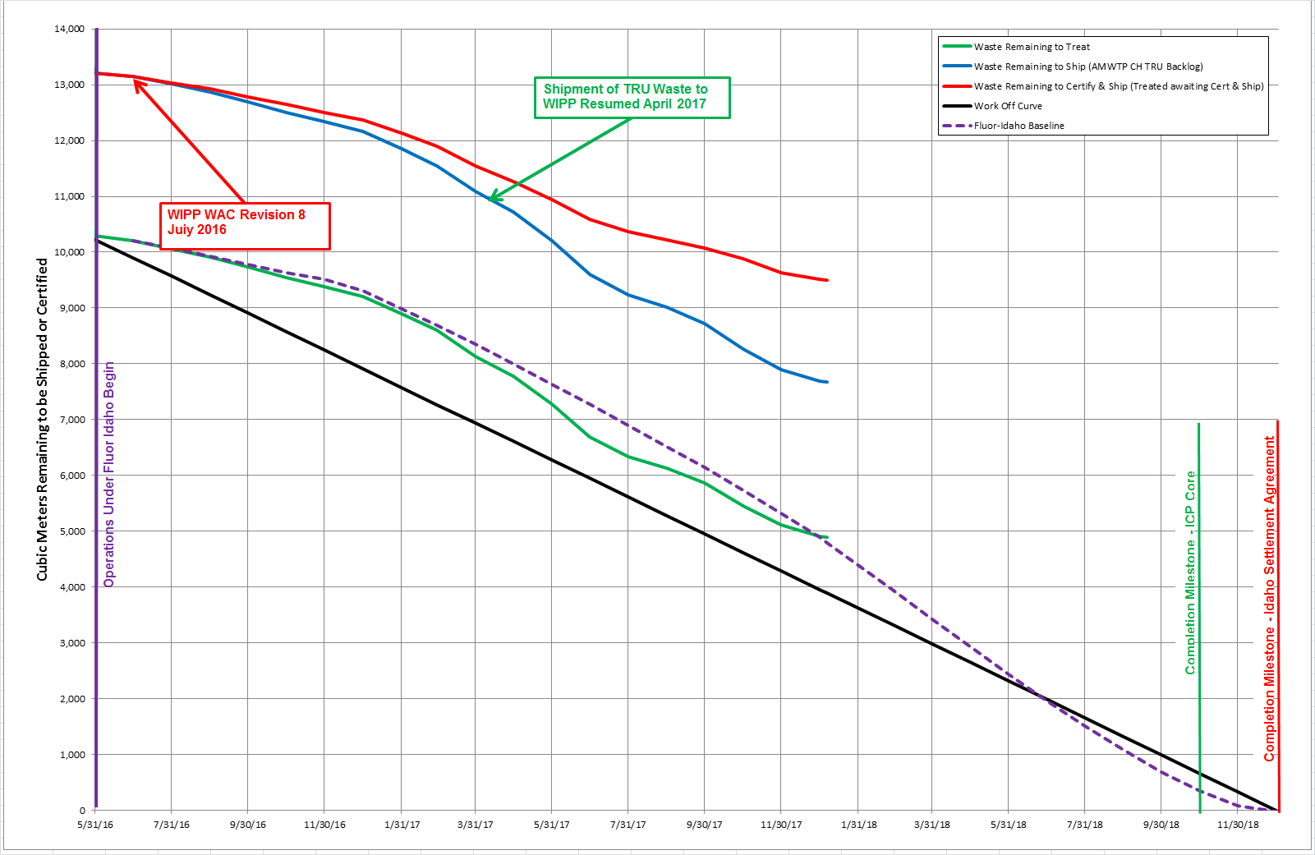
Settlement Agreement TRU Production Status
Notes:
28,700 m³ estimated remaining inventory as of Oct. 1, 2011 *Counts cargo container void volume, which is not reported for Regulatory compliance.
Re-evaluation of the volume remaining to process on May 31, 2016 was 10,300m³, which excludes overpack volumes (e.g. cargo containers, overpacked drums, overpacked boxes, etc.)
Projection of current production demonstrates risk to compliance with the December 31, 2018, 1995 Idaho Settlement Agreement milestone ISA
Projection shows completion near Dec. 31, 2018 if current production rate is increased
Does not account for increasing difficulty of waste to be treated or increasing facility downtime
Total Production through January 6, 2018 – 21,986m³
Remaining Volume to Treat – 4,888m³
Remaining Volume to Ship (AMWTP CH TRU Backlog) – 2,785m³
Remaining Volume to Certify and Ship (Treated Waste awaiting Certification and Shipment) – 1,826m³
Challenges Facing Project Today:
Facility Availability --With North Box Line on-line, Jan. 5, 2017 the facility availability issues have been resolved.
Feed Availability – Due to limited amount of characterized waste in front of treatment processes.
Challenging Waste – High fissile, Roaster Oxides, Oversized Containers, etc.

Slide 9
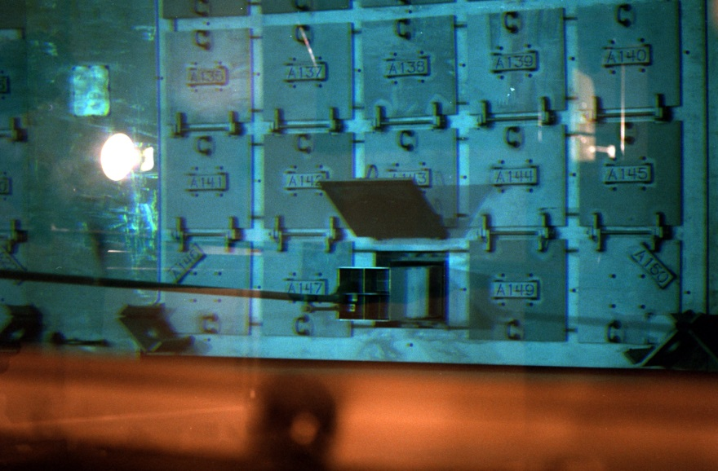
Spent Nuclear Fuel
DOE on target to remove all spent nuclear fuel from CPP-666 underwater storage basin by the 1995 Idaho Settlement Agreement 2023 milestone.
EBR-II fuel is being transferred to the Materials and Fuels Complex for interim storage and, ultimately, processing.
ATR fuels are going directly to dry storage facility at CPP-603.
Several shipments of usable TRIGA fuel are being transferred out of CPP-603 and the State of Idaho to research reactors around the country for continued use.
CPP-666 – Pulling a fuel basket from a rack within the storage pool.

Slide 10
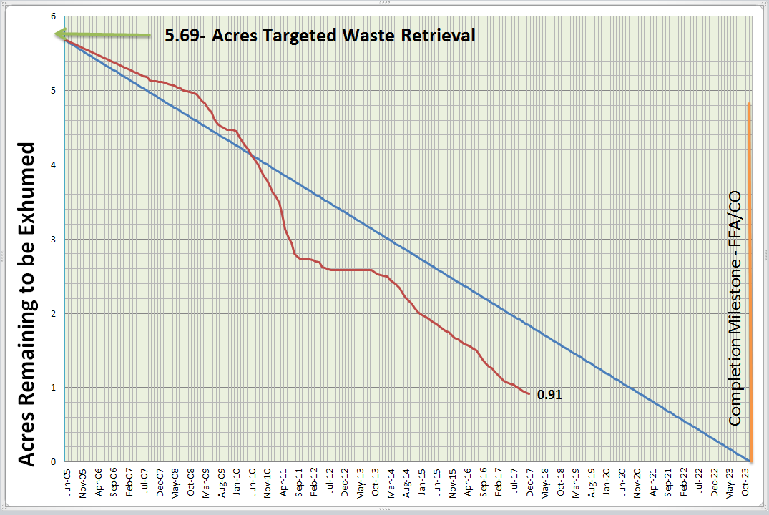
Targeted Buried Waste Exhumation
Buried waste exhumation two years ahead of regulatory milestone.

