Slide 1
Idaho Cleanup Project Update
Leadership in Nuclear Energy Commission
Jim Malmo
Assistant Manager
Idaho Cleanup Project
Oct. 10, 2018

Slide 2
Agenda
Successful simulant run for Integrated Waste Treatment Unit
Stored transuranic waste shipments continue to WIPP
Targeted buried waste exhumation resumes
Investigation conducted into ARP V drum incident

Slide 3
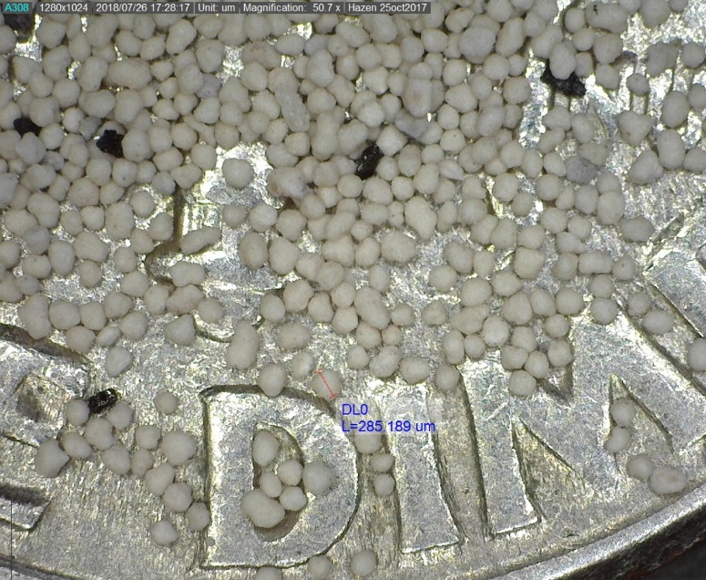
Integrated Waste Treatment Unit Status
Simulant Run 2 was successful and proved the process will work
  Demonstrated reliable Denitration Mineralization Reformer (DMR) fluidization
    Observed very consistent bed temperatures.
    Demonstrated average bed particle size can be controlled with periodic seed particle addition – mean particle size ranged from 190 – 250 µ.
  Auger-grinder functioned well
  – product transfer rates improved.
Feed online efficiency >95%.
Particle size of the simulated waste product was successfully managed during the simulant run.

Slide 4
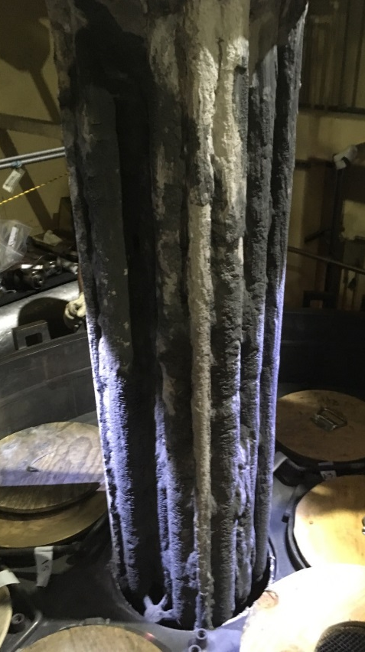
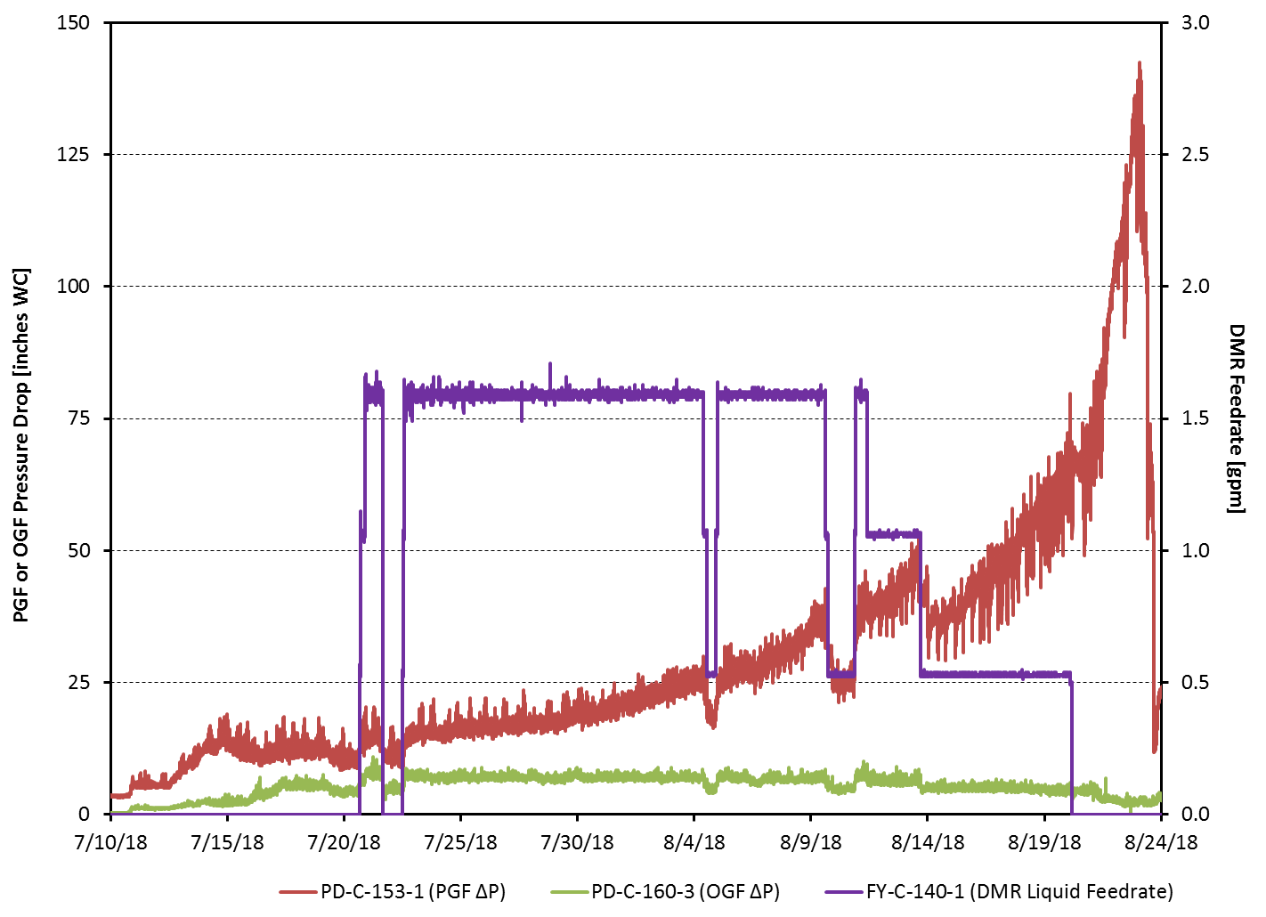
Integrated Waste Treatment Unit Status
Currently in a maintenance outage
Experienced buildup of material on the Process Gas Filter (PGF) elements.
Photo illustrates buildup in the Process Gas Filters.

Slide 5
IWTU Upcoming Activities
Resolve Process Gas Filter (PGF) performance
  Conduct offsite analysis and testing.
  Clean and replace filters.
  Implement operational changes as needed.
Conduct Simulant Run 3
  Anticipate 50 day period of simulated feed on.
  Verify satisfactory plant operations during long term operations at baseline conditions at/or near boundary conditions.
Finalize Plan for Phases 3 and 4
  Outage J – Additional plant modifications and equipment maintenance.
  Confirmatory Run – “Shakedown” of Outage J Mods and establish carbonate bed using simulant.
  System Performance Test – EPA/DEQ oversight, establish permit conditions using tank waste.

Slide 6
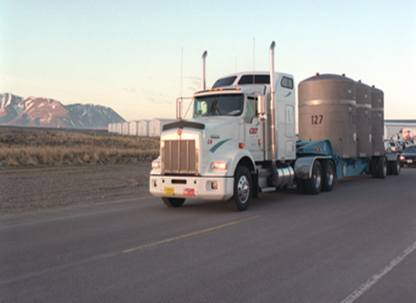
CH-TRU Shipping Status
  Idaho is making 6-8 shipments of CH-TRU per week to WIPP.
  Idaho continues to ship 4 shipments per week of M/LLW to other disposal sites.
Notes:
Approximately 40,000 containers at INL are those currently in storage that are waiting for treatment, characterization, and certification to ship. There are approximately 2,500 certified containers and two additional waste streams are expected to be approved for certification this month.
There are approximately 90 potential RH-TRU shipments are currently in storage with more waste continuing to be processed that will need certified prior to shipping. None are currently certified.
Upcoming Activities:
Continue 6-8 shipments per week of CH TRU waste from Idaho for the foreseeable future to ensure full capability at WIPP is being utilized.
Continue to develop the necessary documentation for CBFO approval of previously certified waste by both Idaho and CCP.

Slide 7
Settlement Agreement TRU Production Status
Notes:
Volume remaining at the beginning of Fluor Idaho’s contract to process as of May 31, 2016 was 10,300m³, which excludes overpack volumes (e.g. cargo containers, overpacked drums, overpacked boxes, etc.)
Projection of current production demonstrates risk to compliance with ISA
Projection shows completion after Dec. 31, 2018 unless current production rate is significantly increased
Does not account for increasing difficulty of waste to be treated or facility downtime
As of August 31, 2018 7,890 m³ left to leave the state of Idaho
Remaining Volume to Treat – 2,905m³
Remaining Volume to Certify and Ship (Treated Waste awaiting Certification and Shipment) – 2,969m³
Remaining Volume to Ship (AMWTP CH TRU Backlog) – 2,005m
The approximate distribution of the waste remaining to treat is:
Debris (TRU) 1,112m³ Debris (MLLW) 730m³
Sludge (TRU) 494m³ Sludge (MLLW) 378m³
Soils (TRU) 145m³ Soils (MLLW) 46m³
Total TRU 1,751m³ Total MLLW 1,153m³
Challenging Waste – High fissile, Roaster Oxides, Oversized Containers, Challenging configurations, Sludges etc.

Slide 8
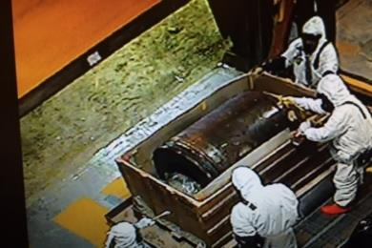
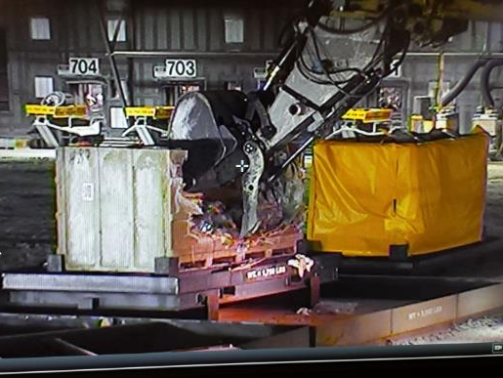
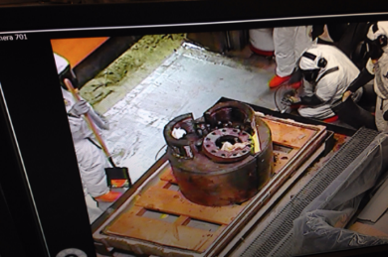
CH-TRU Waste Repackaging in ARP VII
Key Activities:
Large Item repackaging continues in ARP VII.
Upcoming Activities:
Complete waste repackaging and explore use of facility to complete sludge waste treatment.
Crews decontaminate the back-up roller for disposal as M/LLW.
Excavator removing large item from fiberglass reinforced waste box.
Crews decontaminate the machinery items for disposal as M/LLW.
Notes:
Large items are typically large pieces of machinery used in nuclear material production, glove-boxes, or contaminated D&D waste that were packaged in large or oversized boxes.
The large items were identified during Real Time Radiography as part of the characterization process.

Slide 9
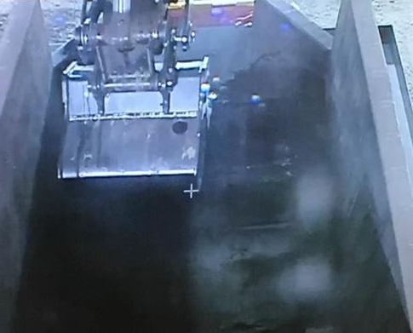
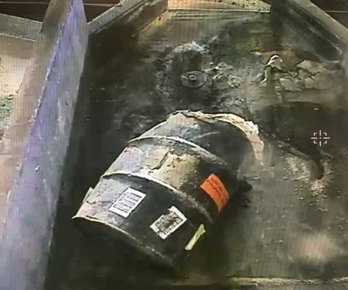
Waste Treatment in ARP IX (Completed)
Excavator bucket raking roaster oxides to ensure treatment.
Drum of roaster oxide waste on the treatment table.
Key Activities:
Roaster oxide waste was treated and repackaged for disposal.
Upcoming Activities:
Turn over facility to make preparations for return to targeted waste exhumation.
Notes:
The treatment of Roaster Oxide waste is complete in ARP IX and the facility is being prepared for exhumation early in calendar 2019.
The waste commonly referred to as “Roaster Oxides” are oil coated flakes, shavings and fines from Uranium processing in a weapons process. The oil coated shavings, flakes and fines are placed in a tumbling, heated “roaster” to ensure the outermost surfaces are completely oxidized to ensure no reaction when exposed to air. Once the material was processed through the “roaster” the material had an outer coating of an oxide material.

Slide 10
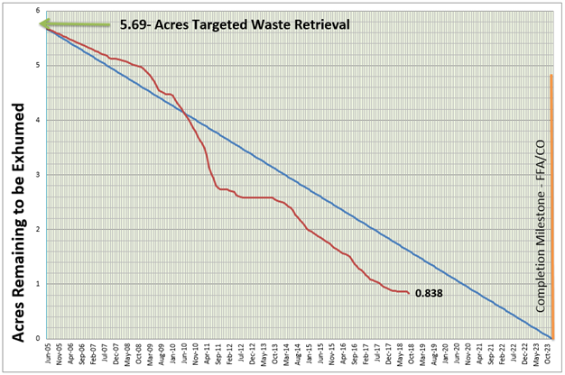
Key Scope: FY 18 Buried Waste Exhumation Performance
Waste Exhumation (Acres) (FYTD) as of September 30, 2018
  Overall, exhumation remains about two years ahead of the regulatory schedule.
  Buried Waste Exhumation was intentionally delayed so exhumation crews could support AMWTP ISA waste processing in the ARPs.
  In addition, the exhumation was placed in a safety step-back from April 11 through August 23 as a result of the ARP V drum incident.

Slide 11
ARP VIII Footprint Exhumation Status
Notes:
Green grids are completed. Light orange grids remain to be completed. The numbers are the square feet to be completed in each grid with a full grid being 15’ X 15’ or 225 ft².

Slide 12
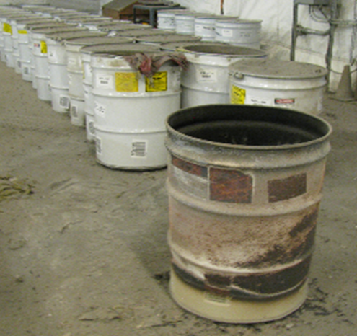
ARP V Drum Incident
In April of this year, four drums experienced over pressurizing event, ejecting the lids.
No injuries or external release of contamination.
ARP V facility is undergoing cleanup.
All loose material was safely cleaned up and placed in 55-gallon drums.
Cleanup of the floor and horizontal surfaces in the airlock is complete.
Cleanup in the airlock in the high, hard-to-reach areas is ongoing.
An investigation into the cause of the incident has been conducted.
Photo shows one of the drums involved in the ARP V over-pressurization event (foreground).

Slide 13
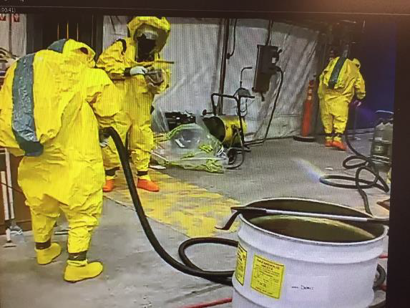
ARP V Drum Incident (continued)
Investigation Prelimary Results:
Causal Analysis investigation conducted
Root cause of the incident was oxidation of a reactive metal (depleted uranium) which heated up the waste and started a secondary reaction.
Changes have been made in waste handling procedures for the start up of the ARP-VIII facility.
Changes in sludge processing are still being evaluated.
Workers vacuum up loose material ejected from the drums.
Notes:
An independent team of experts led the causal analysis investigation, and they sampled a wide range of materials, including ejected materials, waste remaining in the drums and air filter elements.
Root cause of the incident was oxidation of a reactive metal (depleted uranium) in the waste. This heated up waste material, caused a secondary reaction that generated an over pressurization inside the drum – causing the drum lids to pop off and expelling drum contents.
As a result of the investigation, changes have been made in waste handling procedures for the start up of the ARP-VIII facility, such as instituting a 24-hour “hold period” after waste is treated to ensure the treated waste material does not heat up before it is packaged into a drum.
Changes in sludge processing are still being evaluated.

Slide 14
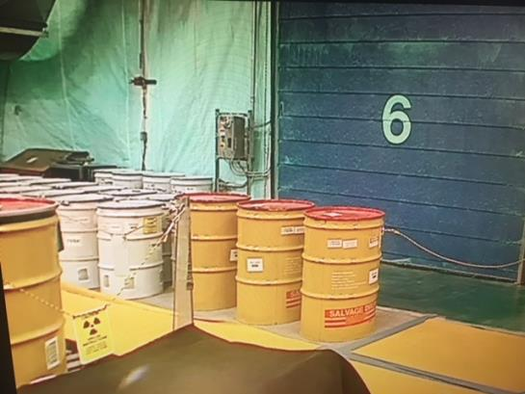
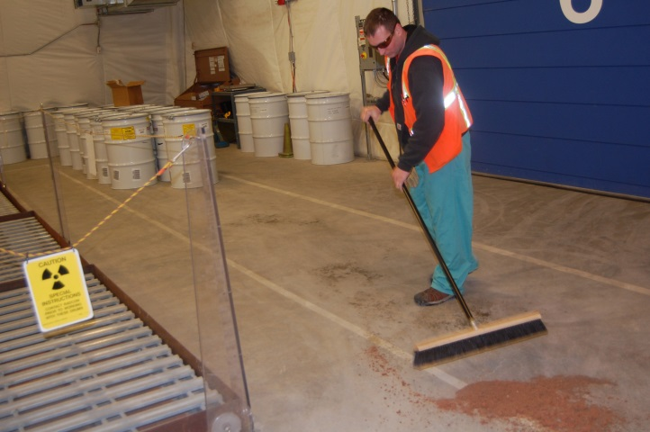
ARP V Evolution
Earlier photo of the ARP V location where the April 11 drum event occurred.
The affected area of ARP V following bulk cleanup.
ARP V just days after the April 11 drum event.

