Slide 1
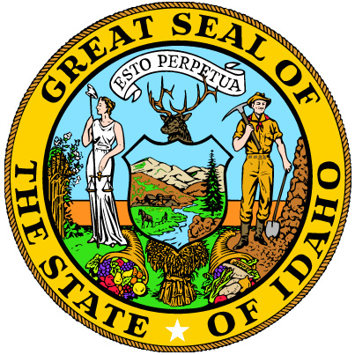
Advanced Reactor Supply Chain in Idaho
Line Commission Discussion
Justin Coleman, INL
GAIN Economics and Policy Lead
Facility Risk Group Lead
October, 10 2018
INL/MIS-18-51705

Slide 2
Outline
Who am I?
Need for advanced reactors
Why Idaho?
What are advanced reactors
What is the advanced reactor supply chain
Potential deployment
Opportunities and actions

Slide 3
Notes:
Husband

Slide 4
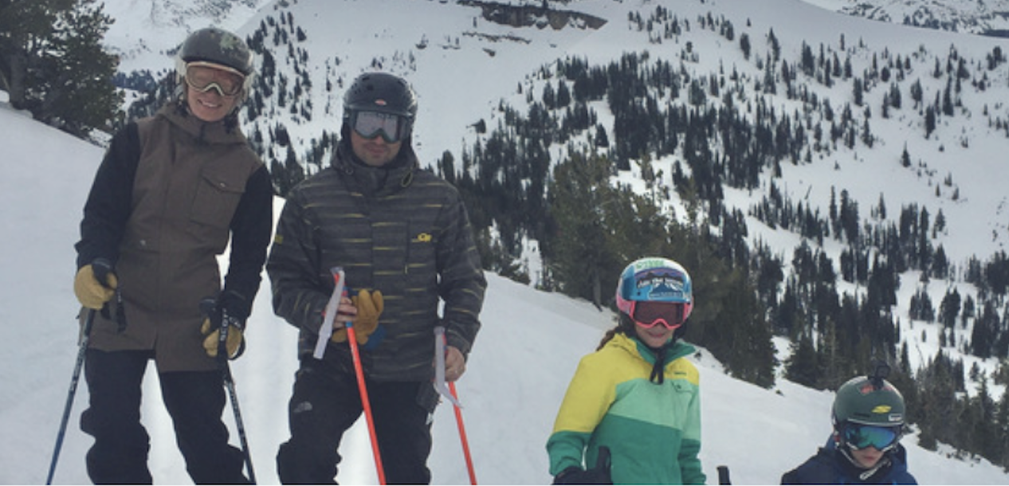
Notes:
Father

Slide 5
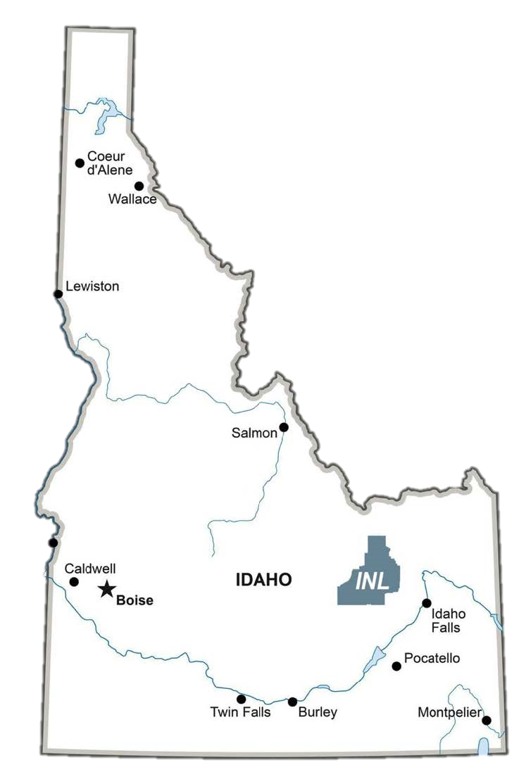
Notes:
Idahoean

Slide 6
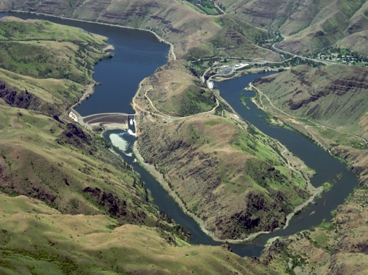
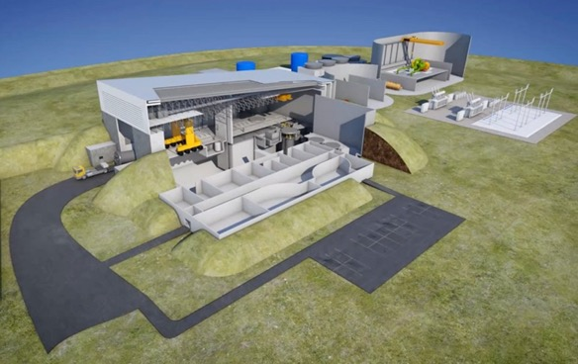
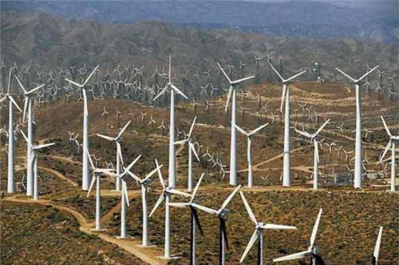
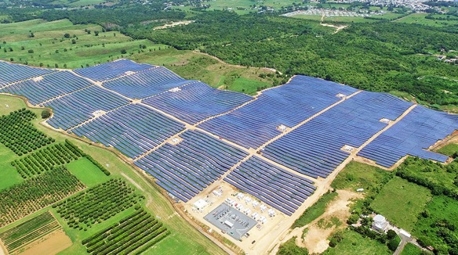
Notes:
Clean energy advocate

Slide 7
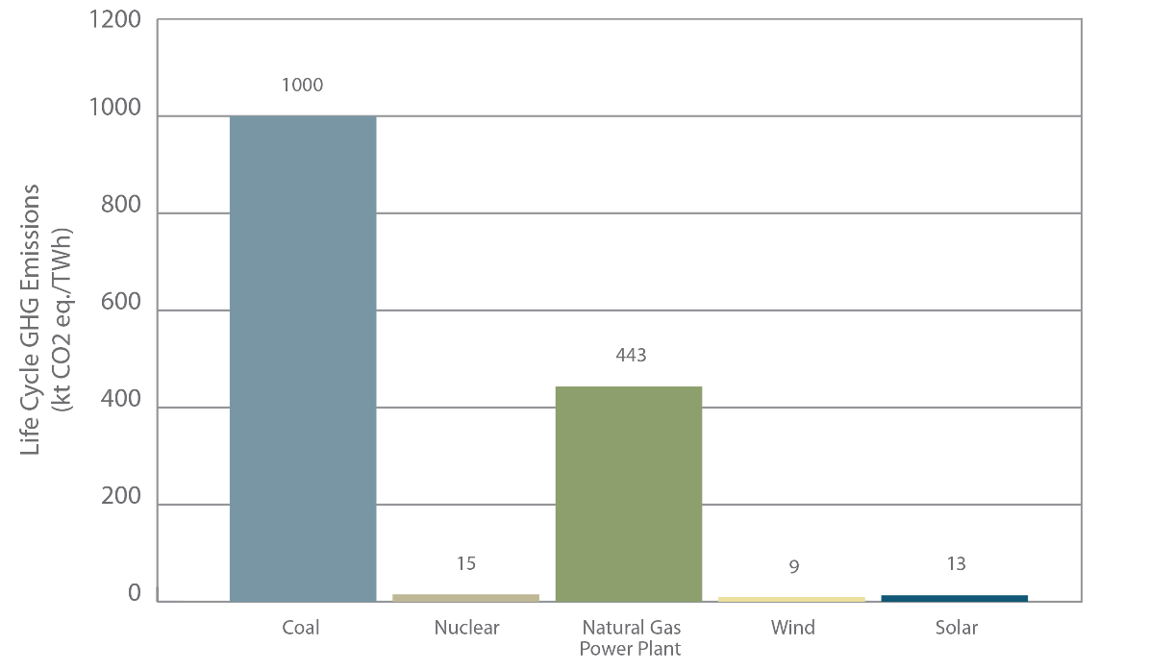
Need for advanced reactors
Greenhouse gas emissions
National security
Don’t want to loose our global leadership
Want our partners to buy US technology – exporting values and expertise
Not Russia, China, others
Notes:
U.S. demand for new nuclear power plants is low.
Nuclear plants facing early retirement are being replaced with natural gas plants that are increasing greenhouse gas emissions. Figure 2 shows that if natural gas replaces a coal plant greenhouse gas emissions are cut in half, if natural gas replaces nuclear greenhouse gas emissions go up 30 times. For the U.S. to transition to a clean energy sector, nuclear power plants MUST be part of the mix
Here’s another reason: national security. For more than three decades, the U.S. has chosen to be on the sidelines, slowly ceding our nuclear energy leadership to competitors, primarily Russia and China. The U.S. hasn’t built a new nuclear reactor in more than three decades. Meanwhile, our high-performing reactor fleet is aging. Here’s a sobering statistic: 78 percent of all new nuclear reactor builds across the globe involve Russia or China. Because the U.S. led development of commercial nuclear energy, our safety and non-proliferations approaches became the world standards. We know that when a nation builds a nuclear reactor in another country, it begins a century-long relationship, a cooperative relationship that involves education, research and development, training, cyber and physical security, environmental protection, and safety and non-proliferation. When we build a nuclear power plant in another country, we’re exporting our technologies and equipment. We’re also exporting our values and expertise.

Slide 8
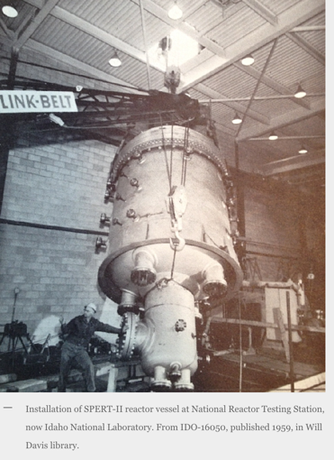
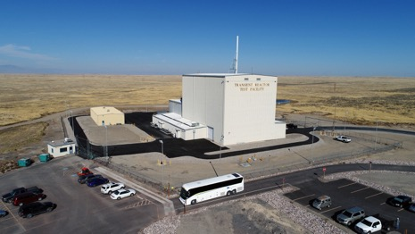
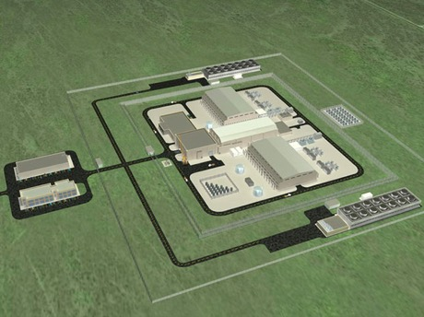
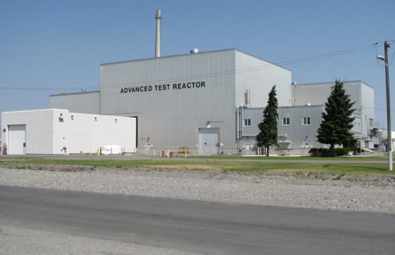
Why Idaho?
Idaho enabled large scale deployment of the current commercial nuclear power industry in the U.S. and around the world.
Leverage the billions in federal and private investment to grow commercial business
S. 97, the Nuclear Energy Innovation Capabilities Act (NEICA)
Versatile reactor-based fast neutron source
FOAK deployment will have an advantage
UAMPS and NuScale
Micro-reactors
others
Notes:
DOE is investing in Idaho like never before
The United States invented the commercial nuclear energy industry. Idaho played a major role in that effort. In fact, it’s safe to say that virtually every nuclear reactor in operation today – in the United States and around the world – can trace some aspect of its existence to research and development conducted at Idaho National Laboratory (INL). With energy demand rising and the desire to reduce carbon emissions becoming more prominent, government and industry are increasingly interested in developing an emissions-free, power generation source that has proven safe, resilient and dependable for more than six decades.
But many people are working hard to reinvigorate the domestic nuclear energy industry. NuScale Power and the Utah Associated Municipal Power Systems (UAMPS) are working to deploy a first-of-its-kind small modular reactor at the INL site by 2026. INL is working with a variety of private sector companies on next-generation reactor designs, including microreactors, which we hope to demonstrate in the next several years. And bipartisan support for nuclear energy development and demonstration was evident in passage of S. 97, the Nuclear Energy Innovation Capabilities Act (NEICA), which instructs the U.S. Department of Energy to:
Establish a National Reactor Innovation Center (NRIC) at INL, to enable the testing and demonstration of new reactor projects;
Determine the need for a “versatile reactor-based fast neutron source,” a capability the U.S. badly needs and which now can only be accessed in Russia.

Slide 10
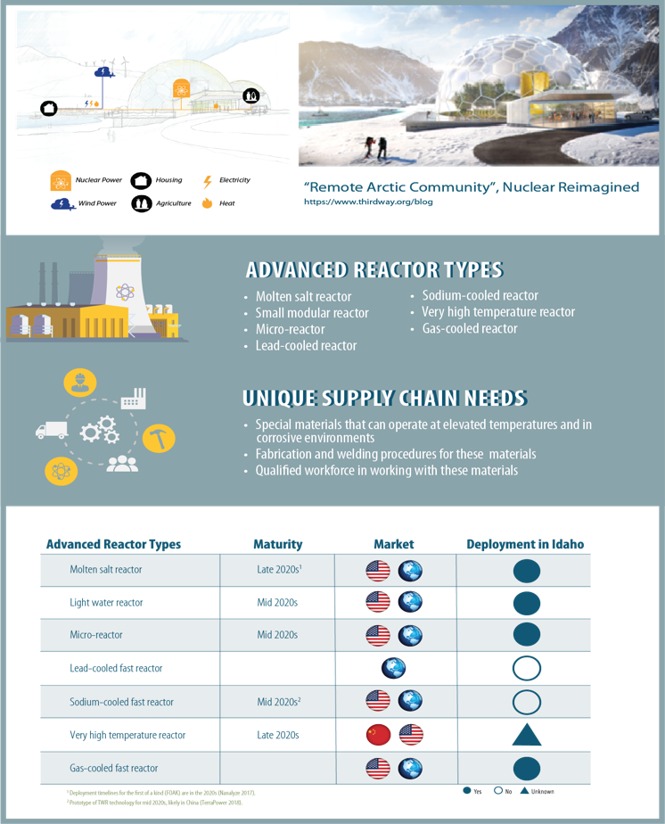
What are advanced reactors
Size: 2 MW – 1,000 MW
Enough to power 2,000 – 800,000 homes
Reactors currently in the design, development, and/or demonstration phase and use novel approaches to increase modularity and passive safety
Over 50 companies involved in various concepts
Notes:
800 homes per MW. Based on 24 hours a day @ 365 days per year and a cap factor of 0.9. One home uses 11,000 kwh per year.

Slide 11
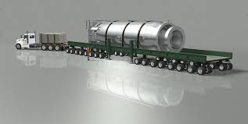
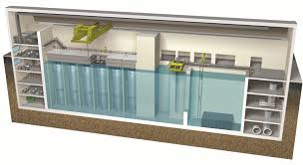
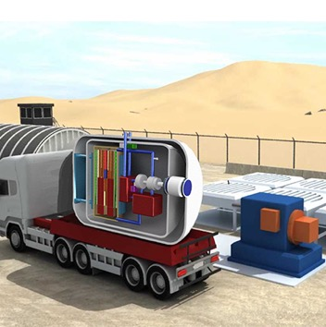
What are advanced reactors
Credit: KAIST
Notes:
100,000 MWh solar farm in carribian…about 57 MW per year @ capacity factor of 20%. This equals about 1 NuScale moduel. The solar farm is about 40 acres = about 55 MW. NuScale 12 pack 35 acre = 580 MW

Slide 12
What is a supply chain?
A system of organizations, skilled workforce, technologies, activities, information and resources involved in moving materials, products and services all the way through the manufacturing process, from the original supplier to the end customer.

Slide 13
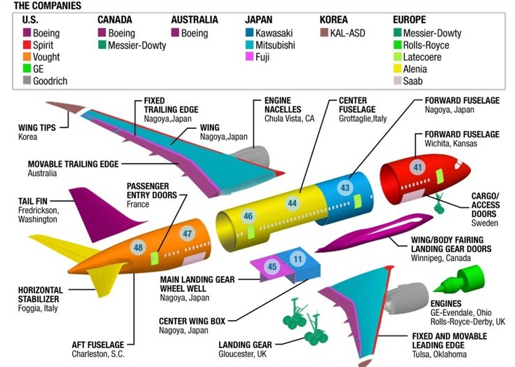
Other Supply chains in adjacent industries
Shipbuilding industry
Ford-class aircraft carriers utilizing extensive offsite assembly of modules in factories.
Modules are transported to the site, and joined
Dramatically decreased time and cost
Boeing and deployment of Dream linear 787:
Modeled Toyota supply chain
Two important aspects: (1) companies in the supply chain are only provided existing and proven technology orders and (2) Toyota invests in their suppliers
1 hour
in a factory
3 hours
in an assembly area
8 hours
onsite

Slide 14
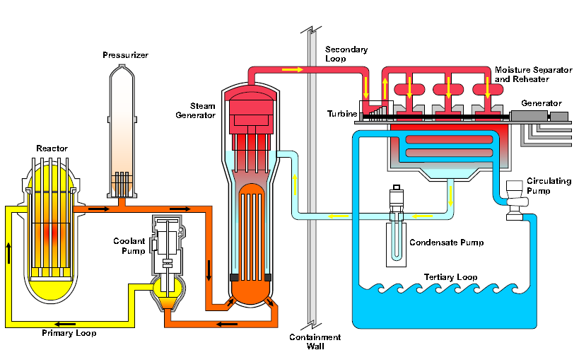
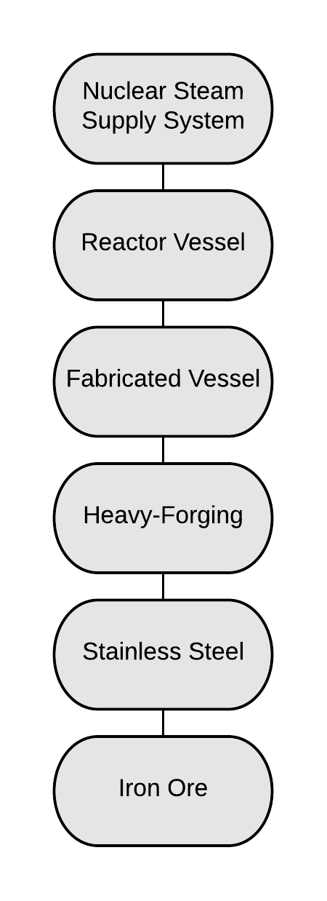
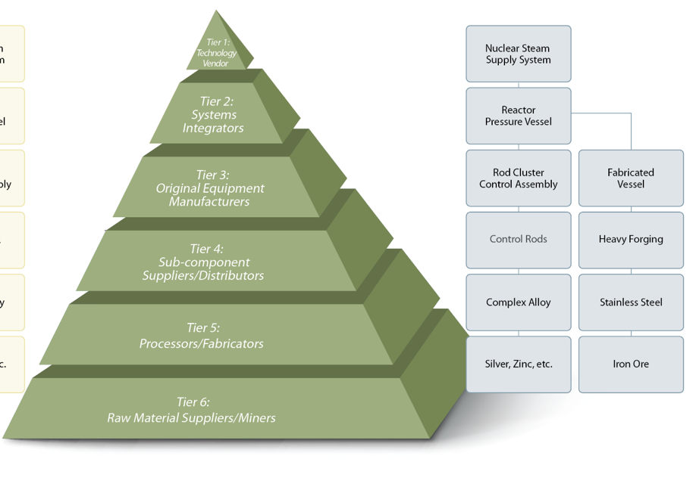
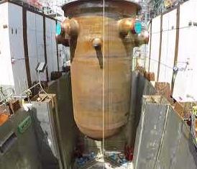
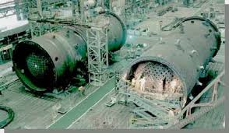
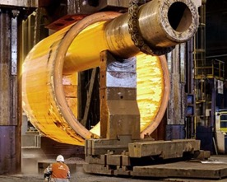
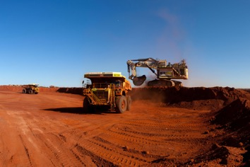
Advanced Reactor Supply Chain

Slide 15
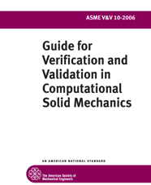
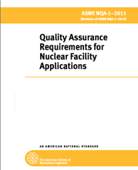
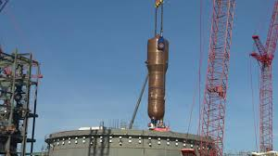
Quality in advanced nuclear
Three quality levels
safety- related (Q)
non-safety related (Non-Q)
non-Q – regulatory treatment of non-safety systems (NSR-Q), note that this is still in a validation process.
Need less safety-related (Q) components than traditional reactors
Opportunities exist for Idaho businesses in both safety and non-safety class components
Difference between Q and non-Q
traceability
certified performance (testing)
more people
Notes:
Show the bolts, ask what the difference is?. Q bolt is 10x more than non-Q bolt. Why, traceability, testing, more people in the process

Slide 16
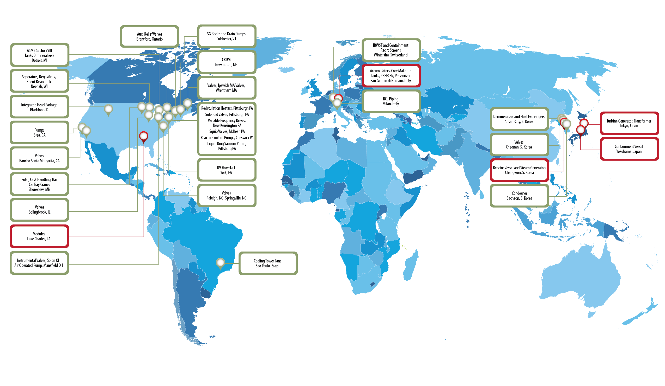
Advanced reactor supply chain – AP1000
Notes:
For AP1000 supply chain was global. Ideally for advanced reactors we build a domestic supply chain.

Slide 17
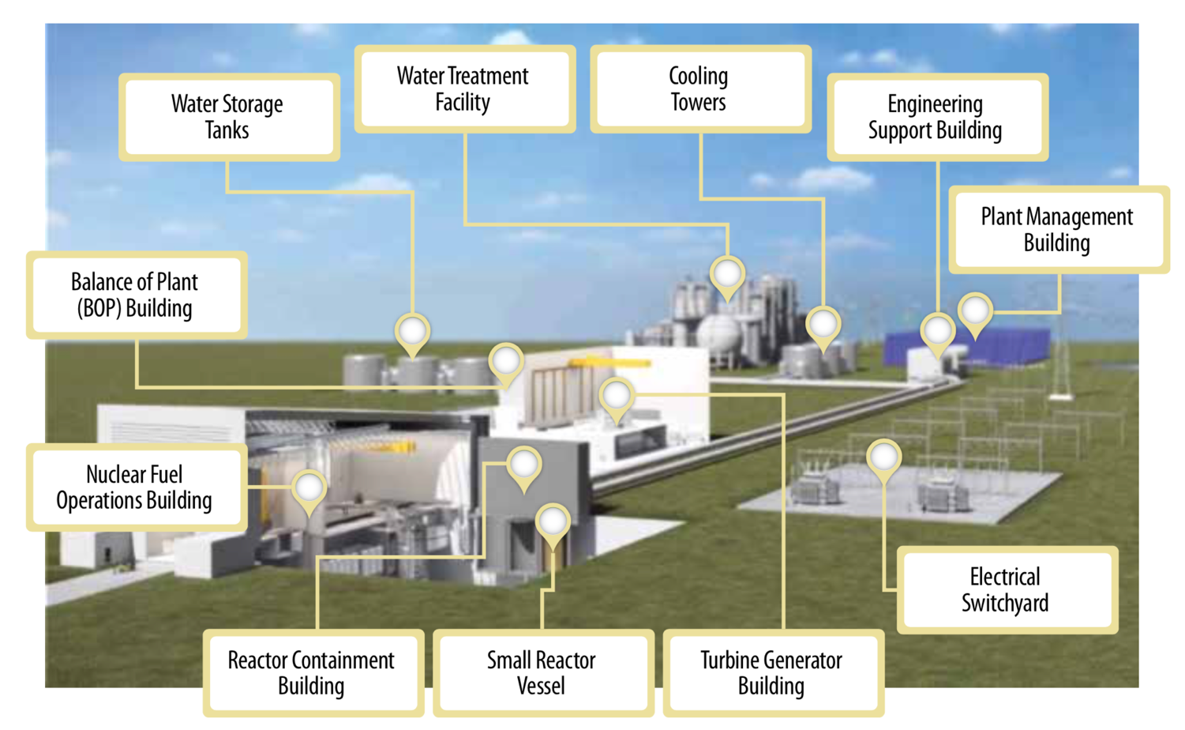
Small nuclear plant
Notes:
07.23.2018 DVG: Original PPT slide submitted to INL to be edited

Slide 18
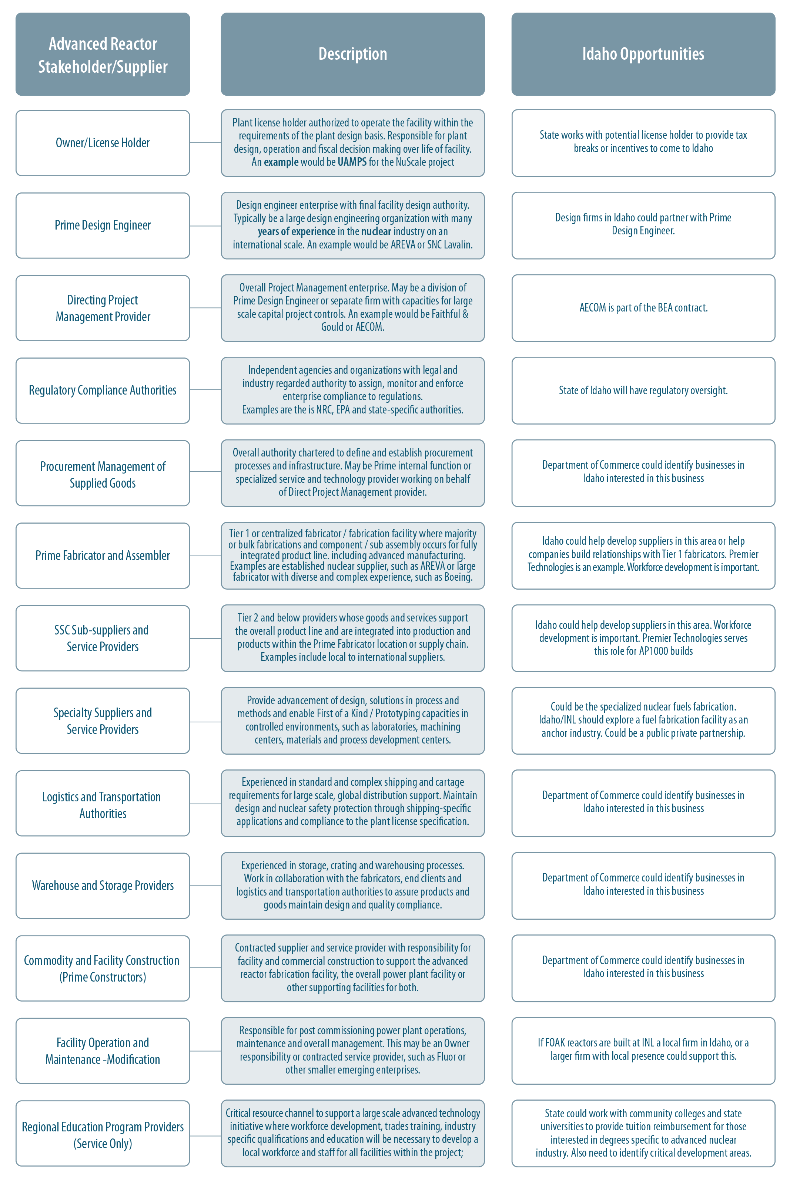
Supply chain poster
Notes:
Go to Poster

Slide 19
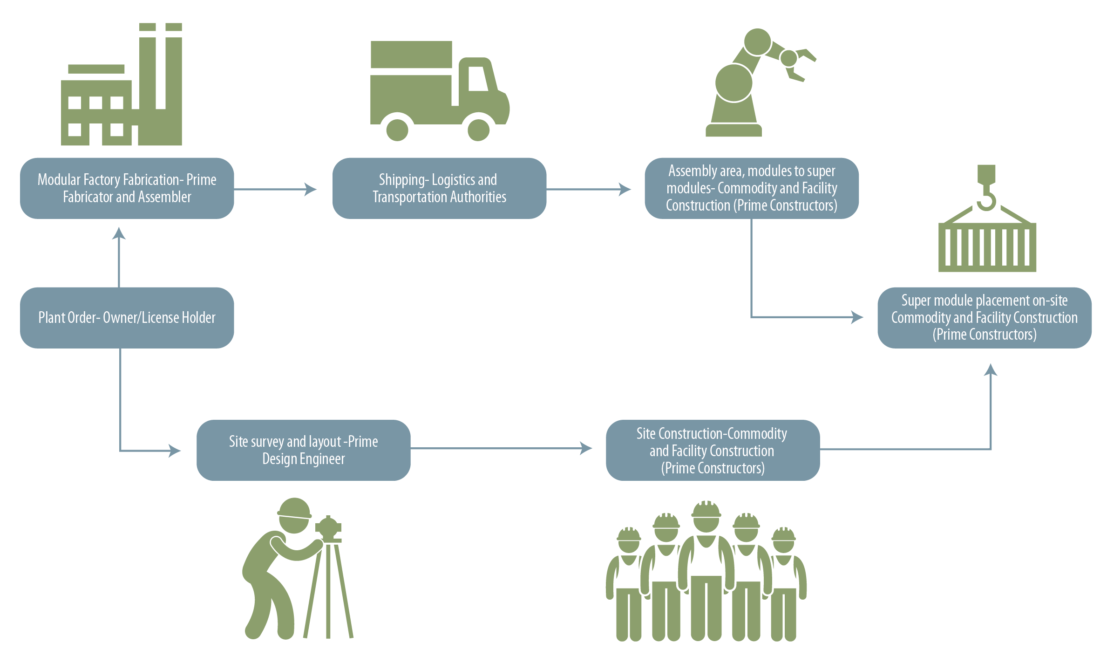
Advanced reactor module example

Slide 20
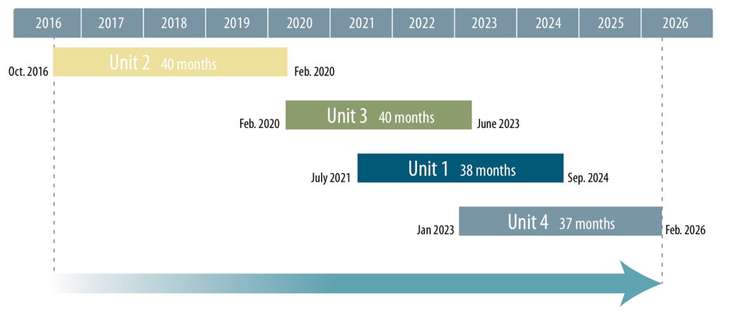
Current nuclear opportunities
A bridge to advanced reactor business
Four opportunities

Slide 21
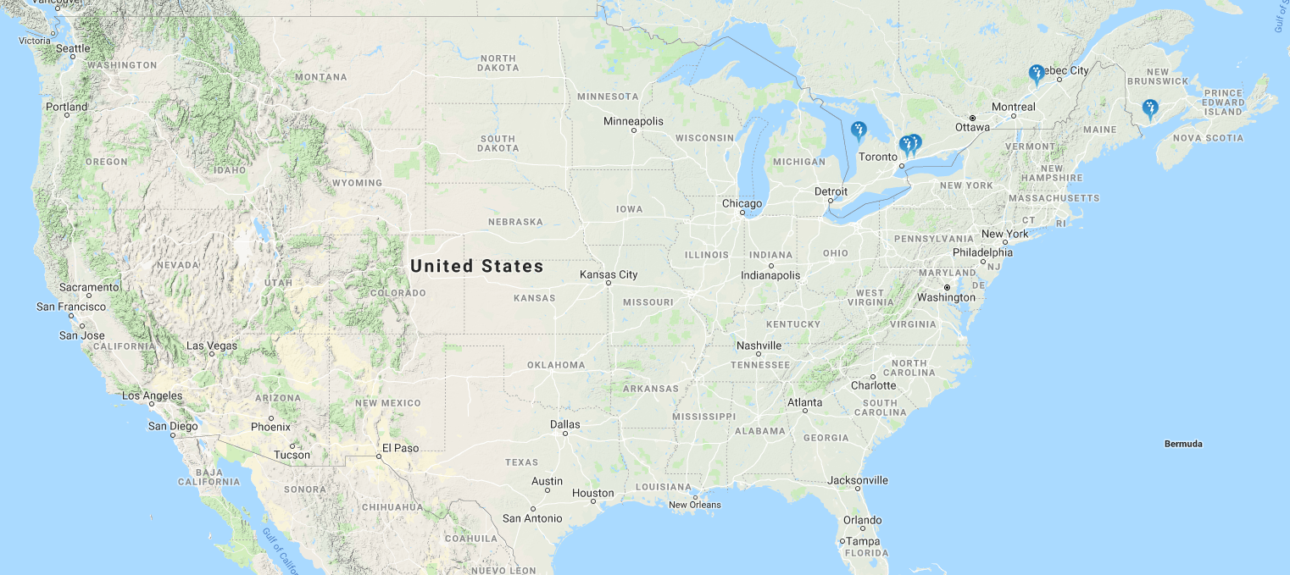
Current Opportunities in the Nuclear Industry: Canada
Scope: Major Refurbishment and Life Extend
Reactor Components
Nuclear Fuel Handling Systems
Bridge Cranes and Tooling
Turbine Generator and Auxiliaries
Steam Generators, Instrumentation
Service Water Piping Systems
Digital Control System
Associated Valves, Motor and Controllers
https://nuclearsafety.gc.ca/eng/resources/maps-of-nuclear-facilities/results.cfm?category=nuclear-power-plants

Slide 22
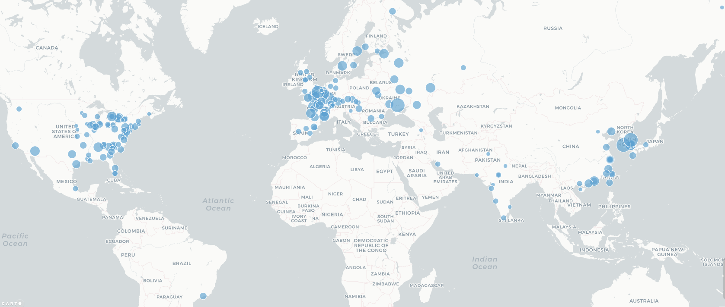
Current Opportunities in the Nuclear Industry: Global
Scope: Green Field Construction In Entirety
All Systems, Subsystem, Components
Support Engineering and Design
Specialty and New Innovations
Construction Services
Steel, Logistics, Shipping
Project Management Services
https://www.carbonbrief.org/mapped-the-worlds-nuclear-power-plants

Slide 23
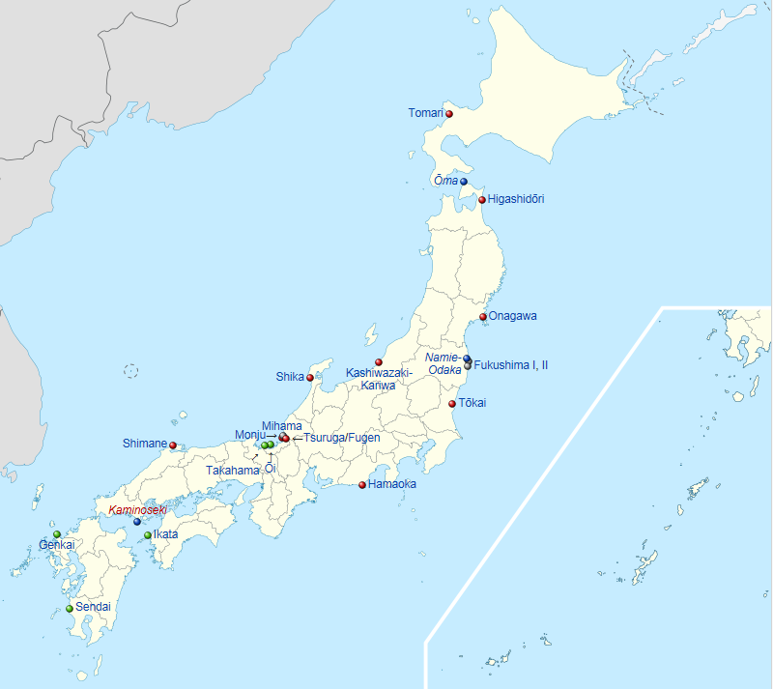
Current Opportunities in the Nuclear Industry: Japan Energy Policy Recovery
Scope: Establish Safety / Quality Condition Pre Start Up
Seismic and Fire Compliance
US Standards Assessments
Licensing Impact Assessments
Reduce Energy Imports
Achieve Environmental Goals
Assess Restart of New Plant Builds
Launch Replacement Modifications
https://en.wikipedia.org/wiki/Nuclear_power_in_Japan

Slide 24
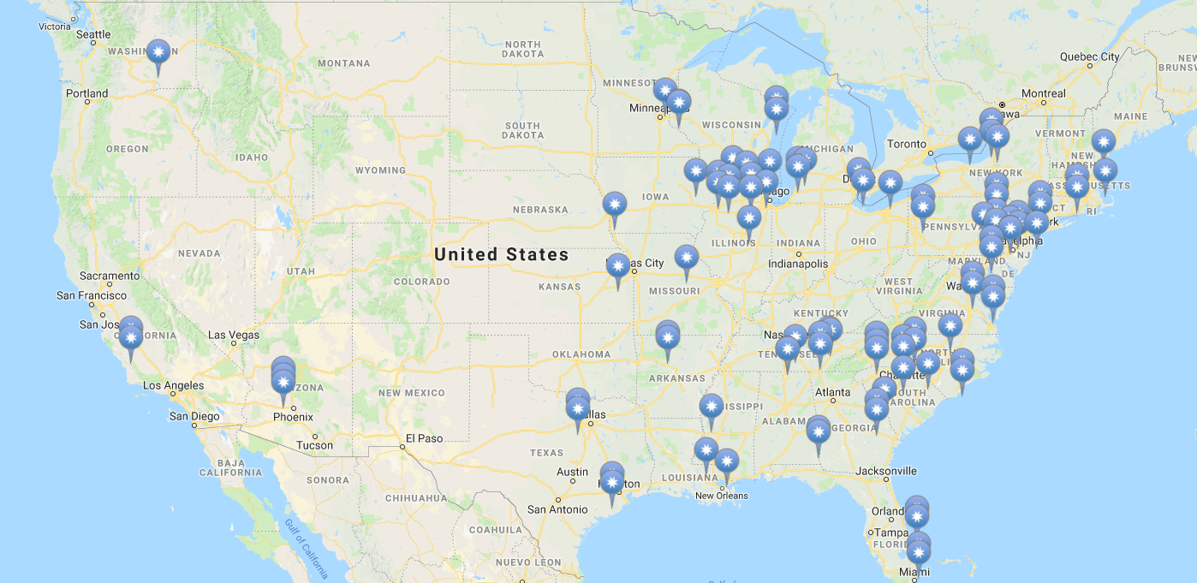
Current Opportunities in the Nuclear Industry: U.S. Nuclear Life Extension
Scope: Equipment Replace / Repair for Life Extend
Main Turbine and Support Systems
Heat Exchangers, Valves, Support Systems
Service Water System Piping Systems
Condenser Tubing
4160 V Cabling, Breakers and Panels
Main Generator, Rotors, Regulators
Fire Protection Systems
Digital and Protective Scheme Controls
https://www.nrc.gov/info-finder/reactors/

Slide 25
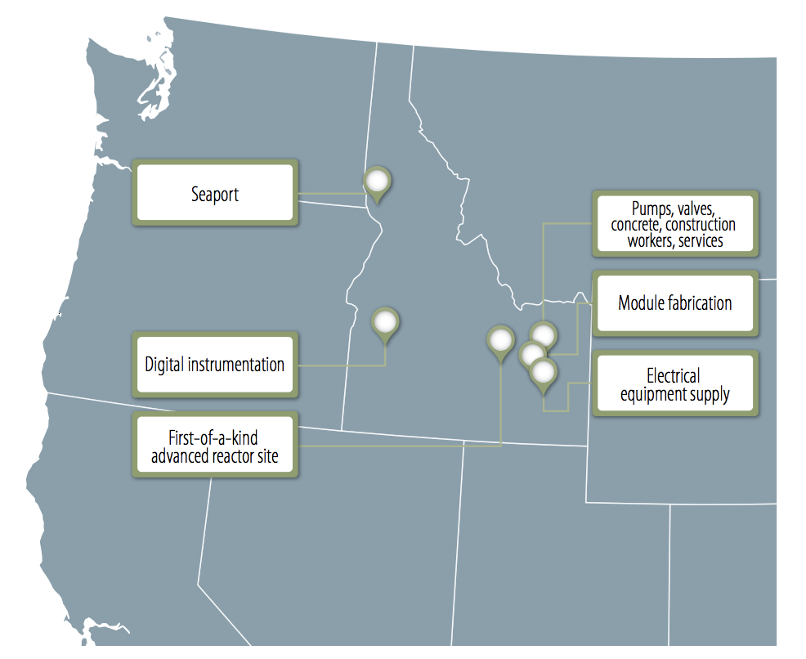
Advanced reactor deployment in Idaho

Slide 26
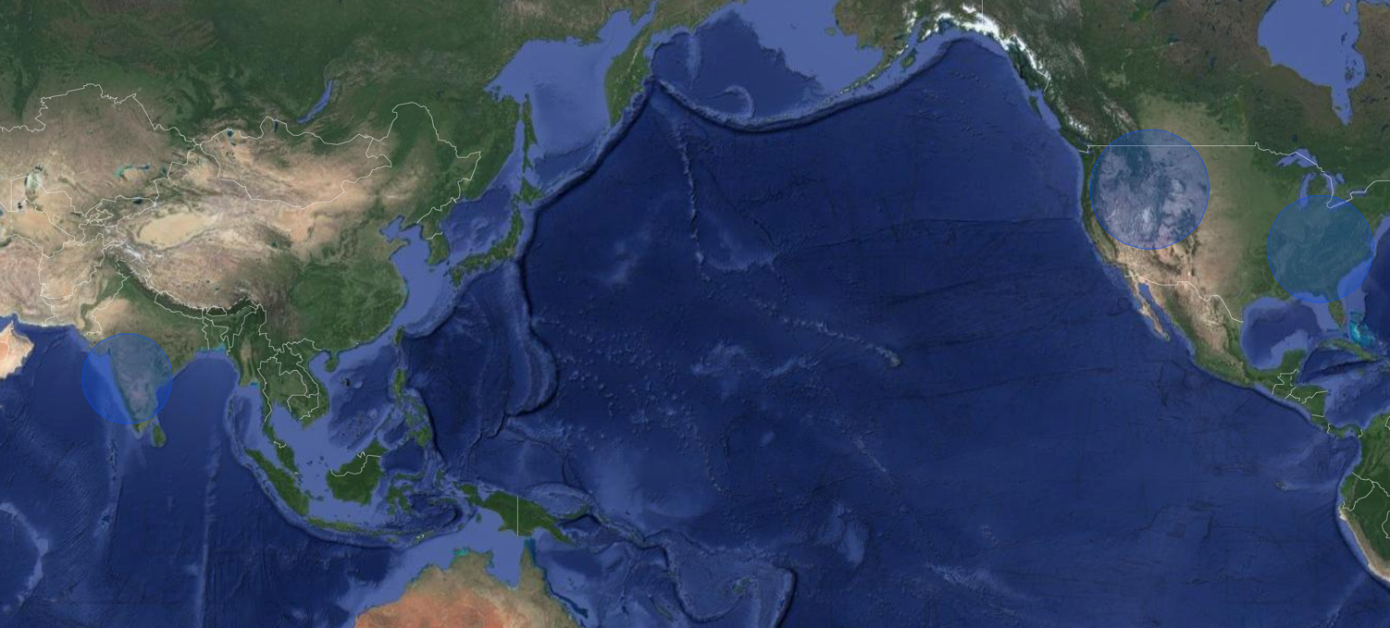
Advanced Reactor Deployment outside US

Slide 27
Opportunities and Action
No orders have been placed for advanced reactors
Creates short-term challenges in attracting businesses
Need to present opportunities in adjacently aligned sectors that allow a “bridge” to future advanced reactor orders
Bridging opportunities include:
Clean energy industry (hydro, wind, solar, nuclear)
Helping Idaho companies build nuclear quality assurance programs
Identify opportunities in the global nuclear supply chain
Develop businesses and/or facilities that will be community anchors

Slide 28
Suggested discussion points for LINE

Slide 29
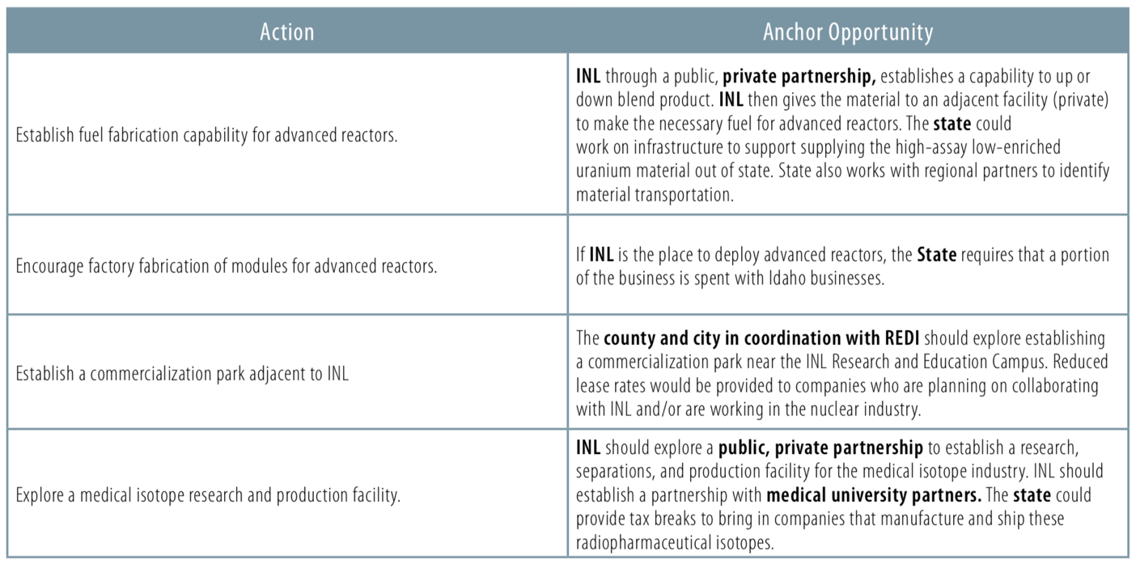
Opportunities and Action - Anchors

Slide 30
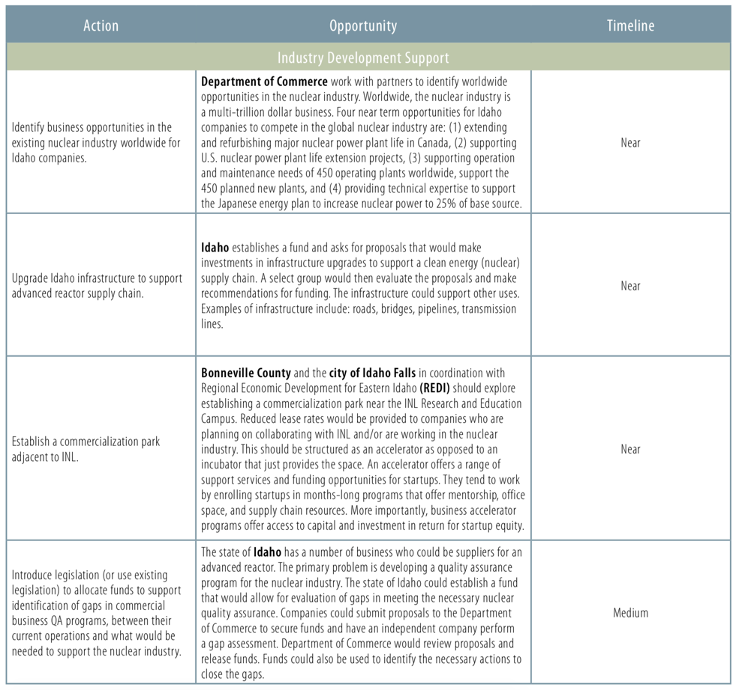
Opportunities and Action – Industry Support

Slide 31
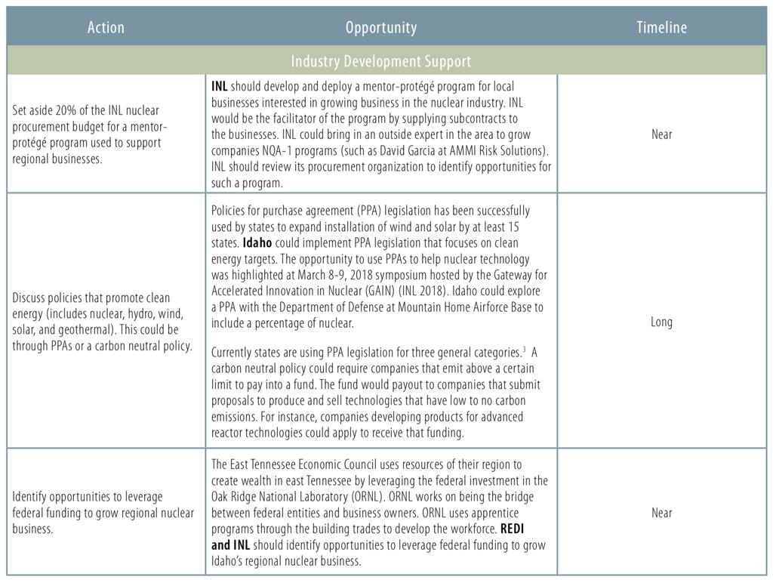
Opportunities and Action – Industry Support

Slide 32
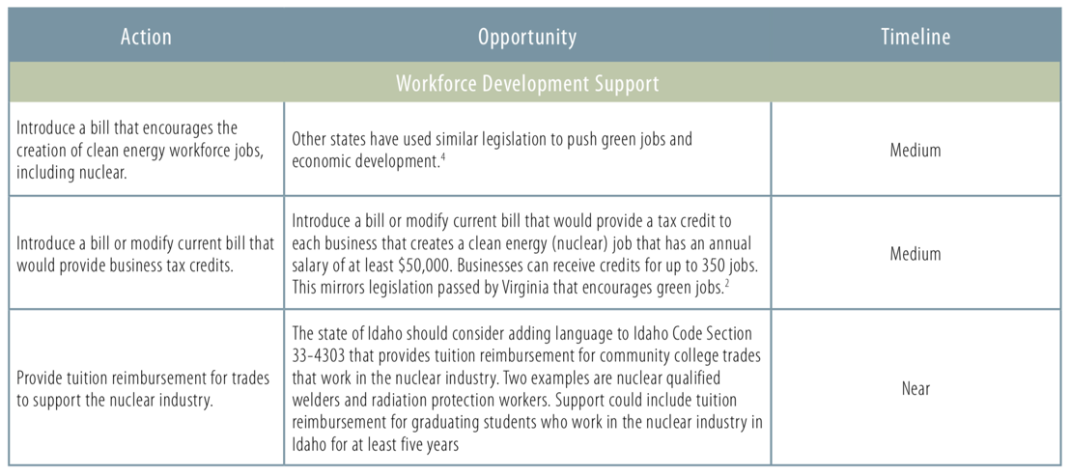
Opportunities and Action – Workforce Support

Slide 33
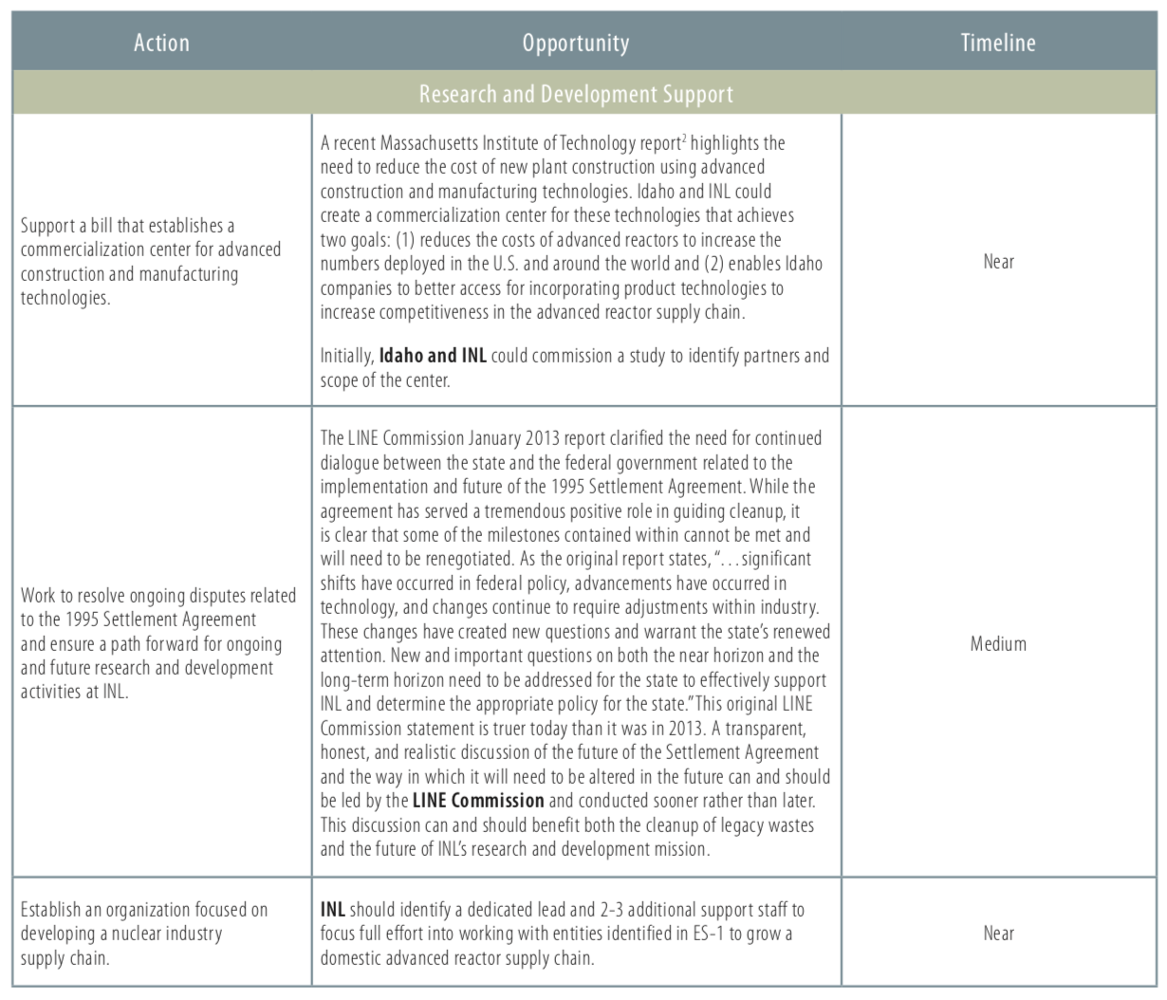
Opportunities and Action – R&D Support

Slide 34
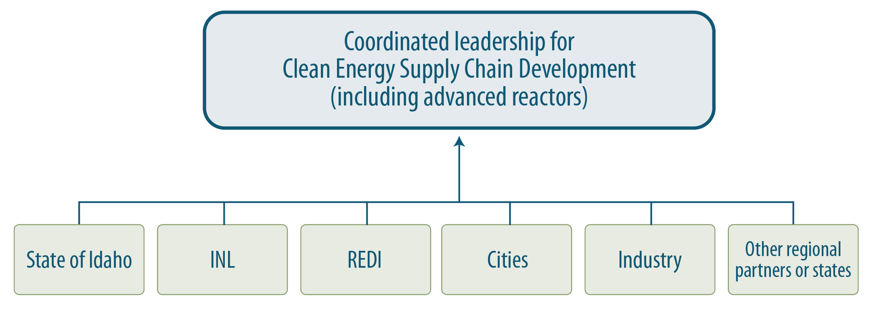
Collaboration the key to success

Slide 35
Questions?

