Slide 1
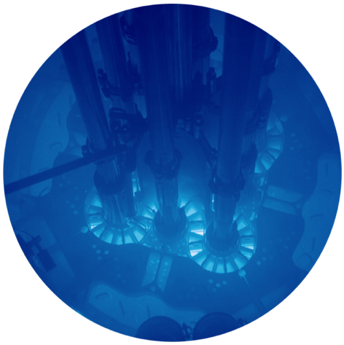
Using INL Capabilities to Support Meeting the Needs for HALEU
John C. Wagner
Nuclear Science and Technology
Associate Laboratory Director,
Idaho National Laboratory
john.wagner@inl.gov
(208) 526-7977
October 10, 2018
LINE Commission, McCall, Idaho

Slide 2
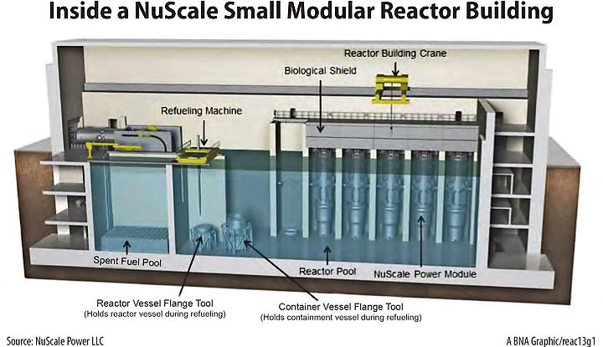
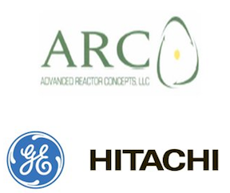
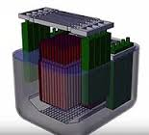
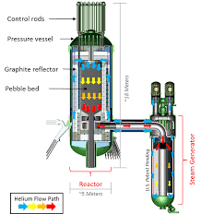
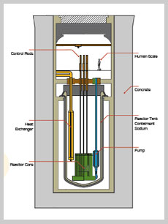
National Reactor Innovation Center is being established at INL
Enable the deployment of new nuclear systems by using INL’s unique infrastructure and expertise to resolve the basic R&D challenges confronting the most promising advanced reactor concepts.
Fuels and core designs that improve the economics of current operating nuclear power plants
Demonstration and first-of-a-kind deployment of new reactor concepts:
Advanced small-modular light water reactors
Advanced non-light water reactors
Microreactors
Development of fuel cycle infrastructure
Xe-100 200 MWt PBR
ARC-100, MWe
150-1500 MWe, Moltex

Slide 3
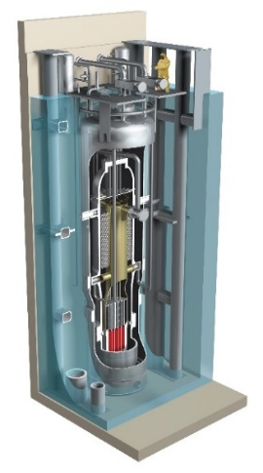
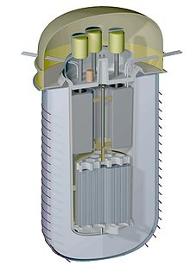
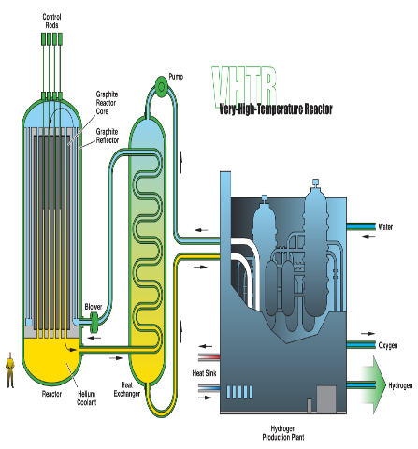
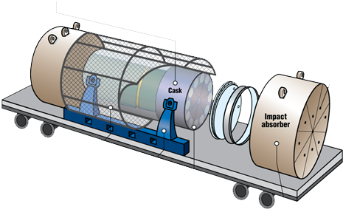
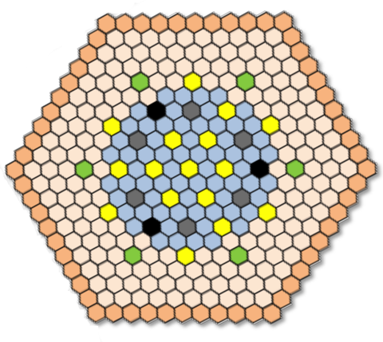
Vision for Advanced Reactor Pipeline
Demonstrate first <10MW micro- reactor by 2021
Resolve advanced reactor issues
Open new markets for nuclear energy
Provide a ‘win’ to build positive momentum
SMR operating by 2026
Enable deployment through siting and technical support
Joint Use Modular Plant leased for federal RDD&D
Versatile Test Reactor (VTR) operating by 2026
Supported by micro-reactor demonstration
Re-establish leadership in fast-spectrum testing and fuel development capability
Support non-LWR advanced reactor demonstration
Non-LWR Advanced Demonstration Reactor by 2030
Demonstrate non-LWR technology replacement of US baseload clean power capacity

Slide 4
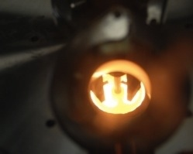
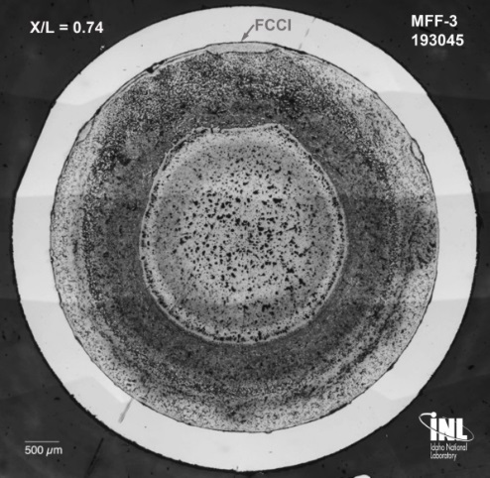
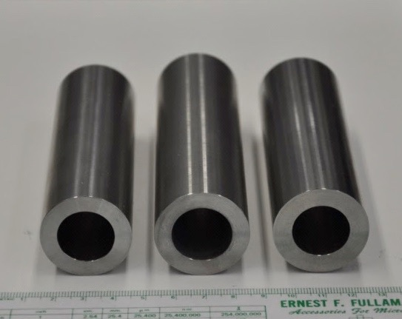
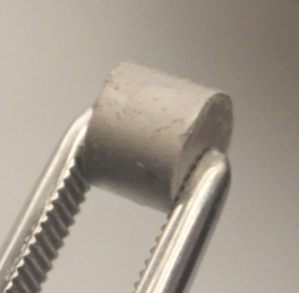
Advanced reactor fuels are needed for advanced reactors
Most advanced reactors require fuel/cladding systems that differ from those used in traditional light water reactors
Physical form - metallic, mixed oxide, nitride, carbide, dispersion, coated particle, even liquid fuel
U-235 enrichment - 5-20%
Cladding - composites or coated materials
There is a need for U enriched between 5 and 20% (commonly referred to as High Assay Low Enrich Uranium [HALEU]) for advanced reactors development
Currently there is no domestic capability
14YWT
CR6
14YWT
CR6b
9YWTV
PM2
U₃Si₂ Pellet

Slide 5
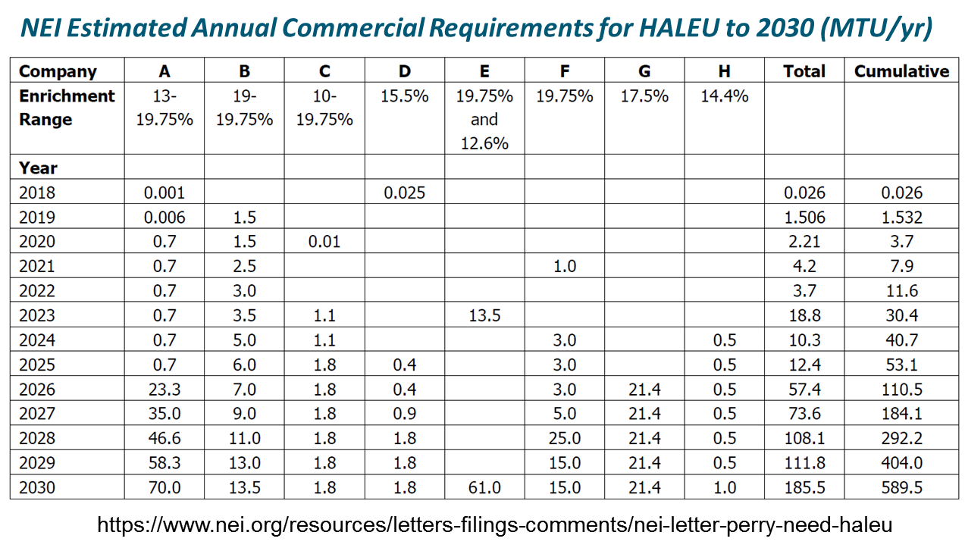
INL R&D capabilities are being used to evaluate options for addressing HALEU needs
Commercial reactor concepts require HALEU for startup cores
In addition, there are other national missions that require a reliable supply of enriched uranium
Expected commercial demands for HALEU
are very significant

Slide 6
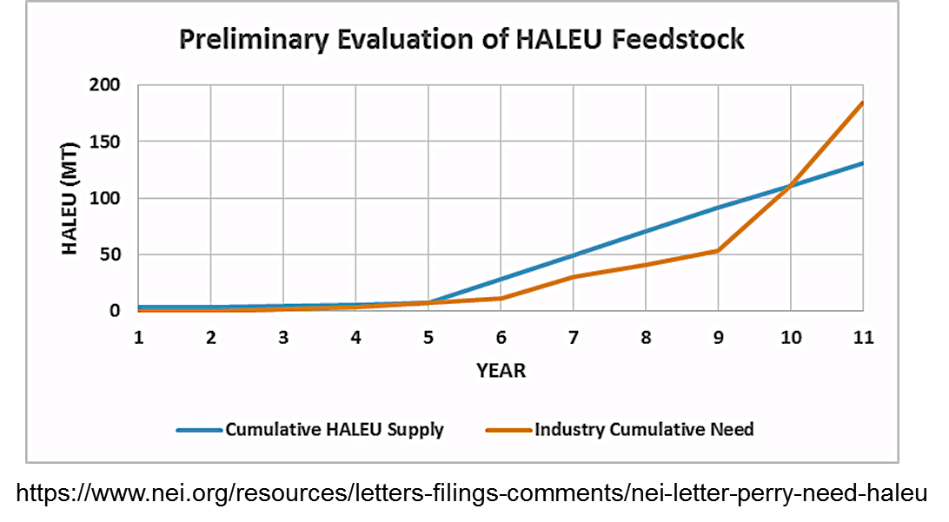
INL HALEU R&D Program Objectives
Evaluate the feasibility of providing an interim supply of HALEU to support fuel-fabrication needs for R&D, and potential demonstration of advanced reactor concepts
Support the development of HALEU infrastructure to include transportation, fuel fabrication, and advanced reactor testing

Slide 7
HALEU R&D Program Strategy
INL is looking into the feasibility of recovering and down-blending HEU from feedstocks with large ratios of HALEU/HEU that otherwise will be disposed at a cost to tax payers
Possible feedstocks include end-of-life fuels from diverse irradiation origins
EBR-II
Naval
Others (ATR, orphan irradiated materials, etc.)
Final HALEU form is determined by fuel specifications and fabrication needs
Down-blending feedstocks varied and may include:
5% enriched LEU
Depleted Uranium
Natural Uranium
Recovery processes (all available/under development at INL) are determined by characteristics of the feedstock and may include:
Electrochemical Process
Hybrid Process (ZIRCEX)
Others

Slide 8
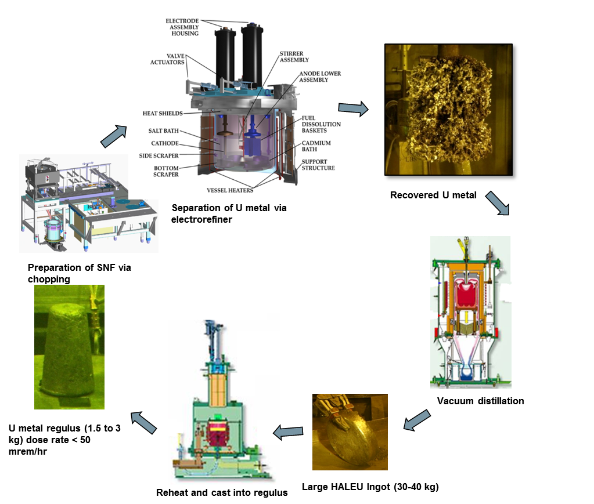
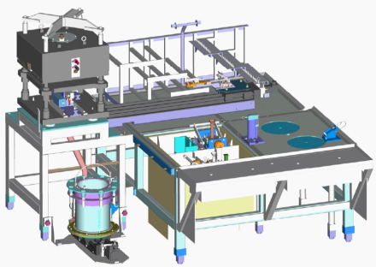
Electrochemical separations process is being applied to EBR-II fuel treatment
Is a batch process that separates and recovers uranium metal from used HEU nuclear fuel and down-blends to HALEU
Step 1 – Irradiated HEU EBR-II fuel is prepared and placed into a high temperature molten salt electrorefiner which facilitates separation of U metal from fission products
Step 2 – Recovered uranium undergoes vacuum distillation to remove electrorefiner salt and is down-blended to <20% U-235
Step 3 – The recovered uranium metal is configured to serve as HALEU feedstock by reheating and casting into low-dose uranium metal ingots
DOE is evaluating the environmental impact of this process and will be issuing a draft Environmental Assessment for public review and comment later this month

Slide 9
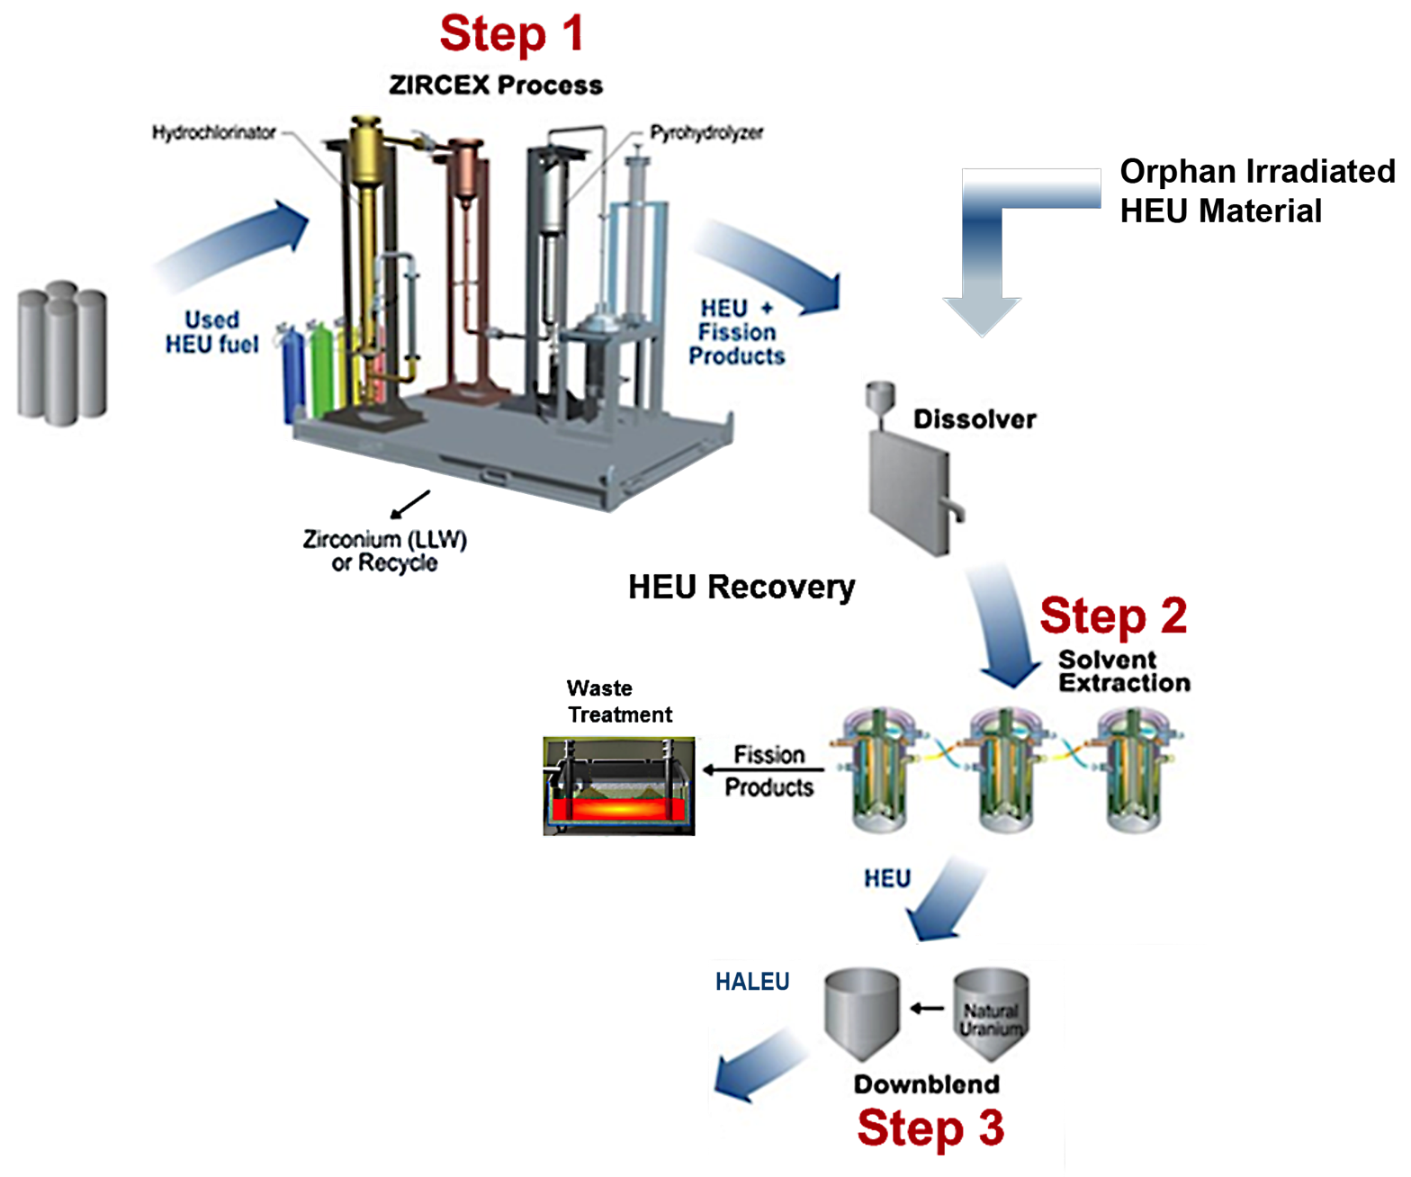
A hybrid (ZIRCEX) process is also being developed and evaluated
A three step process that recovers HEU from nuclear fuel and down-blends it to HALEU
Step 1 – ZIRCEX is a dry head-end process to remove cladding (zirconium or aluminum) from nuclear fuel
Step 2 – Uranium is purified from fission products by a very compact, modular solvent extraction system. The fission products are immobilized in glass using a small in-can melt.
Step 3 – The uranium is down-blended to <20% U-235 prior to fuel fabrication

Slide 10
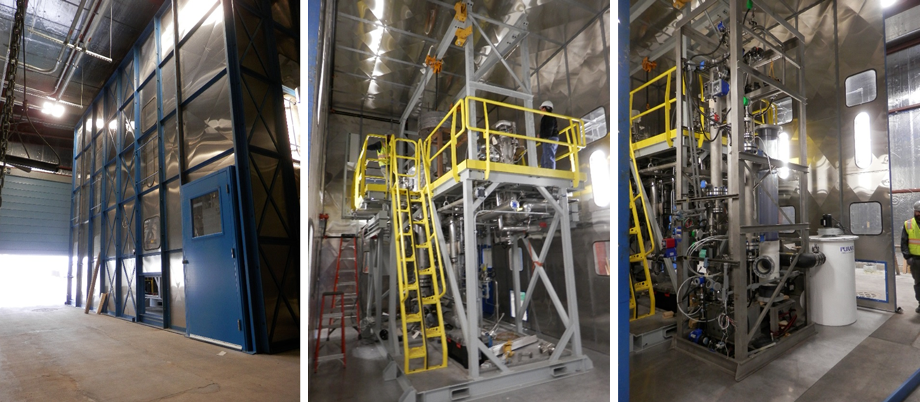
R&D ZIRCEX – Status
Design, fabrication and installation of a ZIRCEX ¼ pilot plant scale system – completed
Functionality testing – underway
Approval to start R&D testing with zirconium expected during October 2018
Pilot Plant located at INTEC CPP-653

Slide 11
R&D FY19 – First Quarter Milestones
Complete staffing for alternatives study – October 30, 2018
Initiate testing of surrogate fuel in ZIRCEX Material Recovery Pilot Plant – November 2018
Begin engineering scoping studies to better understand issues, costs and schedule – November 2018

Slide 12
Questions ?

